Slide 1
Dealing with your Bond Deal
The Morning After…and the Next 30 Years
John Deleray, Wilmington Trust
Anne Pelej, Willdan Financial Services
Julia Cooper, City of San Jose

Slide 2
The Trustee’s Perspective
The Morning After…and the
Next 30 years
John Deleray, Wilmington Trust
VP – Director, Pacific Region Sales & Marketing

Slide 3
Monitoring Your Bond Debt
(with help from your Trustee)
Watch list:
Current Issues in an interesting market
Calculation of Interest to Bondholders
Reserve Fun Requirements Valuations
Cash Flows
Redemption of Bonds
Project Fund Distributions
Investments
Compliance

Slide 4
30 Years of Interest Calculations
Calculation of Interest to Bondholders:
Variable Rate Debt
Remarketing Agent sends rates to trustee who
calculates; or
Trustee is Indexing Agent (Libor / SIFMA)
Possible Repercussions!
Incorrect calculation of interest
Unhappy Bondholders
Or Really happy Bondholders

Slide 5
Issuer & Trustee Working Together
(Interest Calculations)
What might an Issuer do?
Check Trustee’s numbers prior to interest payment
(Bloomberg or ask Trustee for Libor/SIFMA rates)
Receive rates directly from Remarketing Agent
What does your Trustee Do?
Communicate with Issuer!
Uses a second set of eyes
Automate as much as possible

Slide 6
Issuer & Trustee Working Together
(Variable Debt Rate)
Understand failed Remarketings
Know your Credit Facility Arrangement
What should a Trustee Do?
Communicate!
(with Issuer/Remarketing Agent/Credit Facility/
Bondholders)
Understand “Bank Rate” calculation of interest
Prepare to do more than one interest calculation
and payment
What should an Issuer do?

Slide 7
30 Years of Reserve Fund
Requirement Calculations
Reserve Fund Requirement Test
Typically 10% of bonds outstanding/125% of ADS/
MADS
Accurate valuation of investments
(Consider securities purchased at a premium or
discount)
Possible Repercussions
Underfunded Reserve Fund
Excess reserve not being properly utilized

Slide 8
Issuer & Trustee Working Together
(Reserve Fund Requirement Calculations)
What should an Issuer do?
Run your own valuation/test
Understand how to value your investments
What should a Trustee do?
Communicate with Issuer
Share all information – transparency!

Slide 9
30 Years of Funds Movement
Sections of Trust Agreement to Review
Interest Earnings Section
Individual Funds Section
- Costs of Issuance/ Delivery Costs Fund
- Reserve Fund
- Bond Fund/ Revenue Fund
- Lease Payments/Installment Payment Fund
- Debt Service / Principal – Interest Accounts
- Acquisition/ Improvement/ Construction/ Project Funds

Slide 10
30 Years of Funds Movement
Flow of Interest Earnings
Example: from Reserve fund to Project fund
Possible Repercussions!
Project not fully funded
Reserve requirement not fully met
Excess funds not being given properly as a credit

Slide 11
30 Years of Funds Movement
Example: Correct Transfer: Reserve Fund Earnings to Project Fund
$10,000,000
Reserve
Fund
3 Year Project Fund
+ $200,00 per year
= $600,000 total
2% earnings

Slide 12
30 Years of Funds Movement
Example: Incorrect Transfer: Reserve Fund Earnings to Debt Service Fund
$10,000,000
Reserve
Fund
Debt
Service
Fund
Given as
a credit
to issuer
2% earnings
$100,000
Semi- Annual
After 3 years
Project Fund
is
$600,000 short!

Slide 13
Issuer & Trustee Working Together (Funds Movement)
What might an Issuer do?
Meet with Trustee after bond closing
Know and check the movement of interest earnings & flow of funds
Important Dates
Reserve Requirement
What does your Trustee do?
Set up ticklers correctly using a second set of eyes (Secondary Review)
Trustee Statements – Ad Hoc Reporting…….

Slide 14
Issuer and Trustee Working Together
(Feeling the Flow)
What might an Issuer do?
Check trustee’s work
Be aware of possible Prepayments
Know possible redemption dates
What does your Trustee do?
Thorough review of flow when debt is paid and/or
revenues are received
Communicate with Issuer

Slide 15
3 Years of Project Monitoring
Project Fund Distributions:
Requisitions in numerical sequence
Amount paid correctly
Authorized Signers
Call back requirements
Possible Repercussions!
Angry payees
Happy payees (forced repayment)

Slide 16
Issuer and Trustee Working Together
(Monitoring a Project Fund)
What should an Issuer do:
Make sure that requisitions are numbered correctly
Check Trustee statements
What should your Trustee do?
Uses a second set of eyes
Communicates via call back

Slide 17
30 Years of Investing
Sections of Trust Agreement to Review
Investment of Moneys in Funds/Accounts
Permitted Investments
Rebate Fund

Slide 18
30 Years of Investing
Investments
Are they permitted?
Are you maximizing yield? Do you want to?
Liquidity
And what about arbitrage/rebate?

Slide 19
Issuer & Trustee Working Together
(Investments)
Investing is your responsibility
Understand Arbitrage
What does your Trustee Do?
Remind our clients then Arbitrage calculations
are due
Be aware of liquidity
Communicate
Be cognizant of premiums/discounts
What should an Issuer do?

Slide 20
30 Years of GIC-ness
Guaranteed Investment Contracts
Interest being calculated correctly?
GIC provider in balance with trustee?
Most important in Project Funds
Downgrade?
Possible Repercussions:
Incorrect balance in trust
All possible earnings not received
Liquidation

Slide 21
30 Years of GIC-ness
Decreases in GIC Balances are MANUAL entries for a Trustee
Example: $20mm Project Fund
Issuer sends: $3mm Requisition to Trustee (to
pay contractor)
Trustee draws on GIC
GIC statement shows $17mm
Trustee statement shows???

Slide 22
Issuer and Trustee Working Together
(How to Tame the GIC)
What might an Issuer do?
Check GIC provider statements vs. Trustee
statements
What does your Trustee do?
Set up Tickler to compare GIC statement with
Trustee Account Balance

Slide 23
30 Years of Compliance
Audited Financials
Insurance
No Default Certificate
Debt Ratio Certificate
Tax Filings
Other

Slide 24
30 Years of Bond Bliss
Issuer’s Checklist:
Calculate Interest due to Bondholders
Understand Reserve Fund Requirement (consider investments)
Understand Flow of Funds
Understand Redemptions
Consider all Investments
Project Fund Releases
Compliance
- Ticklerize with your Trustee!

Slide 25
The Regulator’s Perspective
Anne Pelej, Willdan Financial Services

Slide 26
The Regulator’s Perspective
Post Issuance Compliance Topics of Greatest Concern
Maintaining Tax Advantage
Communicating with the Market
Conduit Financing Compliance

Slide 27
Maintaining Tax Advantage
Six areas vital to the success of a tax-exempt financing:
Written Procedures for Monitoring Post Issuance Compliance
Timely Arbitrage Rebate and Yield Reduction Payments
Cautious Modification of Existing Debt

Slide 28
Maintaining Tax Advantage
Well Considered Sale of TEB Financed Land and Facilities
Proper Use of TEB Proceeds
Proper Use of TEB Financed Facilities

Slide 29
Written Procedures for Monitoring Compliance
  Designate Responsible Parties
  Promote education and understanding of the regulations
  Establish adequate procedures to monitor long-term compliance
  Maintain adequate record retention policies

Slide 30
Timely Arbitrage Rebate and Yield Reduction Payments
  Arbitrage regulations govern more than just investment earnings.
  Late payment penalty: average 3% interest plus 50% of amount due.
  Improper allocation and accounting methodology can result in financial penalties.
  Small Issuers are only exempt from arbitrage rebate not yield restriction requirements.

Slide 31
Cautious Modification of Existing Debt
  Long-term tax consequences of modifying tax-exempt bonds:
  Changes in interest rates, credit worthiness, or extension of maturities can cause bonds to be considered reissued for tax purposes.
  Early retirement can cause compliance problems for issuers who had planned on blending down investment yields for arbitrage purposes or limit private use over the long-term to ensure the bonds remain tax-exempt.

Slide 32
Cautious Modification of Existing Debt
What triggers the determination of a reissuance:
Change in annual yield
Change in timing of payments
Substitution, addition, or deletion of obligor
Change in security or credit enhancement
Change in priority of an obligation
Change in nature of a debt instrument
Change in payment expectations

Slide 33
Well Considered Sale of TEB Finance Land and Facilities
  Selling property financed with tax-exempt bonds could cause the bond issue to become taxable.
  Three remedial action options:
  redemption or defeasance of non qualified bonds;
  alternative use of disposition proceeds;
  alternative use of facility
  Disposition proceeds are considered gross proceeds of the bonds and are therefore subject to the yield restriction and arbitrage regulations.

Slide 34
Proper Use of TEB Proceeds
  The Issuer must have reasonable expectations that tax-exempt bonds proceeds will be used for approved purposes.
  Perceived over-issuance can jeopardize the tax-exempt status of the bonds.
  Most bonds require 85% of proceeds to be spent within 3 years.

Slide 35
Proper Use of TEB Finance Facilities
  The Issuer must have reasonable expectations that tax-exempt financed facilities will be used for approved purposes.
  Requiring a conduit borrower to document how bond proceeds were spent and provide verification of the use of tax-exempt bond financed facilities is a wise step to take.
  Never underestimate the power of a field trip.

Slide 36
Communicating with the Market
Do
Provide current financial information.
Take steps necessary to prevent materially false or misleading information.
Establish disclosure controls and procedures.

Slide 37
Communicating with the Market
Do
Give investors the information they need regarding risks.
Avoid complex, legalistic, and opaque language.
Use websites with carefully prepared information to communicate.

Slide 38
Communicating with the Market
Don’t
Neglect to obtain auditor’s consent or fail to disclose whether or not the auditor has reviewed the analysis.
If you are a Conduit Issuer with a Letter of Credit backing the debt service payment, don’t omit information on underlying obligors.

Slide 39
Communicating with the Market
Don’t
Omit information about conflicts of interest.
Ignore obligations contained in continuing disclosure agreements and be sure to disclose material events as required by Rule 15c2-12.
Forget the importance of filing timely, accurate and complete information on EMMA.

Slide 40
Conduit Financing Compliance
Require conduit borrowers to designate a monitor for post issuance compliance.
Provide training and technical support to the persons designated above.
Require conduit borrowers to adopt written post issuance compliance procedures before the approval of a bond issue.

Slide 41
Conduit Financing Compliance
Establish a timetable for compliance monitoring and remediation activities.
Require notification of completion of post issuance compliance monitoring activities.

Slide 42
The Issuer’s Perspective
Julia H. Cooper, City of San Jose
Director of Finance

Slide 43
Presentation Overview
Preclosing Activities
Post Issuance Compliance
Summary & Concluding Comments
Key point to remember – it’s all about managing and maintaining the relationships – investors, trustee, credit community, SEC and IRS

Slide 44
Pre-Closing Activities
“Get your Ducks in a Row”

Slide 45
Key Preclosing Activities
Managing the Documents
Understand YOUR Responsibilities in Closing Process
Plan for Executing Documents & Providing Certificates
Provide Instructions for Initial Investment of Funds

Slide 46
Tax Certificate and Form 8038
Don’t view as closing certificate
Review early in process, ensure consistency
Lack of project specificity can be a red flag during IRS audit
Understand the document; ask questions
What is your bond year and why do you care?
Do you have annual calculation requirements?
What representations are being made regarding --
  Project, Use of funds, Spend-down of proceeds and Yield Restriction
Notes:
46
Don’t view as closing certificate
Review early in process, ensure consistency
Lack of project specificity can be a red flag during IRS audit
Understand the document; ask questions
What is your bond year and why do you care?
Do you have annual calculation requirements?
What representations are being made regarding:
Project
Use of funds
Spend-down of proceeds
Yield Restriction

Slide 47
Post-Issuance
Compliance Activities
“Where have all my Friends Gone?

Slide 48
Post-Issuance Compliance Checklist
Tax Law Requirements
  General Matters
  Use of Proceeds
  Private Activity Bonds
  Arbitrage
  Pool Bonds
  Record Retention
Disclosure Requirements
  SEC Rule 15c2-12
  Use of EMMA commenced July 1, 2009
  Notification to Underwriters of Bonds
  Info Requirements to Other Entities

Slide 49
Post-Issuance Compliance Checklist
Miscellaneous Requirements
  Security
  Insurance
  Financial Covenants
  Transfer of Property
  Investments
  Derivatives
  Copy of checklist can be found on GFOA website
  http://www.gfoa.org/downloads/PostIssuanceCompliance.pdf

Slide 50
Trustee Oversight and Management
Use technology to your advantage
Get online access from day of closing
Online reporting reduces paper
Methodology for monitoring activity
Notes:
50
Use technology to your advantage – Get online access from day of closing
Online reporting reduces paper
Ease of creating electronic records
Easier to get documents to rebate consultant
Methodology for monitoring activity
Transfer of funds
Interest earnings appropriate credits

Slide 51
Investment of Bond Proceeds
Principals of good investment management and understanding of inherent risks in investing bond proceeds critical
Initial investment – generally "easier part”
  Project cash flows
  Capitalized Interest
  Debt Service Reserve Fund
  Cost of Issuance
Reinvestment – generally "really hard part”
  Develop process to monitor and make reinvestment decisions
  Use of cash flow expectations v. reality

Slide 52
Active Bond Proceeds Disbursement Review
Reimbursement or Trustee Disbursement
  Contractor payments
  City costs/reimbursements
Investment Liquidity in Construction Fund
  Monitor security maturities
  LAIF – rolling 30 day draw window
Requisition
  Sufficient detail to show qualified expenditures
  Accuracy of expenditures and requisitions
  Record Retention
Notes:
52

Slide 53
Disbursement of Bond Proceeds
Establish Procedures for Disbursement of Bond Proceeds and Train Staff
  Project staff
  Finance staff
Understand eligible expenditures
  Working capital limits
  Private Activity limits/restrictions
  Use of proceeds
  Develop procedures for allocation expenditures of bond proceeds to Projects

Slide 54
Bond Project Monitoring
Critical to complete reinvestment activities
Active involvement with project staff
Review project encumbrance and expenditure needs
Understand project delays
Notes:
Critical to complete reinvestment activities
Active involvement with project staff
Regular conversations
Understanding of current and future capital needs
Review project encumbrance and expenditure needs
Understand project delays
Implications for timely commencement of debt service

Slide 55
Budget Actions –
“You’ve got to Pay it Back”
Annual budget actions necessary to appropriate debt service and related payments
Who in your organization is responsible for debt repayment activities?
How are reserve fund earnings treated?
How are you going to annually “clean out” your debt service payment funds
How are you budgeting for variable rate debt service?
Notes:
Annual budget actions necessary to appropriate debt service and related payments
Budget documents must provide documentation of annual budget and appropriation of debt service
Who in your organization is responsible for debt repayment activities
Verifying debt service payments
Making debt service payments/transfers
Timing of payments
Budget documents must provide documentation of annual budget and appropriation of debt service
How are reserve fund earnings treated?
How are you going to annually “

Slide 56
Record Retention
Establish Record Retention Requirements and Procedures
IRS record retention requirements
IRS Website
  http://www.irs.gov/taxexemptbond/index.html
  FAQ’s -- Record Retention Requirements
  http://www.irs.gov/Tax-Exempt-Bonds/Tax-Exempt-Bond-FAQs-regarding-Record-Retention-Requirements
Notes:
Establish Record Retention Requirements and Procedures
IRS record retention requirements
Term of bonds + 6 years
Types of records
IRS Website
http://www.irs.gov/taxexemptbond/index.html
FAQ’s -- Record Retention Requirements
www.irs.gov/taxexemptbond/article/0,,id=134435,00.html

Slide 57
Arbitrage Rebate - Compliance Activities
Internal monitoring of rebate compliance
Recommend annual calculations during construction period
Paying rebate is not bad, just need to monitor and pay as required
Pay attention to requirements in Tax/Arbitrage Certificate BEFORE you sign!
Notes:
Internal monitoring of rebate compliance
Recommend annual calculations during construction period
Set aside annual rebate liability in Rebate Fund
Get it out of the Construction Fund
Paying rebate is not bad, just need to monitor and pay as required
Pay attention to requirements in Tax/Arbitrage Certificate BEFORE you sign!

Slide 58
Bond Covenants & Agreement Compliance
Develop internal tickler system from beginning
Keep up-to-date
Don’t reinvent the wheel with every deal; similar reporting requirements are okay and always preferred
Keep as simple as possible
  Consider providing multiple parties to deal the same compliance reports

Slide 59
Credit/Liquidity Provider Administration
  Ultimate Credit - Determines Ratings
  Prompt Invoice Payment for Liquidity Facilities
  Track expiration dates
  Research extension terms and fees to current market conditions; take into account internal costs
  Remarketing Agent/CP Dealer Key Player
Notes:
59
In this market … important to think about how diversified you (issuer) are in your portfolio. While having all of your deals insured by the same bond insurer, sold by the same underwriter and liquidity provided by the same bank may seem easier administratively … when disruptions occur in various market segments always better to have diversification in portfolio to minimize risk exposure.
Ultimate Credit - Determines Ratings
Bond Insurance Premium
Up-front vs. Periodic Payment
Prompt Invoice Payment for Liquidity Facilities
Track expiration dates
LOC expiration
Commitment expiration
Stated amount expiration dates
Research extension terms and fees to current market conditions; take into account internal costs
Remarketing Agent/CP Dealer Key Player

Slide 60
Bond Project Monitoring – Facility Use
Maintain records of facility use
  See Record Retention Requirements
Review all agreements for facility use
  Potential impact on tax-exemption
Everything must be reviewed by bond/tax counsel
  Solar panels on roof top or cellular phone receiver on roof top could negatively impact tax-exemption
  Operator Agreements for facilities can also impact tax-exemption

Slide 61
Secondary Market Disclosure
Annual Reporting
Material Event Reporting
“Just Because” Reporting
  Market Participant inquiries
  Event or occurrence drawing attention to organization

Slide 62
Internal Procedures
Secondary Market Disclosure
Identify one individual responsible for “market speak”
  Official communications with market
  Approves all postings to EMMA
Prepare written documentation
Create centralized contact information
Notes:
Identify one individual responsible for “market speak”
Official communications with market
Approves all postings to EMMA
Prepare written documentation to
Identify key players (by title and name)
Responsibilities of key players
Identify key documents/reports
Memorialize the annual reporting requirements
Create centralized contact information
Central phone number with voice mail
Email address – debt.management @sanjoseca.gov
Ensure multiple employees with ability to access and respond to email/voice mail inquiries – check daily

Slide 63
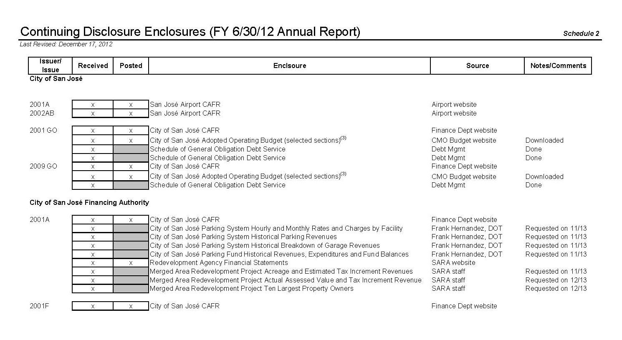
Internal Procedures
Reports and Data Required
Sample of Internal Report for Tracking Source Documents

Slide 64
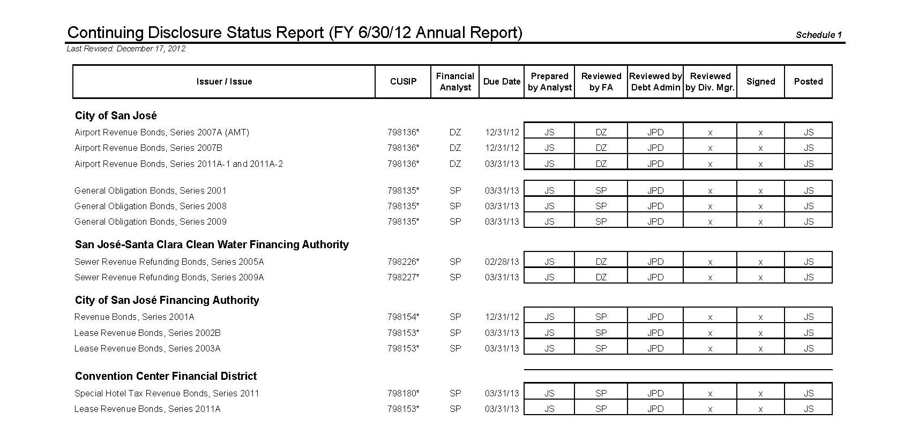
Internal Procedures
Status Reporting
Sample of Internal Status Report

Slide 65
Benefits of EMMA
No reliance on third parties to post/ disseminate information on a timely basis
Ability to uniformly “speak to the market”
Ability to provide investors with alternative ways to obtain additional information about your entity
  URL postings
Easy verification of available information
Ability for ALL investors to access the same information (for free)

Slide 66
Refunding Analysis
Part of overall good debt management
Review in context of multiple factors:
  New money needs
  Consolidation of refunding candidates to increase savings, minimize workload
  Saving thresholds
  Debt restructuring opportunities
Notes:
Part of overall good debt management
Review in context of multiple factors:
New money needs
Consolidation of refunding candidates to increase savings, minimize workload
Saving thresholds
Preservation of one-time advance refunding opportunity
Generally minimum 3% NPV for advance refundings
Debt restructuring opportunities

Slide 67

Summary and Concluding Comments

Slide 68
Summary - Tips for Issuers
Create an e-mail address for notification purposes – not an individual
  debt.management@sanjoseca.gov
Create electronic ticker system for entire debt management team
  Track everything!
Monitor for compliance on regular basis (daily, weekly, monthly)
Invest in Adobe Professional and Scanning capabilities
  Save everything you can electronically
Notes:
Create an e-mail address for notification purposes – not an individual
debt.management@sanjoseca.gov
Create electronic ticker system for entire debt management team
Outlook calendar – “Debt”
Track everything!
Monitor for compliance on regular basis (daily, weekly, monthly)
Invest in Adobe Professional and Scanning capabilities
Save everything you can electronically

Slide 69
Summary
It is just you and the trustee in the end
Must be active, diligent and engaged
City of San Jose spends 75% of debt management resources on monitoring portfolio
Prepare periodic reports on debt management activities to elected officials, public and senior management
Debt Management is NOT a passive sport
Notes:
It is just you and the trustee in the end
Must be active, diligent and engaged
City of San Jose spends 75% of debt management resources on monitoring portfolio
Prepare periodic reports on debt management activities to elected officials, public and senior management
Comprehensive Annual Debt Report & Quarterly Debt Reports
Available online at: www2.csjfinance.org/

