Slide 1


Drivers of Portfolio Performance
February 21, 2013
California Society of Municipal Finance Officers (CSMFO)
Presented by:
  Barbara Boswell
    Finance Director
    City of Lancaster
  David Witthohn, CFA, CIPM
    Director
    Cutwater Asset Management

Slide 2
Cash Flow Forecasting

Slide 3
Do you really need most of your funds within the next 24 hours?
Maturity Distribution – to final
Notes:
Need to swap out with Q1 charts

Slide 4
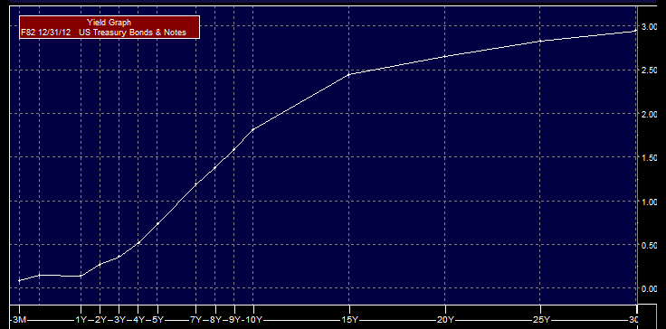
Target Duration: Risk/Return Tradeoff
Normally, the yield curve provides higher returns for longer maturities, but these incremental increases are much smaller for securities that are more than 10 years to maturity.
Source: Bloomberg

Slide 5
What is a Cash Flow Forecast?
Projection of anticipated receipts
Projection of anticipated disbursements
Estimate of investable cash balances
  Liquid funds
  Core funds
Notes:
What is a cash flow forecast?
When we talk about a cash flow forecast, we’re talking about a projection of anticipated receipts and disbursements to get an estimate of the amount of cash available for investment.
We are not talking about a budget or a revenue forecast. We’re talking about a projection of your actual cash balances. How much cash will you have available for investment?
A cash flow forecast is an estimate of the amount of investable funds you’ll have at a given point in time. When we talk about cash forecasting, we’re talking about looking at your anticipated receipts and disbursements. Our goal is to identify what portion of your portfolio must be kept liquid to cover operating expenses and what portion of your portfolio represents your core funds--those funds that you never seem to need or touch. By doing this, you can develop investment strategies for your liquid funds going out less than one year and investment strategies for your core funds going out over one year.

Slide 6
Why Prepare a Cash Flow Forecast?
Improves investment earnings
Ensures liquidity for disbursements
Identifies short-term cash deficits
Warns of impending budget problems
Notes:
An accurate cash forecast is an important management tool.
It can improve investment earnings by forecasting the amount of cash that will be available for investment and for what period of time. By identifying a core portion of your portfolio for longer-term investments, you can earn higher rates of return in a normal yield curve environment. Also, by identifying a core portion of the portfolio for investment, you can make investments in larger chunks knowing that you won’t need to liquidate that investment early. Also, by making investments in larger chunks, you’ll get better pricing and improve your investment earnings.
A forecast can ensure adequate liquidity to meet your operating expenses by providing estimates of the amount of cash that will be on hand at any given time. The worst thing that can happen is that you won’t have enough cash on hand to pay your bills. Imagine the newspaper headlines! Or think about what would happen if you couldn’t meet the payroll.
A forecast can also help identify temporary cash deficits that might require short-term borrowing. When you prepare a forecast, you’ll know when you need to borrow, how much you need to borrow, and for how long.
A forecast also can help identify problems with budgeted numbers. You should monitor your cash flows and communicate the impact of changing circumstances to your budget officials.

Slide 7
Major Impediments to Forecasting
Tendency to think in budget years
Difficulty distinguishing between fund balance and cash balance
Inadequate time and/or staff
Unpredictability of revenues and expenditures
Lack of information and communication
Lack of adequate technology
Notes:
Why is forecasting so difficult?
As finance officials, many of you think in terms of budget years instead of actual cash transactions. You may know that you have the budgetary approval to do something but may not consider the timing of those actions. For example, schools often get their funding at the beginning of the fiscal year. When would be the best time to make major purchases? At the beginning of the year, when you have a lot of cash on hand or at the end of the year when cash is tight?
Difficulty distinguishing between fund balance and cash balance. As public officials, you’re always thinking about fund balances. However, as cash managers, you need to think in terms of cash balances. If you pool your cash for investment purposes, it doesn’t matter which fund it comes from. How much cash will you have on hand to invest?
Another impediment is inadequate time and/or staff. Keeping a forecast up-to-date is not as time consuming as putting one together for the first time or for a new fiscal year. Collecting the information necessary for a forecast and putting it into a useful format may not be a priority in an all-ready busy schedule.
Unpredictable revenues and expenditures can make forecasting more difficult and more time consuming. This is especially true for entities that are undergoing drastic changes, such as rapid growth, and can’t rely on historical numbers for the next year’s forecast.
Another common problem is lack of information and communication. This is especially true for large jurisdictions where there may be several departments to deal with or a lot of different funds that have to be included in the forecast. One of the hardest things to forecast is capital project expenditures. First, you have to get information from the project manager and then you have to depend on that manager to keep you updated on the project. Or you may get resistance from other department managers to share information because they don’t understand why you need it or don’t have time to be bothered by your request.
Forecasting can also be difficult if you have a complicated fund structure and don’t have adequate technology to access data or download data into a spreadsheet.

Slide 8
Types of Cash Forecasts
Annual Forecasts
  Estimates monthly cash position
  Determines cash available for investments
  Provides a useful monthly overview for investment decision-making
  Prepared for this fiscal year and next one- to two-fiscal years
Notes:
There are different types of forecasts you can prepare. The most common forecast is an annual forecast. An annual forecast is prepared once a year and updated periodically. It provides an overview of the expected cash position by month. It doesn’t have a lot of detail but it can help you make investment decisions. You should prepare an annual forecast for this year and the next one- to two-fiscal years, depending on your investment horizon.

Slide 9
Types of Cash Forecasts
Project-based Forecasts
  Provides monthly data on status of capital projects
  Helps fine tune monthly and weekly forecasts
  May require input from contractors or in-house project managers
Notes:
A project-based forecast is useful for long-term projects and capital projects. It provides monthly data on the status of a project and should be accompanied by a schedule of payments.
This type of forecast requires the cooperation from contractors or in-house project managers to keep you informed on the status of a project. Many times a project is behind schedule, or is over budget. If you can, you should set up a system that requires the project manager to notify you of any changes in the payment schedule so you don’t carry a variance on your forecast for the whole year or possibly the next year until someone tells you that that large payment that was scheduled for March of 1999 still hasn’t been made.
You also should set up a system so you don’t have last minute requests for large down payments on a project that you didn’t know even started. Or that someone needs to purchase something that was budgeted without an exact payment date and they picked the worst time in your cash cycle to make that purchase.
You can set up a tickler system where you contact each person monthly and ask for an update on their projects. You also can ask a project manager for a best/worst case scenario at the outset of a project so you can plan your cash flows accordingly.

Slide 10
Tools for Cash Flow Forecasting
Historical data from general ledger
Historical data from bank statements
Current year budget
Capital project spending projections
Other major departments’ budgets
Schedule of investment maturities and coupon payments
Notes:
The first step in preparing a forecast is to gather information.
Historical data from the general ledger will give you a good idea of when certain revenues are received and when certain expenditures are made. By looking at the general ledger you can look for trends in your receipts and disbursements. You also can identify any large payments from the general ledger.
Bank statements provide information on actual cash flows. You can look at bank balances to determine when your cash balances are typically high or low or if you’re keeping excess balances in your bank account that could be put to more productive use in another investment vehicle.
The current budget document provides information on anticipated revenues and expenditures. Do you expect any tax increases? Are there labor negotiations coming up that might affect your payroll numbers? You need to look at this information in relation to the historical data and the bank information. It’s not enough to know how much revenue you expect to receive, you also have to know when to expect it.
We talked about a project-based forecast. The numbers from that forecast also will go into your consolidated forecast. Again, the important thing that you’re trying to determine is when are payments expected to be made.
If you have other departments that you have to coordinate with, you need to know what their budgets are and when they expect to receive large amounts of cash or make large payments. This is especially important if other departments control large expenditures, such as school buses. If they have budgetary approval to purchase buses, when do they plan to do this?
You’ll also need a schedule of your investment maturities and expected coupon payments to complete your forecast. This information will help you make investment decisions. If you know when you have investment maturities coming up, you can tie in any major disbursements.

Slide 11
Identify Revenues and Expenditures
Major revenue types
  Property tax
  Sales and use tax
  User fees
  Federal and state assistance
  Grants
  Bond proceeds
  Other
Major expenditure types
  Payroll (net)
  Withholding and benefits
  Debt service
  Capital expenditures
  Materials and supplies
  Overhead (e.g., utilities)
  Other
Notes:
When you’re developing your forecast, you need to keep it simple. It is important to identify major revenue and expenditure sources and concentrate on forecasting those numbers. You can’t forecast every dollar that comes in or gets paid out. Just concentrate on the major sources.
Here are some examples of major revenue types. Major expenditure types.

Slide 12
Forecasting Receipts
Identify 4-5 categories for major sources of revenue
Compile historical data of actual monthly receipts
Identify significant changes
Identify non-recurring items from prior years and for coming year
Develop analysis of monthly receipts as a percent of annual
Adjust historical distribution for known differences
Notes:
When you’re looking at the major sources, think about which ones are recurring. Then identify no more than 4 or 5 major sources. One rule of thumb is to determine which revenue sources make up at least 15% of the total revenue, or use the 80/20 rule and forecast 20% of revenues that make up 80% of the total. Then lump the other revenues into an “Other” category.
Then take the historical data of actual monthly receipts to see how much of each revenue source was received by month.
Identify any significant changes. Have there been any significant changes in your budget that might affect your cash flows like a property tax increase?
Identify non-recurring items from prior years and for the coming year. What revenues are you expecting this year that you did not get last year? Or what revenues did you get last year that you won’t get this year? Non-recurring revenues might be things like the sale of an asset or bond proceeds.
Then determine how much revenue you expect to collect each month based on a percent of the annual budget.
You’ll need to adjust the historical numbers for any known differences for the current year. For example, if your entity gets a lot of tourist dollars, the economic slow down might affect your receipts.

Slide 13
Receipts Forecast
Notes:
And, here is how it would look in the forecast.

Slide 14
Forecasting Disbursements
Establish reasonable number of categories
Compile historical data of actual monthly disbursements
Identify significant changes
Identify non-recurring items from prior years and for coming year
Develop analysis of recurring monthly disbursements as a percent of annual
Include debt service payments
Notes:
You will follow the same procedure with your disbursements. Again, make sure to limit your categories to a reasonable number, like 4-5. Many of your operating disbursements can be combined into a generic “Payables” category. You also can combine your net payroll with pension and benefits. Anything that does not contribute at least 15% to the total should be lumped into the “Other” category.
Look at your historical data to get monthly totals.
Identify any significant changes and adjust your historical numbers for any known changes. An example would be payroll. If pay raises were in the budget, the historical payroll numbers need to be increased. Or, if there are any lay-offs, then payroll numbers need to be adjusted down.
Identify any non-recurring items that were paid out last year that won’t be paid this year, or any disbursements that will be made this year that aren’t in your historical numbers.
You’ll also need to analyze the recurring disbursements as a percent of the annual total and determine how much will be paid out each month.
If you have debt, you need to schedule out your debt service payments. You might want to separate out the principal and interest payments or lump them together, depending on what works best for you.

Slide 15
Disbursement Forecast
Notes:
Here’s how it would look in your forecast.

Slide 16
Creating a Cash Flow Forecast
Beginning balance of cash and investments
Monthly revenue projections
Monthly expenditure projections
Projected net change
Projected cumulative balance of cash and investments
Notes:
Once you’ve gathered all of the information you need, you’re ready to create your forecast.
To create your forecast, you’ll take your beginning balance of cash and investments, add in the revenues, and subtract out the expenditures to come up a projected net change and a cumulative balance of cash and investments.

Slide 17
Cash Flow Forecast
Notes:
This is an example of a simple cash forecast showing the net cash position at the end of the month. It doesn’t provide much detail and it doesn’t include any investment balances. It does, however, show you if a cumulative balance of cash for the end of each month.

Slide 18
Estimate Timing of Investments
Schedule of current investments
List of maturity dates
Schedule of income payments
Notes:
To create a more detailed cash forecast that you could use for investment decision, you need to schedule out upcoming any investment maturities and income payments. To do that, you need a schedule of your current investments, a list of maturity dates, and a schedule of income payments.

Slide 19
Required Liquidity
Look at the projected net cash flows and hold the amount required to meet the largest negative month and add a margin of safety
Establish a required minimum cash balance that you would prefer to have available.

Slide 20
Comprehensive Cash Flow Forecast
Notes:
Note: This slide has automations that you can either leave in or delete. The make the circles appear on the slide show, press enter. The circles will not appear on the handouts.
This slide is an example of how you can prepare a cash flow forecast using an Excel spreadsheet. This format schedules out your expected receipts and disbursements. You would prepare a forecast for this fiscal year and next fiscal year or longer, depending on how far out your funds can be invested.
To set up a cash flow forecast like this, you need to identify your major revenue and expenditure types. If you issue debt or have capital projects, remember to factor in those cash flows as well. You would determine how much you expect to receive in or pay out each month based on your annual budget. You also need to factor in your investment maturities and coupon payments.
This forecast shows actual numbers through March and forecasted numbers for April through June. Here’s how you can use this forecast to make investment decisions. (Enter) This entity expects to collect $196,000 more than it spends in April. It has an investment maturity of $250,000 coming due. It knows that it is not going to need this money so it can invest any excess cash. In May, (enter) it will have a large investment coming due and most likely won’t need the funds, so it can reinvest those funds. But look at June. (enter) In June, this entity has a debt service payment due and expects to pay out $1.5 million. It has an investment of $1 million coming in. It may need some of those earlier funds to meet cash demands this month. You would also look at other months on your cash forecast to determine how far out you can invest your funds. If you see a month with a shortfall, you would schedule investment maturities to come due then. So, in this example, this entity knows in April that it has $250,000 coming in that it can invest out for at least 60 days.
One of the important things to do with a cash forecast is to determine how much of your portfolio is needed for liquidity purposes and how much is your core portfolio--that portion of your portfolio that you never seem to touch. If you look at the projected balance, you can see that it never goes below $9 million. (enter) In fact, this entity has a core portfolio of well over $9 million. They know that they can invest $9 million and not worry about selling an investment early for liquidity purposes.

Slide 21
Review Cash Forecast
Compare actual versus forecast
Identify reasons for variances
Adjust assumptions if warranted
Follow up with department heads on capital project slippage
Update database for accurate future projection
Retain documentation for future reference
Notes:
Creating a forecast for the first time is the hardest part. Once you’ve created it, you then need to monitor its accuracy. You should look at the actual numbers against the forecasted numbers to see how large the variance is and try to identify reasons for the variance. This is also a good internal control. For example, check fraud is a multi-billion dollar industry. If your actual balances are consistently lower than your forecasted balance, something may be going on.
You may have to adjust your original assumptions and adjust your forecasted numbers going forward. You may unanticipated events that can throw off your forecast. Gasoline example.
If you live in an area that is susceptible to economic downturns, you will have to adjust your historical numbers to take that into consideration. Also, if you jurisdiction is changing--whether it’s growing or shrinking--you’ll need to adjust your numbers. Seasonal factors can have a great impact on the accuracy of the forecast too. If you employ summer help or have a community swimming pool or recreation center, make sure to include those numbers in the forecast.
If you have capital projects, you’ll need to follow up with department heads periodically and see where they are on their projects. Are they on schedule? Are they on budget?
It’s important that you do update the forecast and keep track of those updates. The more you can fine tune the forecast, the more accurate the coming years forecasts will be and the less time you’ll have to spend gathering information and making assumptions. You can do this once a year, once a quarter, or monthly. If you update your numbers monthly, you will greatly improve the accuracy of your forecast.
Keep any notes you make and retain the documentation for future reference. The more accurate a database you can build, the more accurate your forecast will be.

Slide 22
Portfolio Management

Slide 23
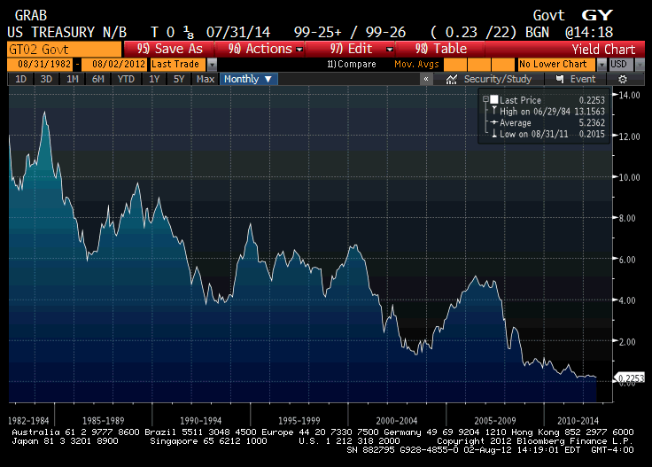
How Did We Get Here?

Slide 24
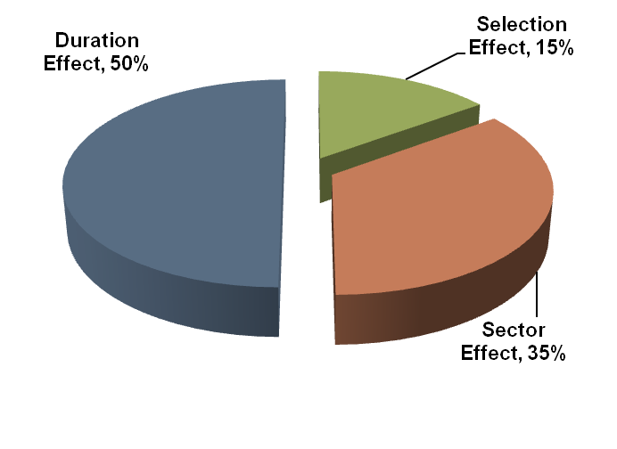
Active Management Strategies
There are three primary drivers of performance for high quality short-term fixed income portfolios:
Duration management
Sector allocation
Security selection

Slide 25
Duration Management

Slide 26
Cash Flow Analysis
To determine how much money you have to invest in your core portfolio and for how long, you need to analyze some basic cash flow projections. Here is an illustration of what that could look like.

Slide 27
Traditional Portfolio Structure
Utilizes traditional money market sectors
Manages liquidity and credit risks
Enables timely reinvestment of cash flows
Captures best duration risk-adjusted returns with the “reserve” portion of the portfolio
Allocates to government and high quality sectors, ensuring liquidity if needed
Insulates portfolio return from interest rate volatility, enhancing portfolio performance
Liquidity Portion of Portfolio
30%
1 to 3 Year Portion of Portfolio
70%

Slide 28
Analyzing the Risk/Return Tradeoff
Return vs. Number of Negative Quarters
January 1, 2003 to December 31, 2012
Source: Bloomberg

Slide 29
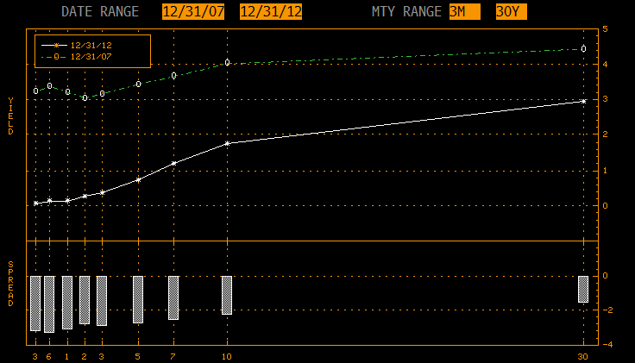
Reduces Volatility of Returns
Source: Bloomberg

Slide 30
Duration Management - Looking Forward

Slide 31
Duration Management
Source: Bloomberg

Slide 32
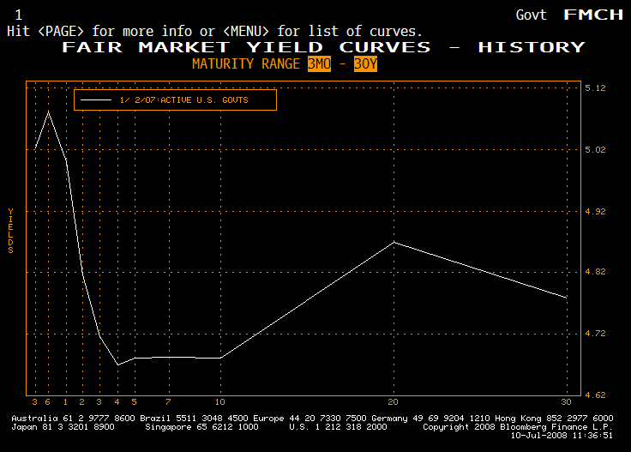
Yield Curve - top of the interest rate cycle
The curve is inverted, enticing investors to stay short.
-40 Basis Points
Lengthen Maturity
Source: Bloomberg

Slide 33
Yield Curve - bottom of the interest rate cycle
The curve is steeply sloped, enticing investors to extend maturities, lower quality or take on extension risk.
71 basis points
Source: Bloomberg

Slide 34
Sector Allocation

Slide 35
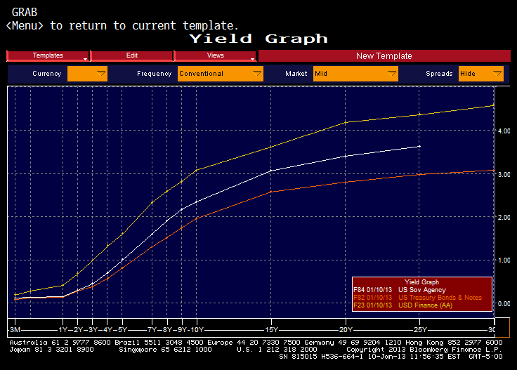
Sector Allocation - Treasury, Agency & Corporate
Source: Bloomberg

Slide 36
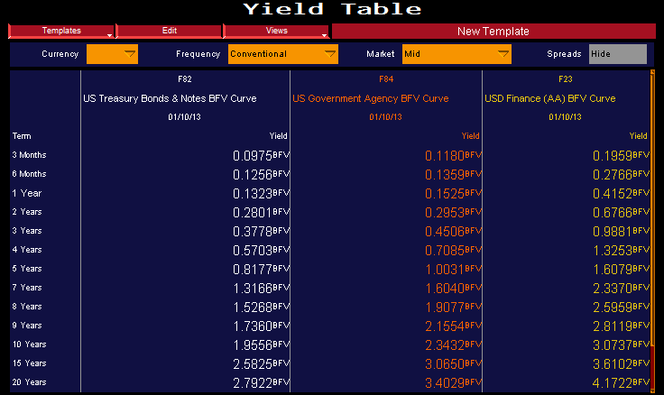
Sector Allocation – Treasury, Agency & Corporate
Source: Bloomberg

Slide 37
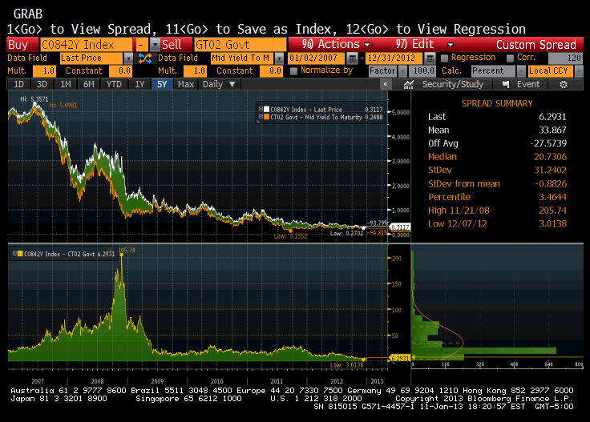
Sector Allocation - Treasury to Agency Spreads
Source: Bloomberg

Slide 38
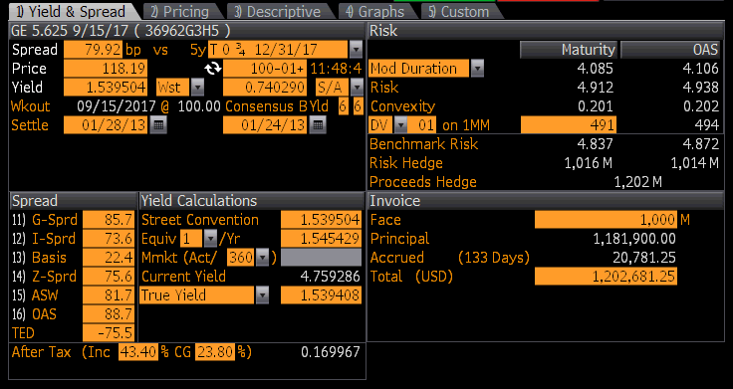
Sector Allocation – Corporate MTN
Disclaimer: All securities shown in this presentation are shown for the purpose of instruction only and are not recommendations to buy or sell a specific security. Cutwater Asset Management acts solely as an investment advisor and not as a broker dealer.
Source: Bloomberg

Slide 39
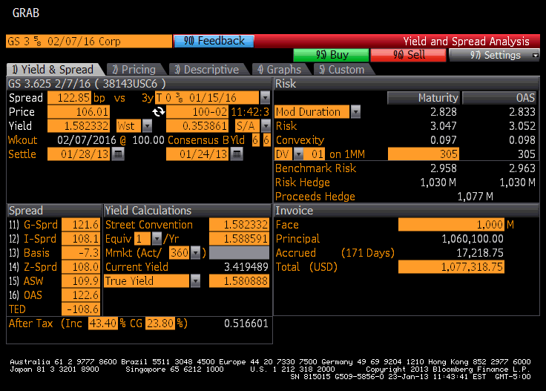
Sector Allocation – Corporate MTN
Source: Bloomberg

Slide 40
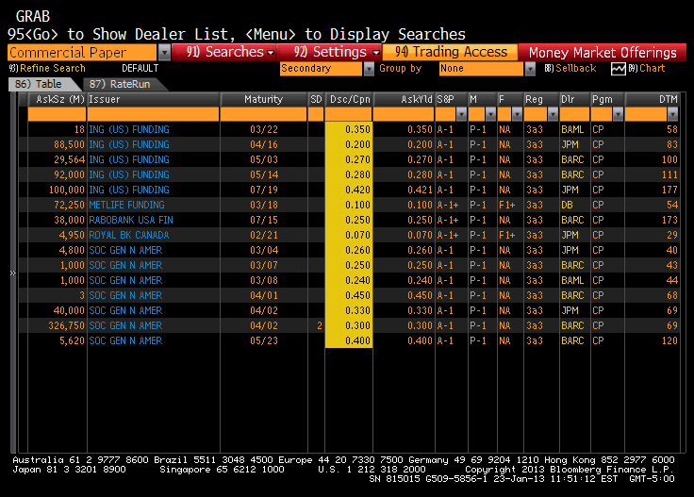
Commercial Paper – “the other corporate”

Slide 41
Security Selection – Security Structure

Slide 42
Security Selection - Structure
Source: Bloomberg

Slide 43
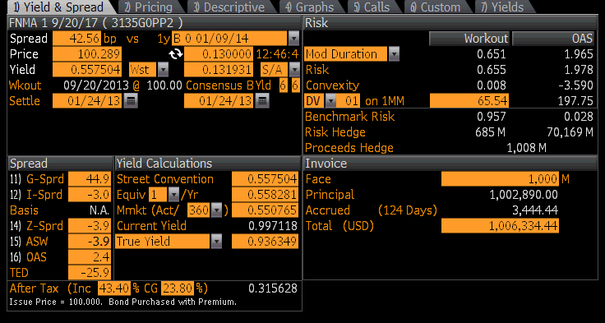
Security Selection - Structure
The structure of a callable security greatly affects both the bond’s duration and performance. Extension risk is a big issue with callable securities.
1,695 days
235 days
Source: Bloomberg

Slide 44
How Many Callables is Too Many?
Notes:
75% of this portfolio is callable.

Slide 45
How Many Callables is Too Many?
06/30/10 |  |  |  |  |  |  |  |  | Final | Effective | Weighted
Issuer / |  | Maturity | Call Date | Acquisition | % of | Days to | Days to | YTM | Wtd. Avg. | Wtd. Avg. | Average
Security | Coupon | Date | (if any) | Cost | Portfolio | Final | Call | (Purchase Y) | Maturity | Maturity | Yield
FNMA POOL | 5.000% | 11/01/10 |  | $ 1,438,167.80 | 2.68% | 124 |  | 0.308% | 3.33 | 3.33 | 0.008%
FNMA POOL | 4.000% | 12/01/10 |  | $ 1,326,607.49 | 2.48% | 154 |  | 0.164% | 3.81 | 3.81 | 0.004%
FNMA POOL | 4.500% | 01/01/11 |  | $ 1,630,747.40 | 2.30% | 185 |  | 0.412% | 4.25 | 4.25 | 0.009%
FNMA POOL | 4.000% | 06/01/11 |  | $ 2,077,436.49 | 3.88% | 336 |  | 0.667% | 13.02 | 13.02 | 0.026%
FNMA | 2.000% | 08/12/13 | 08/12/10 | $ 997,500.00 | 1.86% | 1139 | 43 | 2.074% | 21.20 | 0.80 | 0.039%
FHLB | 1.000% | 05/26/15 | 11/26/10 | $ 1,000,000.00 | 1.87% | 1791 | 149 | 1.000% | 33.42 | 2.78 | 0.019%
FNMA | 2.000% | 12/30/15 | 12/30/10 | $ 1,000,000.00 | 1.87% | 2009 | 183 | 2.000% | 37.48 | 3.41 | 0.037%
FNMA | 4.100% | 07/01/16 | 07/01/10 | $ 1,012,434.23 | 1.89% | 2193 | 1 | 3.889% | 41.43 | 0.02 | 0.073%
FNMA | 2.530% | 05/04/17 | 08/04/10 | $ 1,000,000.00 | 1.87% | 2500 | 35 | 2.530% | 46.65 | 0.65 | 0.047%
FHLMC | 3.100% | 05/19/17 |  | $ 1,000,000.00 | 1.87% | 2515 |  | 3.100% | 46.93 | 46.93 | 0.058%
FNMA | 2.000% | 11/27/17 |  | $ 1,000,000.00 | 1.87% | 2707 |  | 2.000% | 50.51 | 50.51 | 0.037%
FNMA | 2.000% | 12/18/17 | 09/18/10 | $ 747,000.00 | 1.39% | 2728 | 80 | 2.000% | 38.02 | 1.12 | 0.028%
FNMA | 3.000% | 01/29/18 | 07/29/10 | $ 1,000,000.00 | 1.87% | 2770 | 29 | 3.000% | 51.68 | 0.54 | 0.056%
FNMA | 3.000% | 02/12/18 | 08/12/10 | $ 1,000,000.00 | 1.87% | 2784 | 43 | 3.000% | 51.95 | 0.80 | 0.056%
FHLB | 2.500% | 12/23/19 | 09/23/10 | $ 1,000,000.00 | 1.87% | 3463 | 85 | 2.500% | 64.61 | 1.59 | 0.047%
FNMA | 2.000% | 02/24/20 | 02/24/11 | $ 1,000,000.00 | 1.87% | 3526 | 239 | 2.000% | 65.79 | 4.46 | 0.037%
FNMA | 3.000% | 05/19/20 | 11/19/10 | $ 1,000,000.00 | 1.87% | 3611 | 142 | 3.000% | 67.38 | 2.65 | 0.056%
FNMA | 2.000% | 06/16/20 | 06/16/11 | $ 1,000,000.00 | 1.87% | 3639 | 351 | 2.000% | 67.90 | 6.55 | 0.037%
FHLMC POOL | 6.000% | 09/01/21 |  | $ 1,313,080.36 | 2.45% | 4081 |  | 4.945% | 99.98 | 99.98 | 0.121%
FHLMC | 4.000% | 02/25/22 | 08/25/10 | $ 1,000,000.00 | 1.87% | 4258 | 56 | 4.000% | 79.45 | 1.04 | 0.075%
FNMA | 4.000% | 05/28/24 | 08/28/10 | $ 965,000.00 | 1.80% | 5081 | 59 | 4.320% | 91.49 | 1.06 | 0.078%
FNMA | 5.125% | 08/19/24 |  | $ 478,514.06 | 0.89% | 5164 |  | 4.848% | 46.11 | 46.11 | 0.043%
FNMA | 3.000% | 09/30/24 | 09/30/10 | $ 1,000,000.00 | 1.87% | 5206 | 92 | 3.000% | 97.14 | 1.72 | 0.056%
FHLMC | 3.000% | 02/02/25 | 08/12/10 | $ 1,000,000.00 | 1.87% | 5331 | 43 | 3.000% | 99.47 | 0.80 | 0.056%
CD |  | 12/28/10 |  | $ 14,000,000.00 | 26.12% | 181 |  | 2.650% | 47.28 | 47.28 | 0.692%
Money Market |  | 07/01/10 |  | $ 13,594,074.82 | 25.36% | 1 |  | 0.210% | 0.25 | 0.25 | 0.053%
Totals |  |  |  | $ 53,594,961.99 | 100.00% |  |  |  | 1271.94 | 346.90 | 1.850%
Notes:
75% of this portfolio is callable.

Slide 46
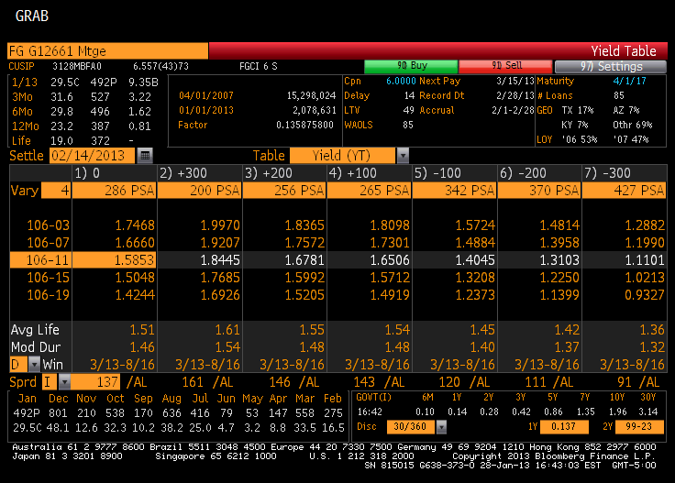
Security Selection - Structure
Mortgage backed securities may provide a performance opportunity for a small portion of the portfolio.
Source: Bloomberg

Slide 47
Security Selection – Credit Analysis

Slide 48

Credit Exposure – Are you a sitting duck?

Slide 49
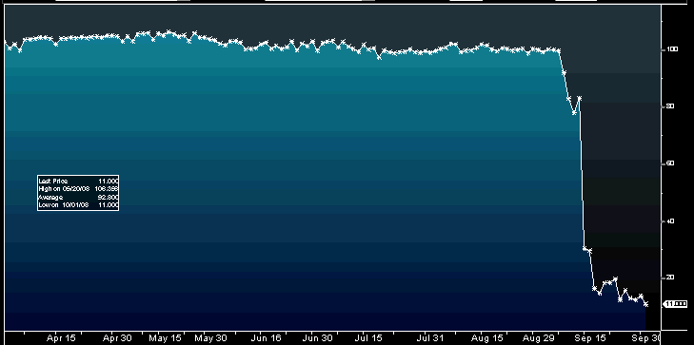
Practical Example – credit analysis
Lehman Brothers MTN 7 7/8% of August 2010
3/1/08
A+ rated
9/12/08
A rated
6/2/08
A rated
9/15/08
CCC- rated
March 17th 2008
“JPMorgan scoops up troubled Bear” CNN
9/16/08
D rated
“Many will say that standalone investment banks’ days are numbered”

Slide 50
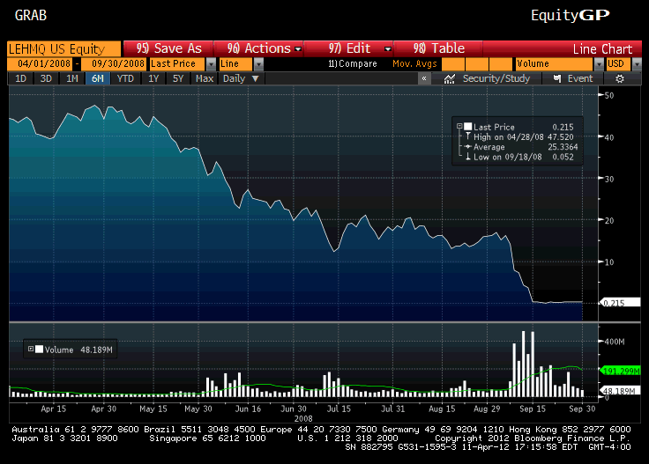
Practical Example – credit analysis
Lehman Brothers Stock

Slide 51
Risk Return Tradeoff

Slide 52
Drivers of Portfolio Performance
      This is not your father’s yield curve
      Three main drivers of performance
      Duration is key
      Look to new asset classes
      Credit analysis is mandatory
      Risk is just as important as return
      The next major move is up

