Slide 1


Evolving Disclosure Practices and Getting the Most from EMMA
California Society of Municipal Finance Officers
February 21, 2013

Slide 2
AGENDA
Who is the MSRB
EMMA
Disclosure Practices & Obligations

Slide 3
About the MSRB
A self-regulatory organization that protects investors and issuers of municipal securities by:
    Regulating municipal securities dealers and municipal advisors
    Operating market transparency systems including the Electronic Municipal Market Access (EMMA®) website
    Conducting education, outreach and market leadership

Slide 4
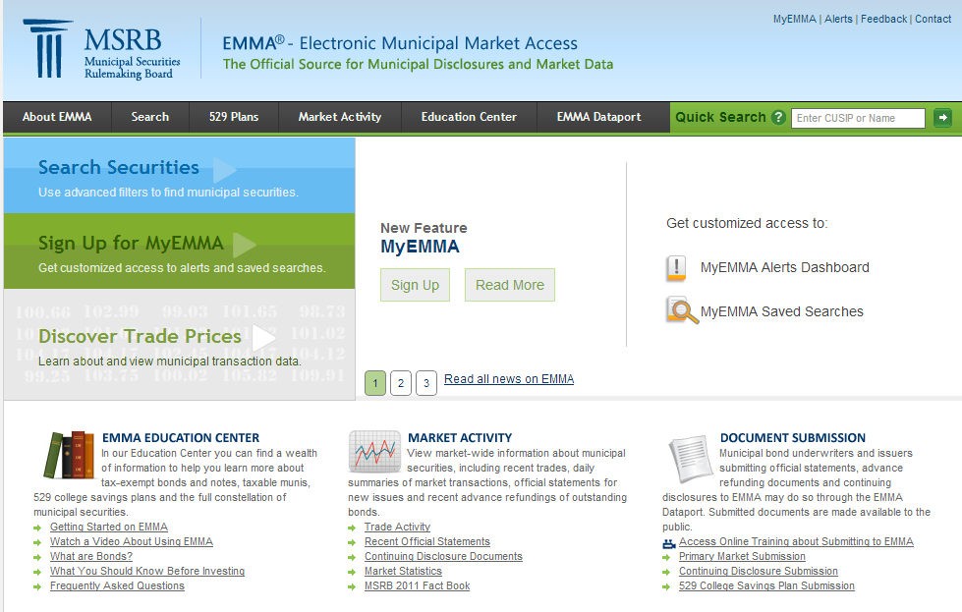
About the EMMA Website
Provides centralized, free public access to key market information, disclosures and data
Promotes market transparency
Serves as platform for issuers to communicate important information to municipal bond investors
Launched in 2008
http://emma.msrb.org

Slide 5
Why Communicating with Investors Matters
Ensures that bondholders stay apprised of important developments that could affect the value of their bonds
Enhances the bond issuer’s market competitiveness – prospective investors value openness and transparency
Communication with current and prospective investors is facilitated by the EMMA® website
Municipal Securities Rulemaking Board 5

Slide 6
Continuing Disclosures
One of the key methods for communicating with investors is through continuing disclosures
  Continuing disclosures provide investors with ongoing information about municipal securities
  Timely and complete continuing disclosures help investors make informed decisions about municipal securities
Municipal Securities Rulemaking Board 6

Slide 7
What is Continuing Disclosure?
Information submitted to the EMMA® website based on contractual agreements established when a bond is issued
  Agreements are established under Securities Exchange Act Rule 15c2-12
Additional voluntary information submitted to the EMMA® website
Municipal Securities Rulemaking Board 7

Slide 8
Types of 15c2-12 Continuing Disclosures
    Required disclosures include:
      Annual financial or other operating information
      Notices of specific events that may have an impact on the value of the bonds
Municipal Securities Rulemaking Board 8

Slide 9
Voluntary Disclosure
State and local governments may provide additional information to market participants on a voluntary basis via EMMA®, including:
  Pre-sale information such as preliminary official statements or investor presentations
  Information about the timing of and accounting standard used to prepare annual financials
  An investor website address
  Information about bank loans
Municipal Securities Rulemaking Board 9

Slide 10
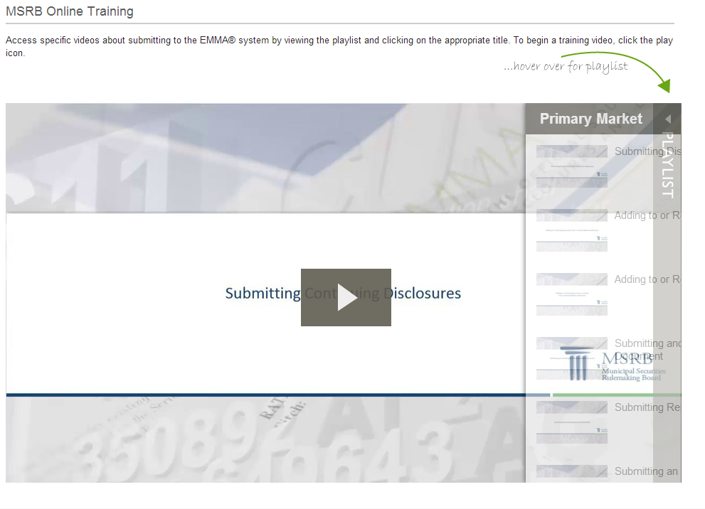
Continuing Disclosure
Online Training
Video tutorials are available in the Online Training section of the MSRB website
  Continuing disclosure topics include:
    Submitting Continuing Disclosures
    Creating and Controlling Groups
Submission manuals also available on www.msrb.org
Municipal Securities Rulemaking Board 10

Slide 11

State and Local Government Toolkit
Free resource designed for small to mid-sized issuers
  Videos, fact sheets and guides about the process of issuing municipal bonds and using the EMMA® website
  Resources on continuing disclosures, including fact sheet on SEC Rule 15c2-12
  New resources coming in Spring 2013
Municipal Securities Rulemaking Board 11

Slide 12
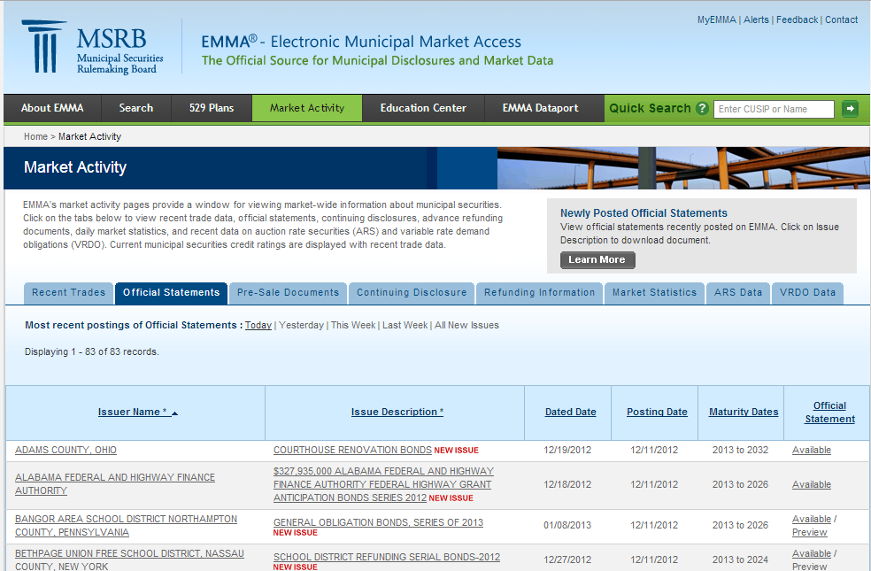
Using the EMMA Website

Slide 13
Information on EMMA
Official statements
Advanced refunding documents
Preliminary official statements
Continuing disclosures
Real-time transaction data
Current credit ratings
Market statistics
Educational material and glossary

Slide 14

Long Range Plan for MSRB Market Transparency Products
Roadmap for further development of EMMA as a tool for market transparency
Ensures EMMA will remain aligned with the needs of the municipal market and responsive to changes
Published in February 2012

Slide 15
New and Planned EMMA Enhancements
“EMMA 2.0”
  Enhanced search functionality
    New filters to search by descriptive characteristics of securities ✓
  New user account options
    Customized access to EMMA features with MyEMMA ✓
  Improved alerts functionality
    MyEMMA Alerts Dashboard for online management and viewing ✓
  Integrated display of information
    Issuer homepages
  Central transparency platform
    Public access to real-time pre- and post-trade pricing information
  Expanded universe of information
    New issuance data and additional market statistics ✓
  One or More Yield Curves
    Measure market movements
  Enhanced submission portal
    Easier submission of continuing disclosures for issuers
Municipal Securities Rulemaking Board 15

