Slide 1
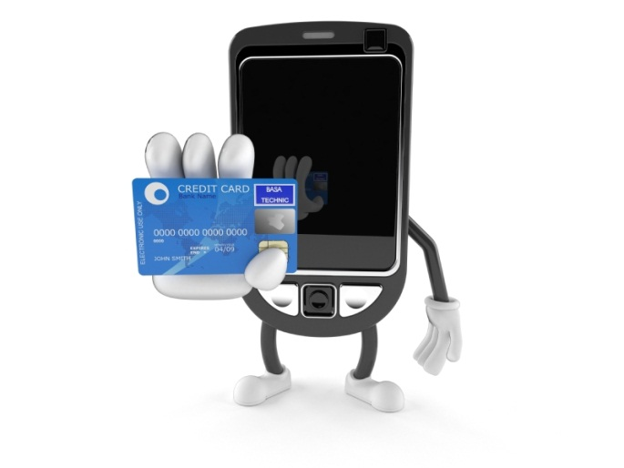

SALES T
SALES TAX…THE FUTURE
California Society of Municipal Finance Officers
February 21, 2013
Notes:
Bob Champion – Founder and President of Champion Real Estate Company which since 1987, has worked with local jurisdictions to complete over 2 million square feet of office, residential and retail development. A nationally recognized expert in shopping centers, vertical retailing, public-private partnerships and mixed–use projects, Bob has taught real estate development and urban planning at USC, UCLA and ICSC University and a has been a frequent speaker at CRA, ULI and ICSC. His Masters of Real Estate Development was earned at the University of Southern California.
LdL to discuss trends impacting future taxable sales and thoughts on potential tax reform. Bob to talk about how these trends impact his development strategies and what cities should be considering in their future planning and economic development

Slide 2
THE PROBLEM THAT NO ONE
IS TALKING ABOUT…
Sales Tax Collections as a Percentage of Personal Income
Revenue From a 1% Sales Tax Rate as a
Percentage of Personal Income
Notes:
Trend been going on since the late 1970’s. Ignore: inflation, population growth, new things to buy: flat screen t-v’s , personal computers, tablets, smart phones, new investment in alternate energy, etc.
Caught my eye was acceleration in trend beginning in 2000.
When you factor out inflation, per capita taxable sales in California were 28% lower than in 2000.
Latest recession accounted for half of the drop but doesn’t explain the rest. What happened?
Went to HdL Cellar.

Slide 3


SPENDING PRIORITIES ARE MOVING AWAY FROM TAXABLE GOODS…..
27% Increase in Household Spending 2000 -2010:
  Housing
  Healthcare
  Food
  Entertainment
  Education
Entire gain by top 20% income Households – Household spending by remaining 80% declined.
Notes:
2010 Census: 78% of the increase in household spending in the last decade was in the five areas listed above. Only small amounts of those were subject to sales tax.
More importantly, the entire increase was by the top 20% income earners. Spending by all other households declined. The remaining 80% have to spend a greater portion of their income on housing, healthcare, food, education. Have less to spend on tangible personal goods.
The top 20% can only buy so much and over time, your taxable per capita sales drop.

Slide 4
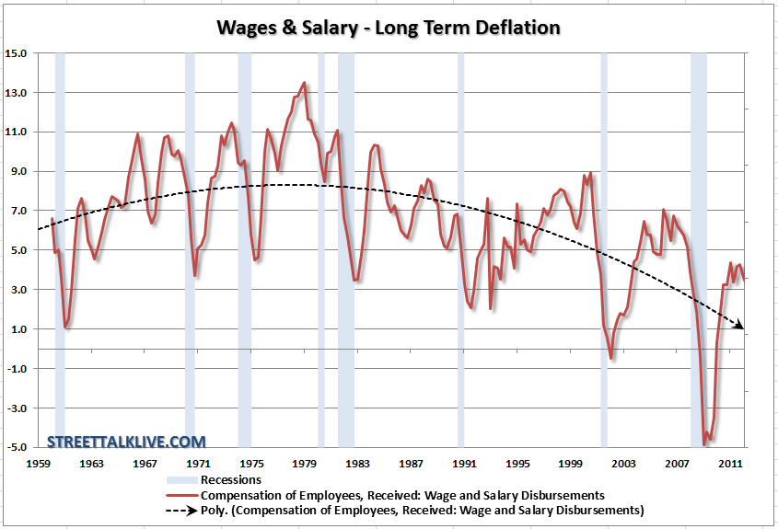
Notes:
Total Wages Received Nationally following each recession - Over time, haven’t kept up with inflation – disparity between rich and poor becomes more pronounced each year.
Lot of this is due to improvements in productivity – no longer need as many employees as used to.
Generally, the only segment of the working population whose income is on the rise is in the entrepreneur, professional and technical ranks that comprise most of the the 20%.

Slide 5


Declining Prices of Tangible Goods
Technology reducing cost of goods – autos, apparel, electronics.
On-line shopping forcing increased price competition.
Shopping Habits of Affluent shifting downward.
Notes:
Cost of goods are declining. Adjusted for inflation, autos, apparel, electronics are all cheaper than ten years ago. The price of flat screen TV’s alone have dropped forty percent in the last four years. Average life of a car in 2000 was 8.9 years. Today it is 10.6 years. Less cost, less obsolesce, less tax.
According to Google, shoppers used an average of 5.3 sources of information to make a purchase decision in 2010. In 2011, the average sources of information jumped to 10.4. More stores being forced to match on-line prices. Best Buy this Christmas – pull out your smart phone and they would match any price that you found else where.
The affluent five percent of the population have traditionally accounted for 37% of all consumer spending. If your combined household income exceeded $166,000 last year, you were considered as part of the wealthy five percent. Accessorize those $500 Christen Louboutin Shoes at Target.

Slide 6
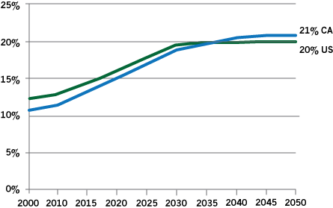
CALIFORNIA’S POPULATION IS AGING
Percentage of Those 65 or Older
Data Sources: California Department of Finance 2012; U.S. Census Bureau 2008
Analysis: Stanford Center on Longevity
Notes:
One in Five California residents will be 65 or over by 2030. Probably even some of the folks in this room. Some of us are already there.
An aging population has a negative impact on sales tax revenues.

Slide 7
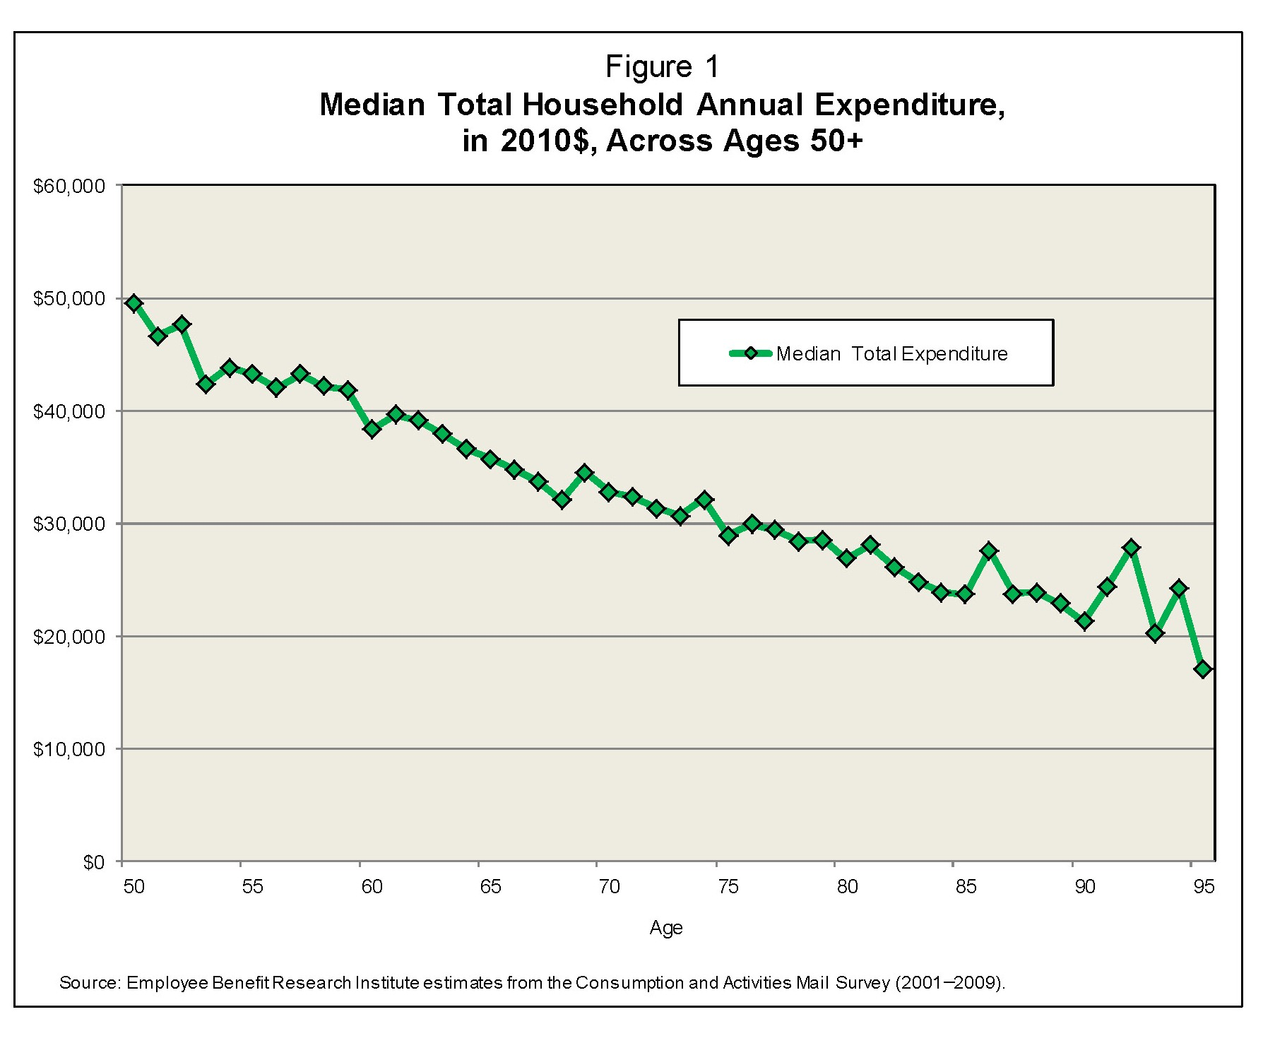
TAXABLE SPENDING
DECLINES WITH AGE
Notes:
You can spoil a grandchild rotten for less than 5% of it costs to raise one. The only expense that consistently goes up after age 65 is medical expenses.
The older the population, the less sales tax.

Slide 8

After the Aging Baby Boomers Come the Cheapskates………….
The Millennials (Generation Y)
Lower Financial Expectations
Urban Dwellers
Education & Social Networking over Stuff
Traders, Renters, Borrowers, Recyclers
Notes:
Baby boomer’s and early generation X trophy babies. Born 1981 and after. They are special. Years of praise and rewards for just showing up. Highly group and social oriented. Drive employers crazy. Want to be part of the team and decision process. Retailers spending a fortune studying this generation:
Less money to expend – heavy college loan debt, not the same rise in property and asset values that we all enjoyed from the 1960’s through the end of the last century – Baby Boomers won’t get out of the way. Pissed away all they made and have to work until they drop.
Urban Dwellers – not as interested in the big lot ranch house in the suburbs – look for social opportunities, high transit and walking scores. Will spends hundreds a month on phone and internet packages and willing to settle for smaller houses, less stuff, less sales tax.
Less materialistic than Baby Boomers and Generation X. More interested in internet than cars. Auto industry going crazy – experimenting with special designs – international show, VW just introduced cross over that claim the Smart Phone was the inspiration for the design. Ford hired team of psychologists – Our generation: cars meant freedom – this generation: cars are too slow, they have face book, twitter and all kinds of aps.

Slide 9
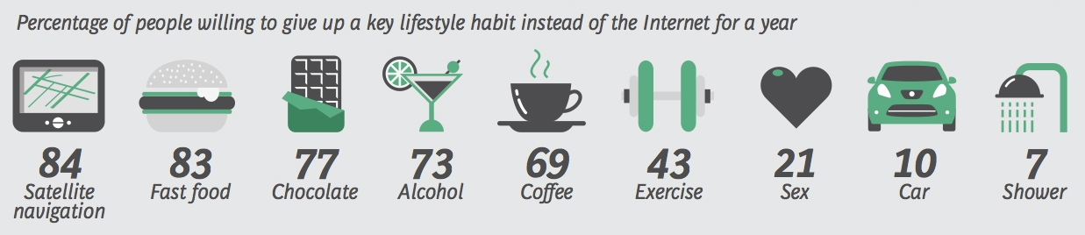
THEIR FUTURE IS ONLINE…...
Sources: Boston Consulting Group, Fast Company Design
Notes:
Digital narcissists – total indifference to privacy – passion for over sharing – Face book, twitter yelp, share shopping likes on pinterest, share photos on instagram and watch themselves on You Tube 24 hours a day.…… Recent survey showed that 21% would give up sex before giving up the internet……future generation of Finance Directors.
Social networking means that you don’t have to buy as much stuff. Need a car? Zip car allows you to share with others. There are similar programs to share bicycles. Need a place to stay? Airbnd hooks you up with folks willing to rent out a room.
Who needs to buy new stuff when you can go on Craig’s list and find what you want at a fraction of the price?
Bottom line – Per capital taxable sales of tangible personal property will continue to decline and the decline will be accelerating
with the changing demographics.

Slide 10
TECHNOLOGY IS CHANGING
HOW WE SHOP
and the distribution of taxes…….
7% of retail transactions on-line, projected to grow to 9% by 2016…shift of tax to location of fulfillment distribution centers rather than stores.
Food Trucks a $2.7 Billion industry by 2017. Shift of tax from brick and mortar restaurants to pools.
No tax on electronic downloads of books, movies, music…anyone remember when photos required film for the camera?
Notes:
7% of retail transactions now on-line. If you remove autos from the definition of retail transactions, the percentage grows to 10%.
Shift of tax revenues away from stores to central distribution centers. Purchase a TV from Best Buy in Oakland, the tax goes to Oakland. Purchase it on-line, the tax goes to the distribution center in Dinuba. Buy a shirt at Kohl’s in Oakland, the tax goes to Oakland. Buy the shirt on line, the tax goes to the distribution center in San Bernardino.
Patronage of Food Trucks have grown fourfold in three years – tax goes into pools. Depending on your agency’s size and the county, your share of the sales tax generated from the pool can be as little as 1% and as much as 50%.
Barnes N Noble now sells twice as many e-books as printed books. The entertainment industry is having trouble because sales of dvd’s and Cd’s have dropped 50%. Now download music on I-pods, stream movies from Netflix, hula, etc. There is no sales tax because electronic downloads are not considered as tangible personal property.
Dying to expose your Mayor or City Manager? Apple has a feature called Breakout Books. Allows you to publish and sell your own non-taxable
e- books.

Slide 11

The Future Is Here and Accelerating….
Smart Phone Apps - Tablets
same day delivery – free returns
mobile wallets
Q.R (quality response) codes
Notes:
Technology is accelerating the shift. 29% of Smart phone owners shop with their phone, 47% of PC tablet owners shop with their tablets. Free delivery and returns are becoming more common.
Holy Grail for every major retailer is same or next day delivery within five years. Don’t like to give your credit information over the internet? Wal-Mart allows you to make an on-line order and than pay for it at the closest store.
Q.R. Codes (Quality Response). Look for more Kiosks in all of the major stores in the future. – don’t have what you want? Allows you to search inventory of entire chain and order with your smart phone.
Two weeks ago, American Express announced a new service that will allow you to order merchandise by twittering. The down side is that the world will know your bra size. But the Millennials in the room don’t care about privacy anyway.

Slide 12

On The Way…
Interactive T-V
Virtual Stores
Digital Fitting Rooms
3-D Printers
Notes:
Next big innovation in e-retail is something called “parametric technology”…stimulates your body type and how fabrics fit based on your weight, height and measurements…sit in front of your T-V and try on the clothes at home….expected to be common within five years. Preview this fall when Nordstrom starts breaking out a commercial variation called swivel. Go into a booth, try on different things and accessories without having to take merchandise into the booth. Want to see how that beach outfit would look when you are on vacation in Hawaii? It will even call a backdrop showing you wearing it in Hawaii.
3-D Printers: Makes objects by building up successive layers of material. Currently churning out prototypes of molds for mfg. of new products. But have also successfully producing medical implants, jewelry and aircraft parts. You can currently buy a home version for $2000. Usually comes with thermoplastic spools or clay for crafts or metallic powders for jewelry. That model of the Eiffel tower on the young lady’s desk was printed out by the three D computer sitting next to it.
Venture capitalists are betting that within ten years the costs of the technology will be down to where you can print out towels, utensils and apparel in your home…the only tax will be on the materials that go into the printer. The blue print to print out the merchandise will be the most expensive part and that will be transmitted electronically. No tangible personal property – no sales tax.

Slide 13
Percentage Growth in E-commerce Sales versus Total Retail Sales
(Billions of Dollars)
Source: U.S. Census Bureau
Notes:
Quick Poll – Finance officers most time starved people in world – how many at 4 AM on Black Friday? How many on-line Christmas shopping for at least a third? Socks/Uncle Jesus to San Bernardino, Wal-Mart to Eastvale, Costco to Mira Loma in Riverside County, Best Buy to Dinuba, Amazon (1/4th) soon to San Bernardino, Tracy and Patterson.
Online shopping 15% more in 2012 than 2011. As the trend grows, less of that tax spent by folks in your community will be going to the community and instead distributed to just a few jurisdictions.

Slide 14
THE COMING SHIFTS IN RETAIL WILL ALSO SHIFT SALES TAX REVENUES….
Stores downsizing to become Touch & Feel showrooms for online sales.
Focus on shopping environment & experience rather than large inventories.
Increased market saturation with smaller, low overhead stores and kiosks in more or temporary locations.
Notes:
Ten years ago, Grocers were building mega stores of 45,000 to 60,000 square feet. Trader Joes, Sprouts, Fresh & Easy and Wal-Mart Express all shot that concept to pieces. Barnes N Noble put most of the neighborhood book stores out of business by creating a mega book and music environment. Today, for two out of every three books sold are e-books for loading on to electronic readers. They no longer need the space and can’t afford to carry the inventory. They just announced that they will be closing 1/3rd of their stores in the next few years. Best Buy expects to close more stores and open more Best Buy Mobile shops concentrating just on phones and tablets.
Every major retailer – Best Buy, J.C. Penny, Office Depot, Wal-Mart, Target, Kohl's, Petsmart, etc. are working on plans for smaller footprints for future outlets. They plan on using less space but offer a broader selection of goods through the placement of kiosks and faster delivery of orders. The smaller footprints are more cost efficient and allow them to go into market areas that didn’t have the land or space to support the old concepts.
On existing stores, more and more are breaking up the space and subleasing. Best Buy to Pacific Sales and J.C. Penny to Sephora are just two examples. Companies such as Toys R Us and Gap are consolidating their special shops – For example bringing Gap, Gap Kids and Baby Gap together or Toys R Us and Babies R Us under one roof. Toys R Us are enhancing their holiday sales with temporary pop-up stores.

Slide 15
TRADITIONAL RETAIL CONCEPTS….
  Gone:
  Anchor Blue, Bassett Furniture, Blockbuster Video, Bombay Company, Borders Books, Cala Foods, Circuit City, Comp USA, DEMO, Discovery Channel Stores, Famsa, Geoffrey Beene, Good Guys, Gottschalks, Great Indoors, Hollywood Video, Home Expo, KB Toys, Linens N Things, Linder's Furniture, Maytag Stores, Mervyns, Petite Sophisticate, Rent A Center, Ritz Cameras, Sharper Image, Shoe Pavilion, Smith & Hawken, Steve & Barry, Tower Records, Virgin Mega Stores, Walden Books, Wickes Furniture, Wild Oaks Markets, Wilson’s Leather, Yard Birds…
  Reducing Number of Stores:
  Abercrombie & Fitch, Albertsons, Barnes and Noble, Best Buy, 84 Lumber, Foot Locker, fresh & easy, Game Stop, Gap, J.C. Penny, K-Mart, Loehmann’s, Lowes, Men’s Wearhouse, Old Navy, Payless Shoes, Pier One, Raley’s, Saks, Sears, Staples, Talbots, Thomasville Furniture…..
Notes:
As more sales are shifted to distribution centers and retail evolves to accommodate changing demographics and shopping patterns, the numbers of traditional retailers will decline…
This isn’t meant to suggest the end of the world There will always be new concepts and there are numerous retailers in an expansion mode – most of the dollar/99 Cent Stores, fast-casual restaurants and smaller specialty retailers such as Jos. A Banks, Tillys, David’s bridal, Urban Outfitters and others. Nordstrom has indicated that they intend to double the number of Rack stores over the next three years. However, they all require less space and the filling of vacancies with the right retail mix is becoming more challenging.

Slide 16
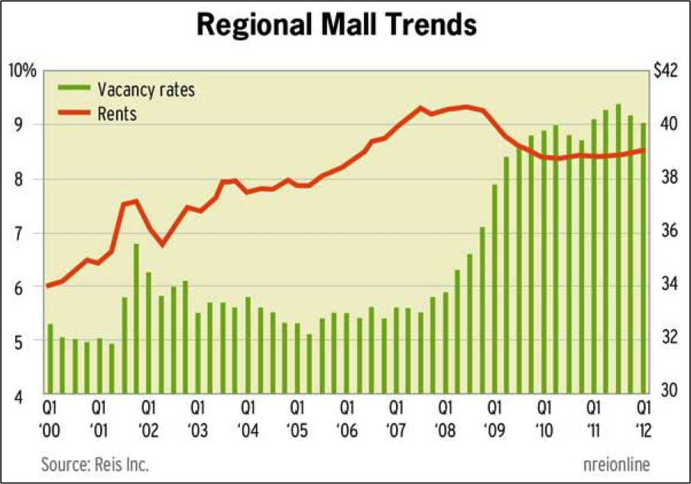
Notes:
Over the long term, more of the sales tax will shift from Big Boxes and enclosed malls to distribution centers and to outlying jurisdictions where retailers will try to capture market share with smaller infill stores.
New opportunities for smaller communities that couldn’t previously accommodate the old formats. Hugh headaches for the previous winners who now have to find ways to fill all that vacant space.

Slide 17
CONSTANT NARROWING OF THE
BASE WITH MORE EXEMPTIONS…
ADMISSION CHARGES FOOD STAMP PURCHASES MOTOR VEHICLE FEES & TAXES SALE & LEASEBACK ARRANGE
AIRCRAFT LEASES (FOREIGN) FOREIGN GOVERNMENTS MUSEUMS SALES FOR RESALE
AIRCRAFT SALES (FOREIGN) FRIENDS OF LIBRARY NEW MOBILE HOMES SAN DIEGO AEROSPACE MUSEUM
ALTERATION OF GARMENTS FUEL - ORGANIC NEW TRAILERS SCHOOL YEARBOOKS
ALTERNATE ENERGY PROJECT FUEL – AIR COMMON CARRIERS NEW VEHICLES – FOREIGN RES SECURITIES
ANIMAL LIFE, FEED, SEEDS FUNGIBLE GOODS NEW VEHICLES – OUT OF STATE SERVICES
ART TRANSFERS (ENTERTAINMENT) GAS, ELECTRICITY, WATER, STEAM NEWSPAPERS/PERIODICALS SPACE FLIGHT PROPERTY
ART WORKS GROUND CONTROL STATIONS NONPROFIT – KID’S CLOTHES STATE GOVERNMENTS
AUXILIARY SVCS TO MUSEUMS HAY PRODUCERS NONPROFIT - AUCTION STORAGE & USE
BLOOD STORAGE UNITS HEALTH/SAFETY MATERIALS NONPROFIT - HANDCRAFTED STUDENT MEALS
BRACELETS - POW HOT FOOD – AIR CARRIERS NONPROFIT – THRIFT STORE TAX-PAID PURCHASES RESOLD
“BUDDY POPPIES” ICE OR DRY ICE NONPROFIT – VETERANS’ ORG TELEPHONE LINES/POLES
CA GOLD MEDALLIONS INDIAN TRIBAL TAXES NONPROFIT – VETERAN MEALS TELEPRODUCTION EQUIP
CA SCIENCE CENTER INSTALLATION LABOR OCCASIONAL SALE - BUSINESS TIMBER HARVESTING EQUIP
CARBON DIOXIDE INTANGIBLE PERSONAL PROP OCCASIONAL SALES TRAILERS – NEW OR USED
CASH DISCOUNTS INTERSTATE/FOREIGM COMMERCE OXYGEN DELIVERIES TRANSPORTATION CHARGES
CHARITABLE ORGANIZATIONS LEASE OF MOTION PICTURES PARENT-TEACHER ASSOC . TRANSPORTATION OF LANDFILL
COGENERATION TECHNOLOGY LEASE, CERTAIN PROP EXCLUDED PARENT COOP NURSERY SCH TRAVEL ACCOMODATIONS
COMMON CARRIERS LEASES OF MOBILE TRANS EQUIP PASSENGER VEHICLES UNITED STATES SALES
COMPONENTS – RAILROAD LEASES OF MOBILE HOMES PERIODICALS USE OF PROPTY HELD FOR SALE
CONSTRUCTION OUTSIDE CA LEASES OF OCCASION. SALE PROP PET ADOPTION USED FLOATING HOMES
CONSUMER COOPERATIVES LEASES PROPERTY – TAX PAID POLLUTION CONTROL USED MOBILE HOMES
CONTAINERS LOANS TO CUSTOMERS POULTRY LITTER VEHICLE MODS - HANDICAPPED
CREDIT – TAX TO OTHER STATES LOCAL TAXES PRESCRIPTION MEDS VEHICLES LOANED TO NIVERSITY
CUSTOM COMPUTER PROGRAMS LODGING PRINTED SALES MATERIAL VEHICLES PURCHASED OUT OF A
DELIVERY TO EXPORT PACKERS MAILING LISTS PRINTING MATERIALS VEHICLES SOLD TO FAMILY
DEMONSTRATION AND DISPLAY MASS COMMUTING VEHICLES PROFESSIONAL HEALTH SVCS VEHICLES SOLD TO FOREIGN RES
DIESEL AND USE FUEL TAX MASTER RECORDS & TAPES PROPERTY LOANED – EDUC VEHICLES SOLD TO LESSEE
DIESEL FUEL – FARM & FOOD PROC MEALS TO ELDERLY/DISABLED PUBLIC PASSENGER VEHIC VEHICLES – SAME OWNER
DONATIONS MEALS BY INSTITUTIONS PURCHASES – FOREIGN CTRY VENDING MACHINE SALES
ENDANGERED ANIMALS/PLANTS MEALS, ELDERLY CONDO PURCHASES FROM UNITED STS VENDING MACHINE SALES - FOOD
EXCISE TAX ON FUEL MEALS, LOW –INCOME ELDERLY RACEHORSE BREEDING VESSELS
FACTORY BUILT HOUSING MEDICAL ID TAGS RAIL FREIGHT CARS VETERINARIANS
FACTORY BUILT SCHOOL BLDGS MEDICAL HEALTH INFORMATION REAL PROPERTY WATER COMMON CARRIERS
FARM EQUIPMENT MEDICATED FEED & WATER RELIGIOUS ORGANIZATIONS WATERCRAFT
FEDERAL EXCISE TAXES MONETIZED/NON BULLION & COINS RENTAL RECEIPTS – OUT OF CA WHEELCHAIRS & WALKERS
FINANCE CHARGES MOTION PICTURE PROD PARTNERS RENTAL – HOUSE FURNITURE WORTHLESS ACCOUNTS
FOOD PRODUCTS MOTION PICTURE PROD SVCS RENTAL – LINEN SUPPLIES YOUTH ORGANIZATIONS
FOOD – VENDING MACHINES MOTOR VEHICLE FUEL RETURNED MERCHANDISE
Notes:
Of course, another factor that will continue to add to the decline is the constant narrowing of the base.
When first adopted in 1933, the rate was 2 2/2 cents but there were only three exemptions: Merchandise sold to the federal government, gold bullion and utilities.....gas, water and electricity. Today, the exemptions fill a book 50 pages long (BOE publication 61) and for those exemptions that they have adequate data, total over $11 Billion per year. Those that they don’t have the data to calculate probably add another $1/2 Billion.
California Alternate Energy and Advanced Transportation Financing Authority about to release guidelines to grant more exemptions for advanced manufacturing projects. Recent State Supreme Court rulings involving Micro Soft and Nortel Networks promises to substantially reduce the taxable values of high tech manufacturing and a representative of the California Association for Local Economic Development told the City Managers a couple of weeks ago that they will be seeking legislation to eliminate sales tax on capital equipment.
All but two of the 45 states that impose sales tax levy it on less goods and services than we do. The smaller the basket of goods that has to absorb the tax, the higher the rate. Now up to !0% in some cities. Hawaii’s sales tax is only 4% but they tax 99% of their economic base. California taxes less than %.

Slide 18

SALES TAX KICKBACKS & THE SHRINKING PIE…..
Bidding of kickbacks for “points of sale” at an all time high… 85% To Owens & Minor, 80% to Kohl’s, 70% to Office Depot, 65% to CDW, 50% to Target Stores, 50% to CEMEX, etc., etc.
20% to 30% of Bradley-Burns revenue pie rebated back to corporate bottom lines.
The smaller the pie, the more desperate the bidding….expect sales tax to shrink even more.
Notes:
In the end, it is a zero sum game. State legislation banned the poaching of big box retailers and auto dealers a few years ago and until recently, sales tax sharing agreements have been primarily used to help seal an unusually difficult project.
However in recent years, the bidding on major business to business sales tax generators has gotten to be huge and is now becoming a major profit center for online retailers of general consumer goods. We now believe that 20% to 30% of the local sales tax is now being rebated back to corporations. The kickbacks rarely expand sales tax revenues. They simply shift from jurisdiction to another while reducing the overall monies available for public services.
Example – Client – tool manufacturer – 25% of tax base. Demand 60% rebate to stay – Jim Starbird – Council adopted holding nose – Three weeks ago – another city hall – shopping agreement to every agency within a 50 mile radius.
Looks smart on an individual basis but from our crows nest watching over 300 plus agencies, it looks like a bunch termites chewing through the bottom of a boat each trying to get a bigger share of the sawdust before it sinks. 50 years local government – most self destructive thing ever seen local governments do.

Slide 19
CITIES WITH TRANSACTIONS TAX DISTRICTS—APRIL 2013
Albany | El Cajon | La Mirada | Paso Robles | San Luis Obispo | Tracy
Arcata | El Cerrito | Lakeport | Pico Rivera | San Mateo | Trinidad
Arroyo Grande | El Monte | Lathrop | Pinole | San Pablo | Truckee
Arvin | Eureka | Los Banos | Pismo Beach | San Rafael | Tulare
Avalon | Fairfax | Mammoth Lakes | Pittsburg | Sand City | Ukiah
Calexico | Fairfield | Manteca | Placerville | Sanger | Union City
Campbell | Farmersville | Marina | Point Arena | Santa Cruz | Vacaville
Capitola | Fort Bragg | Merced | Port Hueneme | Santa Maria | Vallejo
Carmel | Galt | Montclair | Porterville | Santa Monica | Visalia
Cathedral City | Grass Valley | Moraga | Reedley | Santa Rosa | Vista
Ceres | Greenfield | Morro Bay | Richmond | Seaside | Watsonville
Clearlake | Grover Beach | Mount Shasta | Ridgecrest | Sebastopol | West Sacramento
Commerce | Gustine | National City | Rio Vista | Selma | Wheatland
Concord | Half Moon Bay | Nevada City | Rohnert Park | Soledad | Williams
Cotati | Healdsburg | Novato | Sacramento | Sonoma | Willits
Culver City | Hercules | Oakdale | Salinas | Sonora | Woodland
Davis | Hollister | Orinda | San Bernardino | South El Monte
Del Rey Oaks | Inglewood | Oxnard | San Francisco | South Gate
Delano | La Habra | Pacific Grove | San Juan Bautista | South Lake Tahoe
Dinuba | La Mesa | Palm Springs | San Leandro | Stockton
Notes:
Why the conversation now? We are becoming more dependent on a diminishing revenues source. As of the November election, there are 126 municipal transaction tax override districts in 44 county-wide districts. Eight years ago, there were only ten. The State just added another ¼ cent to finance their problems.
By the end of the decade, at least half of the agencies in this room who don’t currently have a transactions act will have one.
We are becoming increasingly dependent on a diminishing tax source that each year, becomes less relevant in this century’s economy.

Slide 20

THE BOTTOM LINE…………….
Demographics and social changes reducing amount of tangible purchases.
Technology converting purchases from tangible to non-taxable intangible goods.
Prices of remaining tangible goods declining.
Future tax growth shifting to Distribution Centers.
Majority of taxes from distribution centers kicked back to corporations instead of public services.
..
………….. NOW WHAT?
Notes:
Not quite as bad as this young Finance Director thinks….
Trends impact only about half of the taxable base – all have different basket of goods.
Population continues to grow. Still need stores to see, touch and taste merchandise and serve as social gathering places.
Inflation will continue and increase once the Feds can no longer subsidize interest rates.
We are still coming out of a recession and will grow for the next couple of years – Christmas quarter in a couple of weeks – dancing in the streets (particularly if you have auto dealers).
What it does mean that growth in sales and use tax revenues will have slowed considerably by the end of this decade and we will not be seeing the gains that we experienced in previous decades. More of the gains will shift to just two or three dozen jurisdictions hosting distribution centers and those two or three dozen will be rebating most of that back to the companies that collect the tax in order to become one of the chosen few.
To keep up with the changes, we are going to have to reevaluate our tax structure and our local economic development strategies.

Slide 21
21st Century
Sales and Use Tax Structure
Lower rates and more economic flexibility from taxing services.
Correct the Nexus deficiency in Transactions Tax Override Districts.
Limitations and standards for Sales Tax Sharing Agreements.
Consider destination based sales tax distribution.
Notes:
Sales tax on less than half of the State’s economic output. Think Long Committee for California: tax everything including services at 5 1/8% and reduce personal income and corporate tax, double homeowners property tax exemption. Sounds regressive. Haven’t seen numbers but they suggest could reduce sales to 3% to 4% would broaden options for creating local tax bases and make tax less regressive. Probably never happen: 1/31/13 survey by Public Policy Institute of California found that only 30% surveyed would support taxing services. Public education efforts would be overshadowed by Millions of dollars spent by opposing industries who currently do no have to collect sales tax from their customers. Schwarzenegger example – Veterinarian services, golf courses, auto repairs.
Nexus issue – Covina/Fairfield example – 5% to 10% loss. With more cities adopted should be looked at.
Sales tax sharing agreements- cities need tools to encourage economic development – sales tax can be just another form of increment – Livermore example. But criteria, standards and limitations. Bidding for just showing up – eating your own.
Need conversation on destination sourcing – 38 of the 45 states – sales tax from brick & Mortar but tax on goods ordered go to taxpayers jurisdiction. Taxpayer gets benefit from tax, eliminates bidding for distribution centers. Cities hosting distribution centers benefit from split tax roll which will probably happen in next few years.

Slide 22
21st Century
Economic Strategies
Updated commercial/retail standards.
Mixed Use – Hotel/Retail, residential/retail, entertainment.
More focus on business and industry.
Diversification, diversification, diversification.
Notes:
Smaller footprints mean new opportunities for smaller cities, new challenges for larger cities.
The man in the trenches – Bob Champion.

Slide 23
(909) 861-4335
www.hdlcompanies.com
Lloyd de Llamas 2/21/13

