Slide 1
2013 CSMFO Pre-conference Training

Slide 2
Revenue Remedies
Topics of the day:
Special Financing Districts
Fees and Charges
UUT, TOT, Sales Tax, etc.
Utility Rates and related charges
And the current legal climate…

Slide 3
Special Financing Districts
Tim Seufert, NBS

Slide 4
Special Financing Districts/SFD’s
Property-related Fees – property owner or voter approved measure to fund capital or maintenance or both
Special or Parcel Taxes/CFD’s – voter-approved (or landowner approval in the case of undeveloped land) mechanism to fund capital or maintenance or both
Assessment Districts – property owner approved District/area to fund capital or maintenance or both
Special Financing Districts

Slide 5
Special Financing Districts/SFD’s
Viva la difference!
Benefit criteria
Approval methods
Funding services and financing infrastructure?
Special Financing Districts

Slide 6
SFD Summary Table
MECHANISM | CAN FUND
1972 Act Landscaping and Lighting | Park maintenance, landscaping, street lighting
1982 Act Benefit Assessment | Flood control / storm drainage, street lighting, street maintenance
1913 / 1915 Act Assessment District | Basic infrastructure; streets, sidewalks, utilities, etc.
Community Facilities District (“CFD,” Mello-Roos) | Services (police, fire, park, library, schools, etc.) and/or infrastructure
Property-related fee | Water, sewer, trash, flood control, stormwater, CSA, etc.
Special Financing Districts

Slide 7
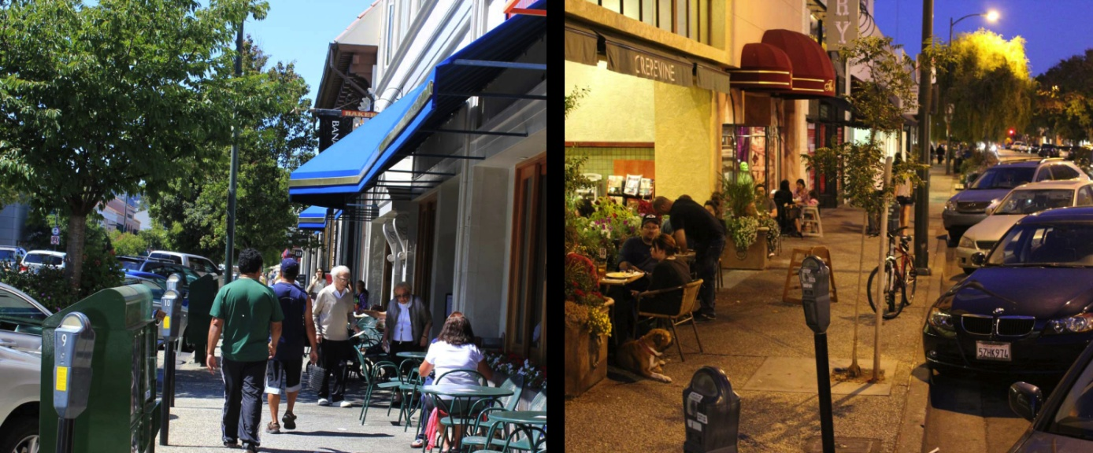
Case Study: City of Burlingame
The Need: Makeover of Burlingame Ave
Funding options:
General Funds
Utility Funds
Street Funds
Special Financing District
Special Financing Districts

Slide 8
MAXIMIZING GENERAL FUND REIMBURSEMENTS through Cost Allocation Plans and User Fee Analysis
Nicole Kissam, NBS

Slide 9
PRESENTATION GOALS
Benefits of enhancing cost recovery through two common revenue tools
  Overhead Cost Allocation
  User and Regulatory Fees
Maximizing General Fund Reimbursements

Slide 10
INDIRECT COST ALLOCATION PLAN
Defines overhead services costs
Allocates costs fairly and equitably to service providing departments
Helps recover overhead costs through:
  fully burdened rates / fees,
  annual transfers, internal service funds
  grant reimbursements,
  charges to outside agencies
May / may not meet OMB A-87 requirements
Maximizing General Fund Reimbursements

Slide 11
EXAMPLE: DEFINING INDIRECT COSTS
Maximizing General Fund Reimbursements

Slide 12
EXAMPLE: RESULTS OF ALLOCATED COSTS
Maximizing General Fund Reimbursements

Slide 13
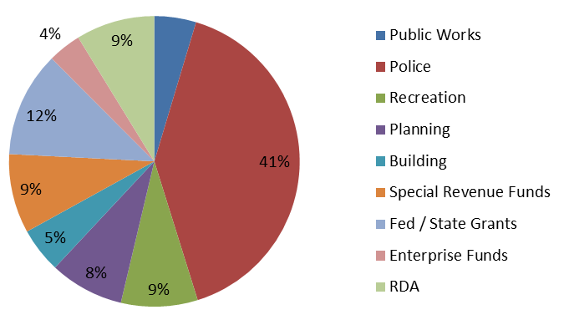
EXAMPLE – RESULTS OF
ALLOCATED COSTS
Maximizing General Fund Reimbursements
Notes:
Geralin – Add animation so each bullet slides in with a click of the mouse / pointer, etc.

Slide 14
USER AND REGULATORY FEES
  User Fees: Charges imposed for a service provided or required due to the request or action of an individual/entity
  Regulatory Fees: Charges imposed to recover costs associated with the City’s power to govern certain activities
  Cost recovery opportunities
  Revenues which the City Council / Board implements
  NOT: Taxes, Fines, Development Impact Fees, Utility Rates, etc.
Maximizing General Fund Reimbursements
Notes:
Geralin space the bullets / resize the text as needed

Slide 15
FEE SETTING GUIDANCE
Proposition 218 Section 6(b)(2)
  “Revenues derived from the fee or charge shall not be used for any purpose other than that for which the fee or charge was imposed”
  Must Pair Revenues to Costs - What are the Costs?
CA Government Code §66014(a)
  “Those fees may not exceed the estimated reasonable cost of providing the service for which the fee is charged”
  Focus on “Estimated Reasonable”
Proposition 26
  Article XIIIC§1(e)(3) Inspections and Regulatory Permits are exempt …however are still limited to the local government’s reasonable costs.
Maximizing General Fund Reimbursements

Slide 16
BENEFITS OF REALIGNING FEES
Reduce General Fund subsidy
Realize revenue for services reduced or eliminated:
  Police and Fire Services
  Recreation Programs for youth & seniors
  Street Maintenance
Fund departments efficiently
Set realistic expectations for cost recovery
Maximizing General Fund Reimbursements
Notes:
Resize text / vary the bullets for indented text

Slide 17
STUDY YOUR FEES
Establish the full cost of providing services for the biggest fee chargers:
Know your true costs
Update fee schedules accordingly
  • Development Services (Building, Planning, Engineering)
  • Public Safety (Police and Fire)
  • Public Works
  • Other Miscellaneous User and Regulatory Fees
Maximizing General Fund Reimbursements
Notes:
Resize text / vary the bullets for indented text

Slide 18
ROAD MAP OF A FEE STUDY
Time Data or Estimates
Total Annual Cost of Service
Time Data or Estimates
Existing Recovery
Direct Costs
Division or Dept-Wide
Budgeted Labor Costs
Fully-Loaded Hourly Rates
Volume Statistics
Cost Recovery Objectives
Data Collection
1. Define Costs
2. Allocate Overhead Costs
3. Calculate the “Full Cost”
4. Set Fee Structure
5. Establish Policy
Indirect Costs
Agency-Wide
Budgeted Non-Labor Costs
Costs by Function of Service
Fee Structures
Targeted Recovery from Fees
Cost of Service Analysis
Fee Design
Key areas of policy input needed from departments and/or management group
Maximizing General Fund Reimbursements

Slide 19
COST OF SERVICE ANALYSIS
Full Cost of Service Recoverable in Fees
Fully-Burdened Hourly Rates for All Personnel Directly Involved in Service
Estimated/Known Time to Provide Individual Service
Substantive / Discrete Materials or Services Incurred
Outcome
x
+
Maximum Fee Amount
Maximizing General Fund Reimbursements

Slide 20
FEE SCHEDULE DESIGN
Select Fee Structure
Apply Cost Recovery Objectives
Flat Fees
Full Cost Recovery from Fees
Variable Fees Based on Project Characteristics
Fiscal Sustainability?
Specific Private Benefit?
Economic Development?
Board Goals / Priorities?
Behavior Modification?
Compliance Concerns?
At-Large Public Benefit?
Variable Fees Based on Actual Time Tracked (with Deposits Managed and Minimum Fees as Needed)
Other Funding Source Subsidy
Maximizing General Fund Reimbursements

Slide 21
Adding Up Subsidies
Building Permit - $480 ($200 Subsidy)
($200 x 860 units = $172,000)
Zoning Variance - $165($95 Subsidy)
($95 x 1350 units = $128,250)
Impound Release - $75 ($60 Subsidy)
($60 x 3400 units = $204,000)
Who wants to leave $500K on the table?
Maximizing General Fund Reimbursements

Slide 22
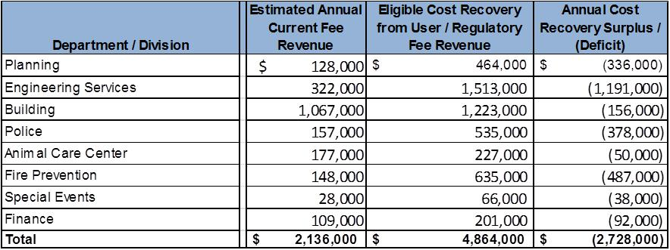
Summary Results for Fee Related Services
Adopting all User/Regulatory fess would reduce the annual General Fund subsidy of these services by $2.7 Million
The Fee Study analysis provides information needed to re-align fees to collect the “true” full cost
Maximizing General Fund Reimbursements

Slide 23
COST RECOVERY POLICY AND FINANCIAL STABILITY
Established cost recovery policy helps:
  Attain revenue stability
  Raise awareness about costs, and subsidies
  Provide necessary and basic services
  Enhance service delivery
  Build confidence in local government
  Streamline the on-going fee setting process
Maximizing General Fund Reimbursements

Slide 24
COST RECOVERY POLICY AND FEE SETTING - 1
Maximum Level of Targeted Cost Recovery (100%)
Full Cost of Service ($)
Amount of Subsidy from Other City Resources (%)
Current Level of Cost Recovery (%)
Revenue from Current Fee ($)
Minimum Level of Targeted Cost Recovery (0%)
Maximizing General Fund Reimbursements

Slide 25
COST RECOVERY DECISION MATRIX
Fees should be assessed according to the individual or private benefit gained:
GENERAL BENEFIT
SPECIFIC BENEFIT
RECREATION/ COMMUNITY SERVICES
BUILDING PERMITS
POLICE
PLANNING AND ZONING APPROVAL
PARK MAINTENANCE
FIRE SUPPRESSION
ENGINEERING DEVELOPMENT REVIEW
TAX FUNDED
FEE FUNDED
Maximizing General Fund Reimbursements
Notes:
Geralin – we need to come up with a completely redesigned graphic for the table shown. Can you think of a more creative format / put something together? We need this for future use in PPTs

Slide 26
New Revenue
Opportunities
Transactions & Use Tax
Utility User’s Tax
Transient Occupancy Tax
Business License Tax
Doug Jensen, MuniServices

Slide 27
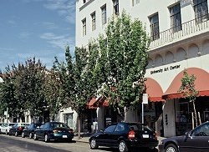
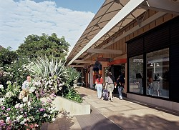
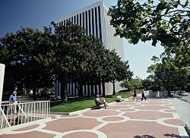


Local Governments’ Fiscal
Self-Reliance
X
=
Tax Structure
Economic Base
Operational Budget
Sales/Use
Property
Utility Users
TOT
Franchise Fees
Land
Buildings
Personal Property
Users
  Commercial, Industrial, Residential, Institutional, Governmental
New Revenue Opportunities

Slide 28
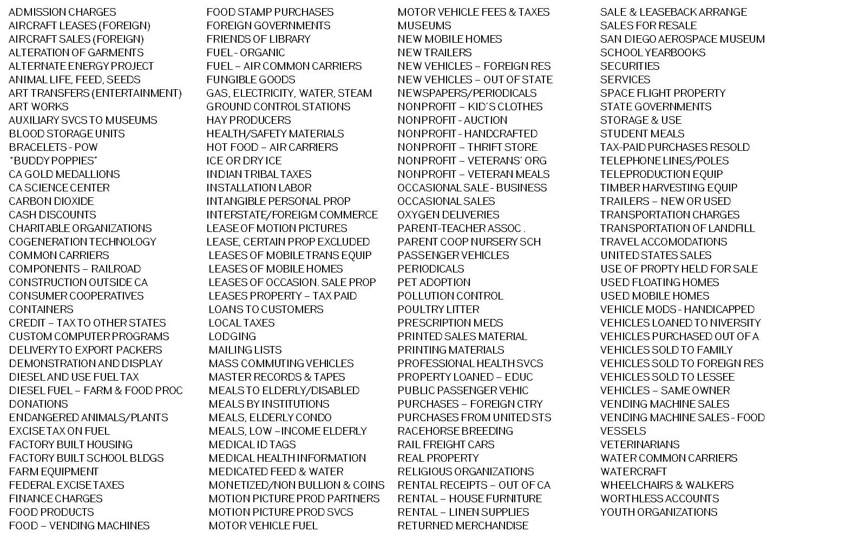
STATE LOCAL/FISCAL RELATIONSHIP
State Takeaways from Local
Governments (2001 – 2012)
Over $21.6 Billion Siphoned from Locals
to State!
ERAF Property Tax Shifts ($10.6 Billion)
Booking Fees & Prop Tax Admin ($1.1 Billion)
Business Inventory Exemption Reimbursements ($3.7 Billion)
Financial Aid to Local Agencies (Bank In-Lieu) ($1.76 Billion)
Liquor License Fees ($484 Million)
Redevelopment Tax Increment first year alone over $4 Billion
State Granted Sales Tax
Exemptions
When Sales Tax started in 1933 there were
only three exemptions
Now the exemption list is
over 50 pages long
Sales Tax rate was 2.5%
Base now at 7.5% ranging up to 10.0%
New Revenue Opportunities

Slide 29
EVALUATION OF REVENUE OPTION FOR YOUR AGENCY
EASE: evaluating potential local revenue sources
Equity: the tax burden falls equally across all businesses and/or individuals.
Administrability: minimized cost of compliance on taxpayers, minimizing costs to the City of enforcing tax policy and maximizing taxpayer compliance.
Stability: Focuses on how the tax in question would affect the volatility of the revenue.
Economic Benefits: Promotes City’s economic objectives and minimal disruption on taxpayers. Economically efficient.
New Revenue Opportunities

Slide 30
FOUR COMMON OPTIONS
  Transactions and Use Tax (District Tax): District taxes are not an increase in sales taxes. It’s entirely different and based on the buyer’s zip code (destination).
  Utility Users Tax: UUT ordinances have generally followed the IRS rules in applying the federal excise tax but new “modern” ordinances are written to deal with both the repeal of the FET and changing technologies.
  Transient Occupancy Tax: TOT ordinances are common throughout the country. Average rate is around 10%. Many cities still have rates below 10%.
  Business License Tax: Cities are exploring the option of implementing a modified business tax program. Comparative analyses and surveys of business tax fees and classifications are critical.
New Revenue Opportunities

Slide 31
BACKGROUND MATERIALS (deeper dive into 4 options)
 | Equity | Administrability | Stability | Economic Benefits
Transactions & Use Tax | No | Yes | No | Yes
UUT | Yes | Yes | No | Yes
TOT | No | Yes | No | Yes
Business License | Yes | Yes | Yes | Yes
New Revenue Opportunities

Slide 32
NEW REVENUE FROM SOLID WASTE
  Financial and Operational Audit: Cities of every size are losing money every year to solid waste haulers. Financial audits only uncover a portion of lost revenue. Operational audits uncover the revenue loss you would never find in a financial audit.
  Permit Program: Legislation requires Cities to track solid waste and recycling disposal in their jurisdictions, even waste not collected by franchised haulers. A permit program, when conducted the right way, not only generates revenue, but also identifies data for State reporting requirements.
  Administration: Cities can improve practices, increase revenue and minimize expenditures through outsourcing administration of solid waste hauler contract management, audit and permit program.
New Revenue Opportunities

Slide 33
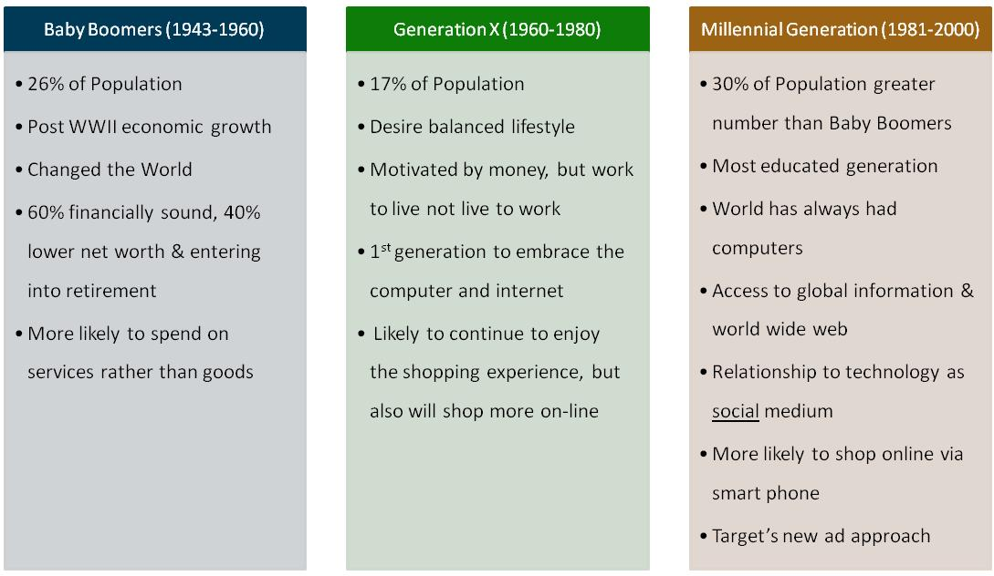
GENERAL COHORTS’ IMPACTS ON SALES TAX
New Revenue Opportunities

Slide 34
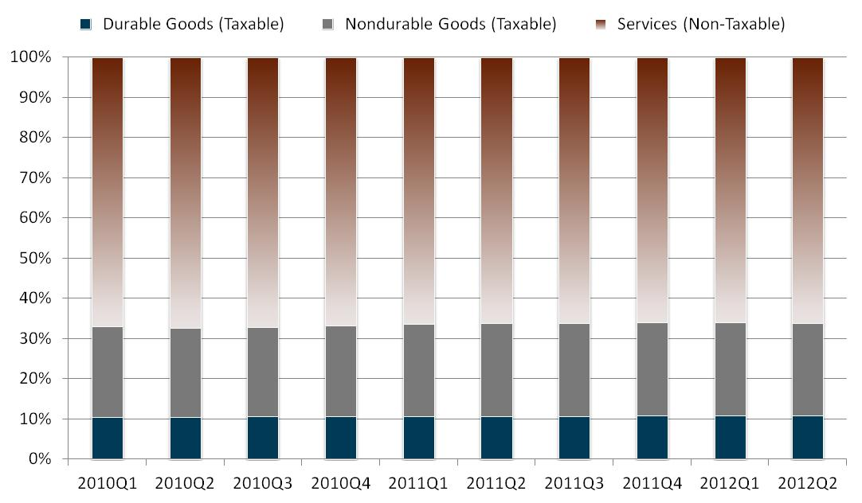
CONSUMER SPENDING – GOODS VS. SERVICES
New Revenue Opportunities

Slide 35
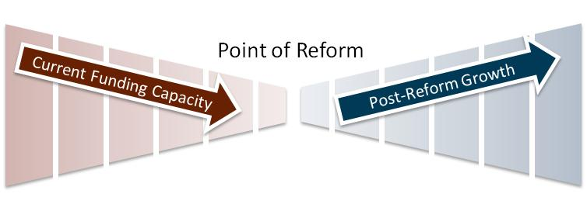
TAX STRUCTURE ALTERNATIVES
Eroding Funding Capacity:
Dwindling Taxable Base
Changing Economy
Structural Deficits
Options:
Expand sales and use tax to services and lower rate
Statewide business tax
Broaden sales tax base
Challenges:
Politically next-to-impossible
Equitable
Opposing interests
Local 1% Bradley Burns, YE 2Q 2012 | Local 1% Bradley Burns, w/ Expanded Base
5,398,323,789 | 11,246,507,894
triple flip withhold -1,362,696,728
Net Cash Statewide 4,035,627,061 | 8,407,556,377
New Revenue Opportunities

Slide 36
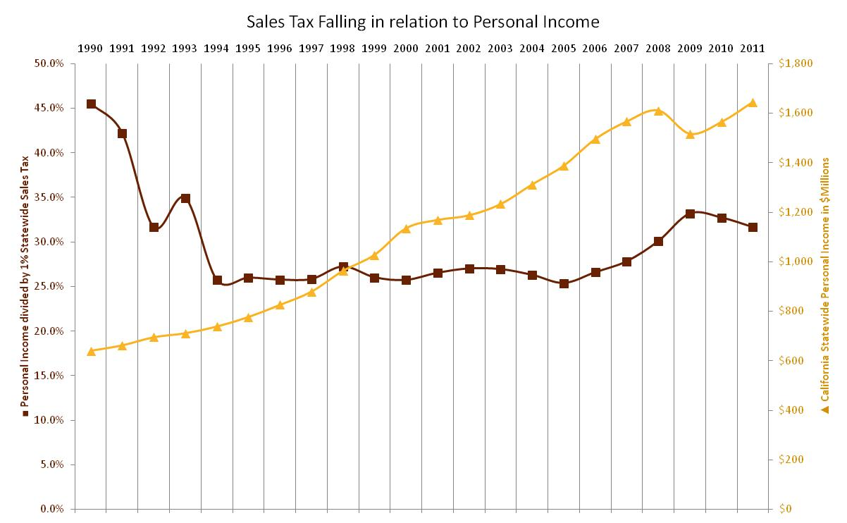
RESULTS ON SALES & USE TAX
New Revenue Opportunities

Slide 37
POTENTIAL WATER/SEWER UTILITY REVENUE REMEDIES
Greg Clumpner, NBS

Slide 38
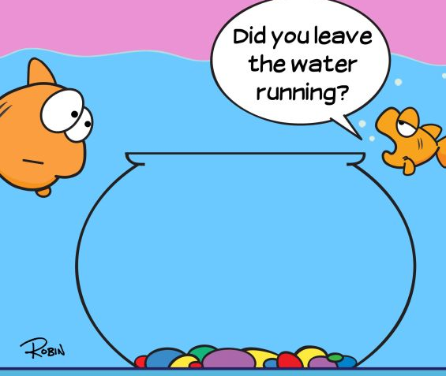
1. ACCOUNT VERIFICATION/ RECLASSIFICATION
Most Agencies rarely (if ever) field verify water/sewer accounts or classifications
Master-metered commercial accounts in particular are prone to errors in classifications and missing accounts (i.e., changes aren’t reflected in billing system)
There are typical at least some accounts that receive service but are never billed
Potential Water/Sewer Utility Revenue Remedies

Slide 39

2. METER REPLACEMENT PROGRAMS
As water meters age, they typically “under-read”, resulting in lost revenue
Several meter/equipment venders (e.g., Johnson Controls) offer meter replacement programs:
  No upfront costs to the agency
  Replacement of older meters, particularly older & larger meters
  Additional revenue is used to pay for meters
  There is a guaranteed net revenue gain
Potential Water/Sewer Utility Revenue Remedies

Slide 40

3. RATE DESIGN AND REDUCTIONS TO PEAK WATER DEMANDS
Water systems are designed to meet “Peak Demand” (summer use)
As Conservation-based water rates are implemented (e.g., multi-tiered and water-budget rates), reducing peak demands……and lowering costs
ALSO…Capital improvement programs (Master Plans) should be re-visited, and some capacity-related project might be delayed because of reduced peak demands
Potential Water/Sewer Utility Revenue Remedies

Slide 41
4. UPDATE OF CUWCC BMP #1.4
BMP #1.4 “Requires” 70% of water rate revenue come from volumetric charges
This has produced revenue instability in many water agencies (e.g., EID lost 18% of rate revenue due to a cool/wet spring/summer after adopting this 70/30 rate design approach (changed back to a 50/50 rate design)
  This change actually stabilized their rate revenue and resulted in higher credit rating and lower borrowing costs
Potential Water/Sewer Utility Revenue Remedies

Slide 42

4. UPDATE OF CUWCC BMP #1.4
For other agencies
(e.g., North Coast, Tahoe area) this approach makes no sense (“We’ve got 10 times more water than we could ever sell – why should we emphasize conservation?” - )
BMP #1.4 is “under review” and likely will be softened to offer more flexibility and reduce the negative impacts, particularly on a “case-by-case” basis
Potential Water/Sewer Utility Revenue Remedies

Slide 43
5. CONSIDER RESTRUCTURING FACILITY OWNERSHIP
Service areas (water and sewer) typically follow a “postage-stamp” rate principle (same rates for all customers within each customer class, regardless of differences in the facilities serving them)
BUT…Some facilities (WTP, WWTP) may serve a specific part of the service area, and have much lower average costs than older, higher cost facilities)
Creation of a new agency (e.g., CSD) could isolate benefits to particular customers (in the area served by lower-cost facilities) could reduce monthly bills to those customers
Potential Water/Sewer Utility Revenue Remedies

Slide 44
UPDATE ON THE LAW OF PUBLIC REVENUES
Michael Colantuono, Colantuono & Levin

Slide 45
TAXES
Many proposals to amend Prop. 13 to allow some or all special taxes on 55% rather than 2/3 vote
  ACA 3 police and fire services and facilities, SCA 3 school services, SCA 4 & 8 transportation, SCA 7 libraries, SCA 9 economic development SCA 11 for all special taxes
Update on the Law of Public Revenues

Slide 46
UTILITY USERS TAXES
Ardon v. City of LA (Cal. S. Ct. 2011)
  Los Angeles lacked ordinance imposing local claiming requirement
  Gov’t Claims Act does not prohibit class claims for refunds of taxes and fees
McWilliams v. Long Beach (pending)
  Does Gov’t Claims Act preempt local claiming ordinances that expressly bar class & representative claims
Update on the Law of Public Revenues

Slide 47
UTILITY USERS TAXES (cont.)
Sipple v. City of Alameda & 134 other UUT Agencies
  AT&T / New Cingular Wireless settled consumer class action in Illinois, agreeing to refund taxes on wireless packages that included internet due to preemption by Internet Tax Freedom Act of 2009
  AT&T sued all California agencies w/ telephone taxes in Los Angeles Superior Court in July 2011
  Demurrer granted; on appeal
Update on the Law of Public Revenues

Slide 48
UTILITY USERS TAXES (cont.)
Federal Legislation Proposed to Bar New or Amended Cell Taxes above 1% for 5 years
  HR 1002 (Lofgren, D-San Jose)
  S 543 (Wyden, D-OR)
  Passed House; died in Senate Finance Comm.
  Exempts: “a local jurisdiction tax that may not be imposed without voter approval, provides for at least 90 days’ prior notice to mobile service providers, and is required by law to be collected from mobile service customers.”
Update on the Law of Public Revenues

Slide 49
UTILITY USERS TAXES (cont.)
Federal Legislation to Regulate Fees on Phone service to fund 911 services
  HR 2788 (Davis, D-Chicago)
  Never got out of committee in 2012
  Intended to exempt calling cards and other pre-paid services from 911 fees so these fees are borne by consumers, but not by carriers
Update on the Law of Public Revenues

Slide 50
UTILITY USERS TAXES (cont.)
A.B. 1050 (Ma, D-San Francisco)
  Clarifies collection of State and local telephony taxes on calling cards and other prepaid services
  Could resolve substantial litigation industry has brought against LA and others on this issue
  Died in Senate Committee in June ’12
  Likely to return in next session
Update on the Law of Public Revenues

Slide 51
Sales & Use Taxes
Marketplace Fairness Act, S 1832
  Introduced 2011 by Enzi (R-WY), never got out of Senate Committee, 11 bi-partisan cosponsors (not Feinstein or Boxer)
  internet retailers w/ sales >$500k to collect state & local sales & use taxes consistently w/ Streamlined Sales & Use Tax Agreement
AB 155 (Calderon, D-Whittier)
  Adopted R&T 6203 to require web retailers to collect sales & use taxes
Update on the Law of Public Revenues

Slide 52
Transaction & Use Taxes
AB 686 (Huffman, D-San Rafael)
  Authorizes Transactions & Use Taxes (i.e., local sales taxes) in ⅛ % increments
  Previously only ¼ % increments were permitted
  Effective 1/1/12
Update on the Law of Public Revenues

Slide 53
Prop. 218 & Annexation
Citizen’s Ass’n of Sunset Beach v. Orange County LAFCO (4th DCA 2012)
Ass’n challenged LAFCO approval of island annexation for lack of election to approve extension of Huntington Beach’s taxes into annexation area
  Citing Prop. 13 precedent, court found no election required
  Supreme Court refused review
Update on the Law of Public Revenues

Slide 54
Fines are not Taxes
Cal. Taxpayers Ass’n v. FTB (3rd DCA 2010)
  20% penalty on late corporate taxes raising $1.4b not a tax requiring 2/3 vote of Legislature
  Distinguishing characteristics: label, revenues diminish over time, triggered by violation
  No need for findings or good faith defense; post-payment remedy sufficient
  Relevant to Prop. 26 analysis
Update on the Law of Public Revenues

Slide 55
Flood Control & Water Quality Fees
Greene v. Marin County Flood Control Dist., (Cal. S. Ct. 2010)
  Ballot secrecy does not apply to 218 elections on property-related fees for things other than water, sewer and trash
  218 Omnibus Implement’n Act is good authority
  Deference to local procedural rules on property-related fees
Update on the Law of Public Revenues

Slide 56
Water Fees
City of Palmdale v. Palmdale Water District (2nd DCA 2011)
  City challenged conservation water rates, claiming Prop. 218 disallows them
  DCA found 218 and Constitutional provision against wasting water could be harmonized but struck down PWD rates as insufficiently justified
  Caution required when constructing conservation rates
Update on the Law of Public Revenues

Slide 57
Prop. 218 & Water Rates
Morgan v. Imperial Irrigation, Dist., 4th DCA Case No. D061087
  Are farmers entitled to separate protest vote on water rates imposed on domestic, municipal, industrial and agricultural water customers?
  Farm Bureau and local farmers sued; trial court ruled for plaintiffs; IID appealed
  ACWA, League amicus support for IID
  Fully briefed 7/11/12
Update on the Law of Public Revenues

Slide 58
Initiatives & Water Rates
Mission Springs Water District v. Verjil, 4th DCA Case No. E055176
  Initiative to reduce water rates, bar increases for a year and limit future increases
  Registrar certified petition & District filed decl. relief action to prevent election; trial court denied HJTA’s demurrer & anti-SLAPP motion
  HJTA appealed and case fully briefed as of 7/05/12
Update on the Law of Public Revenues

Slide 59
Sewer Fees
AB 2567 (Carter, D-Rialto)
  Amends GC 53756 to add “wastewater” and “wastewater treatment”
  This allows these agencies to set rates under Prop. 218 and to include inflation-adjustment mechanisms in rate schedules without new Prop. 218 proceeding until sooner of:
    Five years
    Increase beyond the inflation adjusted rate
Update on the Law of Public Revenues

Slide 60
Solid Waste Fees
Torres v. Arakelian Enterprises, 2nd DCA Case Nos. B246515, B246526
  Trial court invalidated award of exclusive franchise for failure to comply with Prop. 218 in setting rates
  Residential fee collected by city
  Appeal in earliest stages in February 2013
Update on the Law of Public Revenues

Slide 61
Solid Waste Fees
SB 713 (Wolk, D-Davis)
  Prevents enforcement of solid waste franchise provisions requiring hauler to indemnify franchising city or county for violations of Prop. 218 with respect to rate-setting
  Adopts Pub. Res. C 40059.2
  Effective 7/1/12
Update on the Law of Public Revenues

Slide 62
Development Impact Fees
Trinity Park, LP v. City of Sunnyvale
(6th DCA 2011)
  Developer challenge to inclusionary housing condition of approval time-barred
  90-day period for challenges to development permits applied rather than 180-day limit of Mitigation Fee Act

Slide 63
Green Building Permit Fees
A.G. Op. No. 09-903 (12/27/2011)
  HSC 18931.6 requires building departments to collect $4 / $100k in project value to fund the State Bldg. Stds. Comm.’s green building standards
  AG opined these were proper fees and not taxes
  Does not consider Prop. 26 b/c statutes dates from 2009 – before Prop. 26’s retroactive date for the state

Slide 64
Vehicle License Fees
California Department of Finance v. Grimes, Orange Co. Sup. Ct. Case. No. 30-2012-00559592
  State challenge to O.C. withholding property taxes based on challenge to SB 89
  Trial set for 1/28/13
Update on the Law of Public Revenues

Slide 65
Business License Fees
AB 619 (Halderman, R-Fresno)
  Limits business license regulatory fees (not taxes) on massage businesses to the amount of the fee imposed on other “professional services” businesses
  Effective 1/1/12
Update on the Law of Public Revenues

Slide 66
Prop. 26
Griffith v. City of Santa Cruz (6th DCA 2012) Challenge to fee on landlords for housing code enforcement
  Court found no violation of equal protection, 218 or 13
  Helpful discussion of burden of proof under 26, practical application of licensing exception, applies pre-26 regulatory fee case law
Update on the Law of Public Revenues

Slide 67
Prop. 26 Litigation
Citizens for Fair REU Rates v. City of Redding (3d DCA Case No. C071906)
  Challenge to electric utility PILOT
  City won on ground that 26 not retroactive; appeal pending
Bauer v. Harris (E.D. CA No. 11 CV 01440)
  Challenge to gun registration fees under 2nd Amendment and Prop. 26; to be tried 1/28/14
Update on the Law of Public Revenues

Slide 68
Prop. 26 Litigation (cont.)
Schmeer v. County of Los Angeles 2nd DCA Case No. B240592
  Challenge to provision of plastic bag ban requiring retailers to charge $0.10 for paper bags
  Trial court concluded this was not a government fee subject to Prop. 26
  Argued 2/5 and looks like County victory
Other challenges pending in San Luis Obispo & San Francisco
Update on the Law of Public Revenues

Slide 69
Assessments
Silicon Valley Taxpayer’s Ass’n v. Sta. Clara Co. Open Space Auth. (Cal. S. Ct. 2008)
  Independent judicial review of assessments
  Tighter definition of special benefit
  Open space and other services that benefit public broadly harder to justify
  Proportionality requirement unclear
Update on the Law of Public Revenues

Slide 70
BID Assessments
Dahms v. Downtown Pomona PBID
(2nd DCA 2009), allows:
  exemption of residential pty from assessment for security, streetscape maintenance & marketing
  discounted assessments for non-profits
  use of front-street frontage for apportionment, along with lot & building size
  Very generous to agency; later cases less so
Update on the Law of Public Revenues

Slide 71
Utility Undergrounding Assessments
Tiburon v. Bonander (1st DCA 2010)
No general benefit for utility undergrounding
Court can look outside agency’s own record
Invalidated allocation of assessment and establishment of zones of benefit
Update on the Law of Public Revenues

Slide 72
Park Assessments
Beutz v. Riverside Co. (4th DCA 2010)
Park M&O can be 100% assessment financed b/c capital provided with other $
Agency must always prove special benefit and proportional allocation even if challenger doesn’t raise these points
Questions use of cost to allocate benefit
Update on the Law of Public Revenues

Slide 73
Fire Suppression Assessments
Concerned Citizens v. West Point FPD
Cal. S. Ct. Case No. S195152
Sufficiency of engineer’s report to show special benefit or proportionality
Use of cost to allocate benefit
Dismissed as moot and DCA opinion not republished
Update on the Law of Public Revenues

Slide 74
Maintenance Assessments
Golden Hill Neighborhood Ass’n v. City of San Diego (4th DCA 2011)
  Invalidated maintenance district under 1972 Lighting & Landscaping Act for inadequate engineer’s report (no basis for allocation of votes to City property)
  Helpfully limited DCA’s West Point decision and provides guidance for engineers’ reports
Update on the Law of Public Revenues

Slide 75
Advice re Assessments
Use a strong, current engineer’s report
Get legal review of reports at least until assessment law stabilizes
Watch for current developments

Slide 76
Questions?
Update on the Law of Public Revenues

Slide 77
Contact Information
Greg Clumpner, NBS
Michael Colantuono, Colantuono & Levin
Doug Jensen, MuniServices
Nicole Kissam, NBS
Tim Seufert, NBS
(P) 800.676.7516
(E) gclumpner@nbsgov.com
(P) 530.432.7357
(E) mcolantuono@cllaw.us
(P) 800.800.8181
(E)doug.jensen@muniservices.com
(P) 800.676.7516
(E) nkissam@nbsgov.com
(P) 800.434.8349
(E) tseufert@nbsgov.com

