Slide 1
What To Do When Revenue Is Up: Being Strategic About Expenditures
CSMFO Conference
February 21, 2013

Slide 2
PRESENTERS
Jan Perkins, Senior Partner, Management Partners
Mike Parness, City Manager, Napa
Mark Danaj, Assistant City Manager/COO, Fremont

Slide 3
Session Purpose
Once revenues begin to pick up, there will be many claims on those new revenues. Cities will be well served by planning for this "good news" rather than waiting for the loudest or first voices who will attempt to direct where new spending will go.
Learn how to create a strategic recovery plan for your city.

Slide 4
Economy is Picking Up

Slide 5
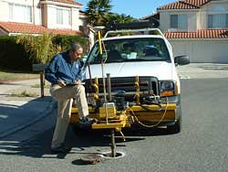
Cities Have Many Pent Up Demands
Compensation
Park maintenance
Facilities
Sidewalks and streets
Staffing
Technology
OPEB

Slide 6
Strategic Plan for Economic Recovery
Four Key Components
Multi-year financial forecast (revenue, expenditures and growth trends)
Principles (underlying bases for allocating resources)
Top priorities
Allocation plan

Slide 7

Multi-Year Financial Forecast
1. Revenue:
  Likely new dollars: sources, amounts, when they will flow in
  Identify factors that could affect actuals
2. Expenditures:
  Cost drivers
  New facilities, capital expenditures, deferred maintenance
  Pent up community demands
  Labor expectations

Slide 8
Set Principles to Frame the Plan
Examples:
  Use one-time revenue for one-time purposes
  Do not allocate all expected dollars because new costs or unexpected State takeaways could happen (e.g., allocate only 50% of expected new ongoing revenue in first year)
  Allocate dollars for the basics
  Consider dedicating RDA “boomerang” funds for economic development

Slide 9
Identify Priorities
Internal City Services
Recruitment and Retention
Training
Protection of City Assets
New Facilities
Community Services
Mandates
Reserves
OPEB funding
Post-RDA World

Slide 10
Create Allocation Plan
This is the plan for how new dollars will be allocated
Should be flexible enough to adjust to changing revenue and expenditure realities
Multi-year plan – with allocations planned for each year based on principles and priorities

Slide 11

City of Napa
We’ve been through some tough times
Now the economic outlook is more positive
Significant deferred needs
  Community services
  Internal services and support functions
  Capital improvements
  Maintenance

Slide 12
Our Audience
Council – what they see as important to the community
Employees – they’ve given up compensation, many are doing two and three jobs
Public – they have needs and interests
Development community – we’ve lost RDA and yet economic development requires investment in infrastructure

Slide 13
Emerging Themes for Us
Our financial outlook is improving
Bargaining units have collaborated on major cost reductions
Addressing inefficiencies require major investments
Service enhancements are needed
Infrastructure requires ongoing investment
We should seize opportunities to purchase property before prices go up
Long range planning is critical

Slide 14
Our Process
Where Are We – Where Are We Going
Long Term Financial Plan
  Updated revenue and expenditure assumptions
  10 years trends & 6 year forecast
  Identified realistic capacity for budget growth

Slide 15
Our Strategic Recovery Plan
Principles for Decision Making
Six year horizon – becoming the basis for future budgets
Principles
  Fiscal Sustainability
  Back to Basics
  Service Enhancements
  Economic Vitality
  Long Term Vision
  Infrastructure Investments

Slide 16
Our Strategic Recovery Plan
Council Core Strategies
Financial Stability
Organizational Efficiency and Stability
Economic Vitality & Sustainability
Addressing Service Needs

Slide 17
Evaluation of Priority Options
Financial Stability
  Employee compensation
  Risk Management program enhancement
  Finance system improvements
Economic Vitality & Sustainability
  Development Plan for Soscal Corridor
  Infrastructure financing
  Implement Sustainability Plan
Organizational Efficiency and Stability
  Charter Revision
  Employee development plan
  City-wide records system
Addressing Service Needs
  Fire Station #5
  Downtown Police beat
  Parking Plan
  Restore Park Maintenance

Slide 18
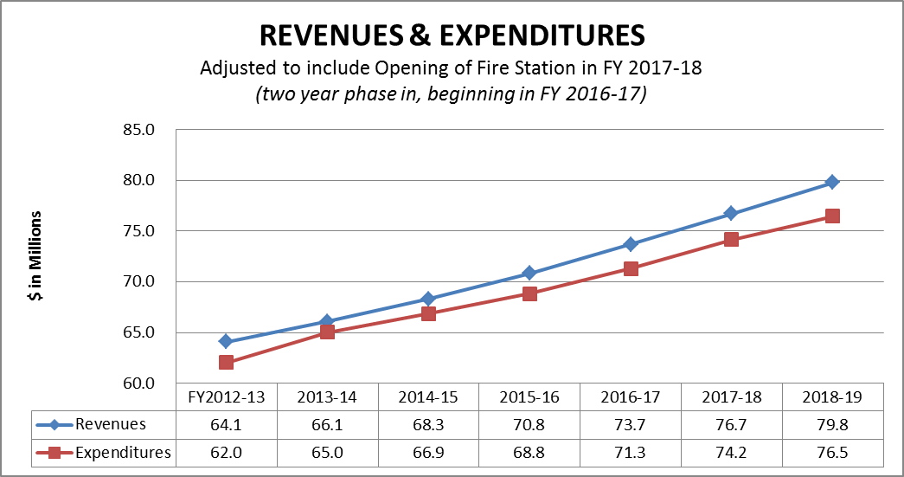
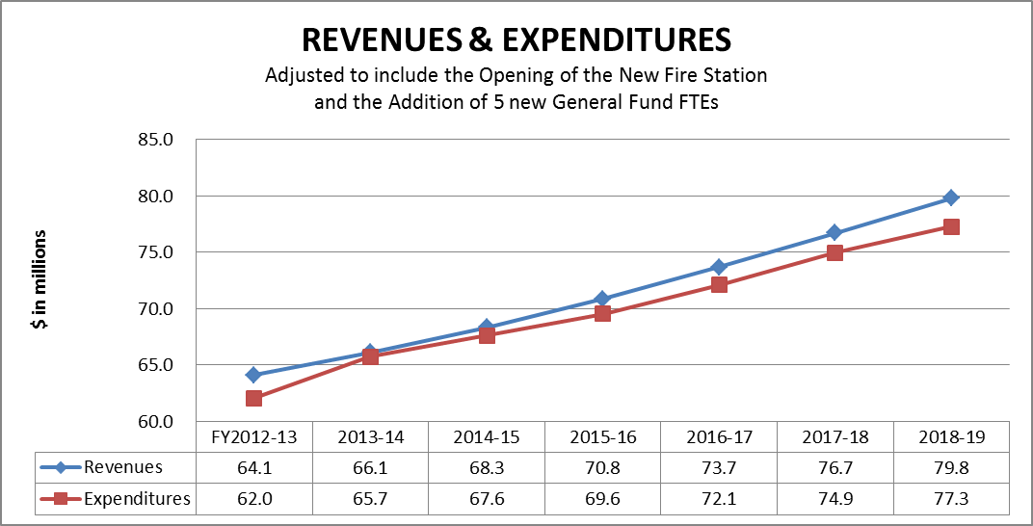
Impact of decisions
Budget Scenarios
Management team retreat to discuss priorities going forward
Workshop with City Council to hear their priorities and analyze impacts

Slide 19
What We’ve Learned
The process in a downturn should be the same in a growth period
  Long Term Financial Plan - annual updates, with trend analysis to tie numbers to decisions made
  Balanced, strategic approach, with focus on long term sustainability
  Quarterly updates
Include stakeholders in strategy process
  “What you focus on determines what you miss”
Sound financial practices should be the bedrock of decision making in good times and bad
  Fiscal policies

Slide 20
City of Fremont
Very similar to Napa
From famine to (something short of a) feast
  Elimination of structural deficit
  RDA boomerang funds coming in sooner than expected
How do we ensure we don’t go back to the old way of doing business?
Managing employee expectations after concessions

Slide 21


Unmet Needs
Unmet Need | Additional Funding Needed
Street Maintenance | $10.5 million annually
Deferred Maintenance of Existing Capital Assets (other than streets) | $1 million (at least) annually
Economic Development: Downtown Plan | $500,000 (at least) annually
*South Fremont/Warm Springs | $250,000 (at least) annually
Public Safety Needs: Open Fire Station 11 | $1.7 million annually
Add 3-6 Police Officers | $960,000 annually
Other Post-Employment Benefits (OPEB) | $3.9 million annually
*Additional Library Hours (4 hours on Sundays at the Main Library) | $240,000 annually
TOTAL | $19.1 million (at least) annually
* New Additions to Unmet Needs
FY 2012/13 Budget Update
December 4, 2012
Notes:
HARRIET
This slide is our list of unmet needs, as discussed with Council in May. To that list, we’ve added two items. One is an acknowledgement of a funding need for the South Fremont/Warm Springs project. This amount is a placeholder – it’s quite likely the amount will need to be much larger as the project becomes more defined. The other item is the result of Council’s willingness to consider funding additional Sunday library hours at the Fremont Main Library, which was indicated during the July 10, 2012 session. This list is also informed by a community survey that was undertaken this past spring. The results of that survey both validate and align with the Council’s list of unmet needs. For example, two of the highest priorities in the community are public safety and economic development. In addition, a concern noted within the community survey is the level of street maintenance, which is clearly identified on the unmet needs list here.
As a reminder, the number of additional Police Officers noted on this list has been reduced by 4, as a result of Council action on September 4, 2012 to add 4 police officer positions to the budget.

Slide 22
Unmet Needs List
Balanced approach
Transparency going in, coming out
  Council
  Community
  Senior staff
  Employees
Controlling guide for future funding

Slide 23
What We’ve Learned
Preserve the hard-fought BPR gains
Meter in the “new” funds with sound financial practices
Present an alternative picture without RDA
Identify your post-RDA strategies

Slide 24

The Change from Deficit to Surplus is Mainly Due to the RDA Wind-Down
Dollars in Millions | 2012/13 Update December 2012 without RDA | 2012/13 Update December 2012 with RDA | Difference
Revenue and transfers in | $132.4 | $145.7 | $13.3
Expenditures and transfers out | 133.4 | 133.4 | 0.0
Begin to fund unmet needs:
RDA : One-time |  | 5.1 | 5.1
RDA Housing: One-time |  | 2.7 | 2.7
Strategic Investment Opportunities |  | 2.0 | 2.0
Net results of operations | (1.0) | 2.5 | 3.5
Encumbrances | 0.0 | 0.0 | 0.0
Beginning Fund Balance | (1.0) | 2.5 | 3.5
Ending Fund Balance | ($2.0) | $5.0 | $7.0
FY 2012/13 Budget Update
December 4, 2012
Notes:
HARRIET
Just to recap - this slide summarizes the information from the last two slides in one place, to more clearly show the impact of the one-time and on-going RDA property tax revenues. Again, of the $13.3 million (9.1% of the total revenue and transfers in) in additional revenue, $7.8 million of that is one-time, while $5.5 million of it is ongoing. With this additional RDA property tax revenue, it will be possible to begin to fund both one-time and ongoing unmet needs.
Consistent with the Budget Principles adopted by Council in June, it is highly recommended (best practice) that one-time money only be used to fund one-time needs, while on-going funding can be used for either on-going unmet needs or one-time needs. Because the property tax revenue that went to the former RDA was used for Housing and Economic Development purposes, Council may want to consider keeping the one-time AND MUCH OF THE ON-GOING revenue from that source aligned and used for those needs.

Slide 25

Audience Comments and Questions
Who in the audience is also beginning to create a plan to allocate new resources?
How are you going about it?
What challenges are you facing?
What successes are you having?

Slide 26
Thank You
Mike Parness, City Manager, City of Napa – mparness@cityofnapa.org
Mark Danaj, Assistant City Manager/COO, City of Fremont – mdanaj@fremont.gov
Jan Perkins, Senior Partner, Management Partners – jperkins@managementpartners.com

