Slide 1

Crossing the line
February 18, 2015
CSMFO ANNUAL CONFERENCE
Identifying Fraud in Government

Slide 2
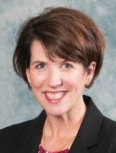
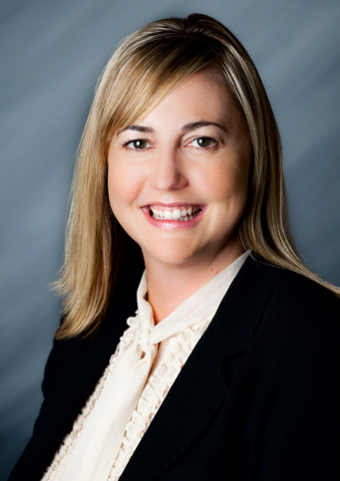
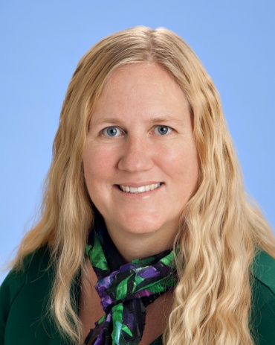
The judges
Debby Cherney, CPA, MBA
Deputy General Manager, Eastern Municipal Water District
EMWD provides water and wastewater services to a population of 785,000 people in Western Riverside County. In her capacity as Deputy General Manager, Debby has oversight responsibility over all of the Administrative Services functions of the District.
Jennifer Farr, CPA, MBA
Shareholder, Mayer Hoffman McCann P.C.
Jennifer has been with Mayer Hoffman McCann for the past 17 years focusing on local government and nonprofit auditing. Jennifer is the Attest Practice Leader of the Orange County Office. She is responsible for developing the local government audit methodology and training for the National office.
Margaret Moggia, CPA, CGMA
Chief Financial Officer, West Basin Municipal Water District
Margaret oversees accounting, treasury, debt management, procurement, information technology and serves as on the steering committee for records management and as a lead to develop a small business enterprise program. Prior to the District, Margaret worked at Coopers & Lybrand focusing on governments and nonprofit audits.

Slide 3

Today’s analysis
Recent Government Fraud
Who Does Fraud Impact?
Detection Techniques
Prevention Techniques
Top 10 Warning Signs

Slide 4
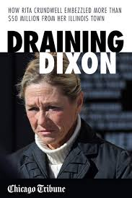
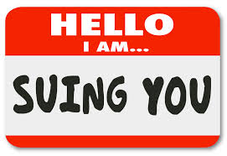
Did they cross the line?

Slide 5
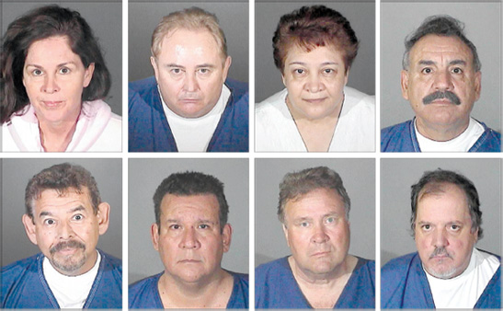
Did they cross the line?

Slide 6
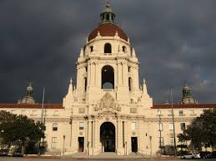
Did they cross the line?

Slide 7

Did they cross the line?

Slide 8
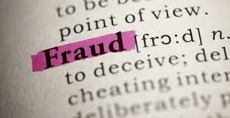
Did they cross the line?

Slide 9
Who is impacted by fraud
City Council or Board of Directors
  Increased amount of questions and scrutiny of their actions or inactions
  Questions may be raised about appropriate oversight of their fiduciary responsibility
  Communicating effectively the real and/or the perceived fraud of the use of public funds

Slide 10
Who is impacted by fraud
The Public Employee
  The Executive Leader
    What “tone at the top” message is being made and how is being responded to
    Implement meaningful changes
    Communicating the message about the real or perceived fraud
  The Staff
    Developing and/or revising internal control procedures
    Developing new forms
    Additional workload and questions from interested third parties
    Communication Strategy

Slide 11
Who is impacted by fraud
Professional Relationships
  Auditors
    Additional audit procedures to evaluate internal controls
    More intense scrutiny during the audit period
  Attorneys
    What additional policies are necessary to govern the city/agency
    Address the legal side of the fraud

Slide 12
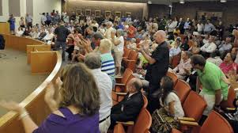
Who is impacted by fraud
The Public
  Citizens and rate payers
    Loss of trust in city/agency
  Community Based Organizations
    Partnerships may be strained and the common goals to move forward are stalled
  Government Oversight Agencies
    Creates additional reporting requirements to address public outcry

Slide 13

Fraud detection techniques
A financial statement audit is not designed to detect fraud
What can you do to detect fraud at your organization?

Slide 14
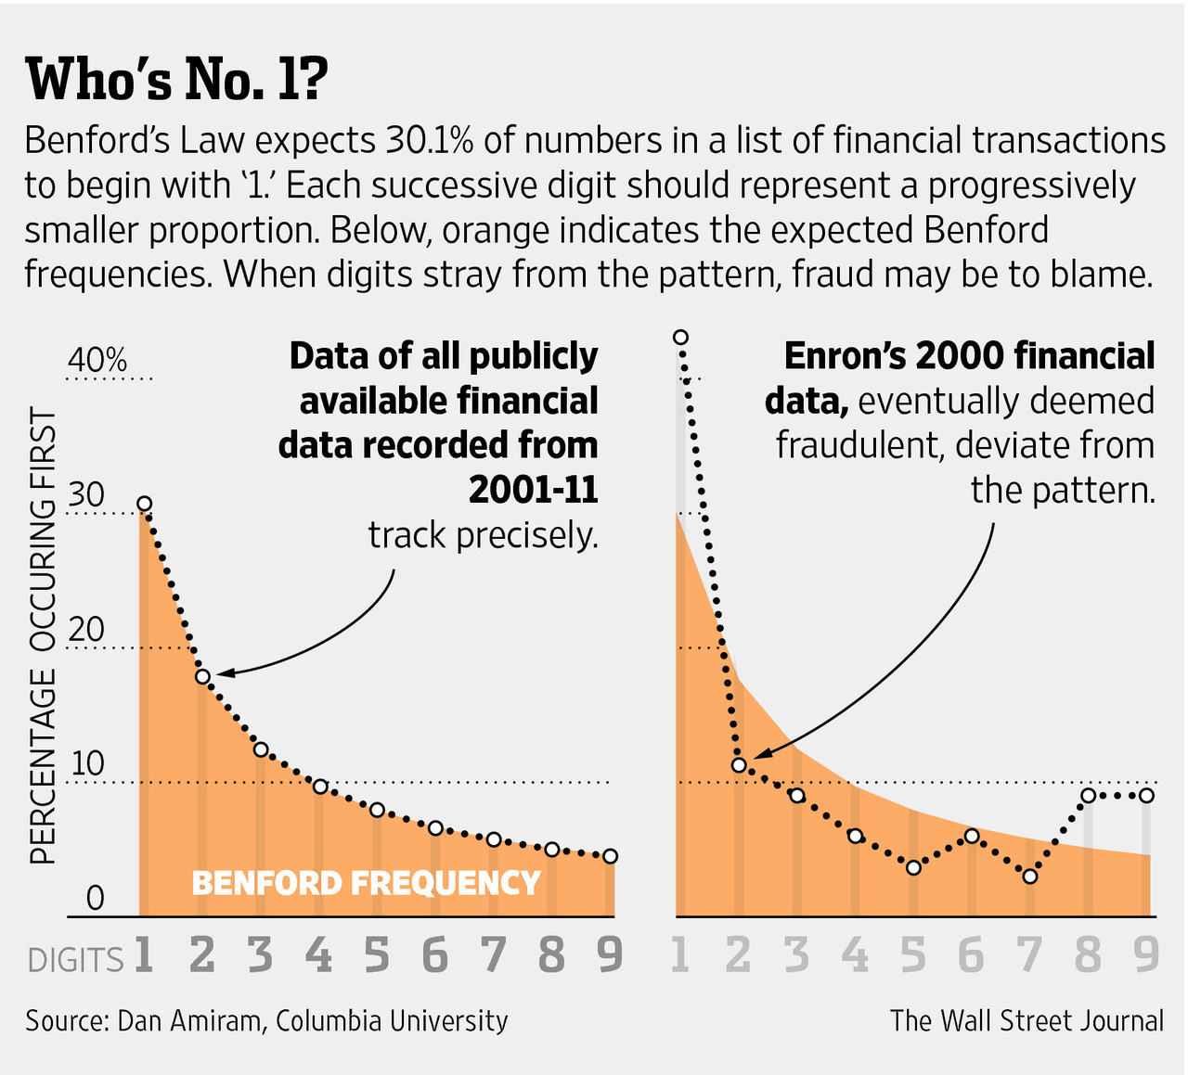
Benford’s law

Slide 15
Bank account activity
Comparison of checks per the bank statement to checks recorded in the general ledger
  Would your bank reconciliation catch this?
  Who is reviewing the bank reconciliation?

Slide 16
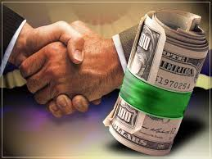
Vendor management
Who can add new vendors to your system?
Comparison of Vendor vs. Employee addresses

Slide 17

Prevention techniques
Organizational Tone: Values, Beliefs, Ethics
Background Checks
Education
Hotlines
Internal Audit Functions
Consequences =
Deterrence Effect

Slide 18
Warning signs
Doesn’t take holidays/time off
Unusual amount of control for their position
Refuses promotion or position changes
Excessive lifestyle
Defense mechanisms
Overstated expense reimbursements
Accounts not reconciled to subsidiary records
No financial issues in area they are responsible for
Secrecy
Excessive journal entries using balance sheet accounts

Slide 19



Questions
Contact Information:
  Margaret Moggia
    margaretm@westbasin.org
    (310) 660-6256
  Jennifer Farr
    jfarr@cbiz.com
    (949) 783-1740
  Debby Cherney
    cherneyd@emwd.org
    (951) 928-6154

