Slide 1
Here We Go Again!
Big Changes in Measuring OPEB
Costs and Liabilities
CSMFO Annual Meeting February 19, 2015
Shari Strain, Finance Officer, Big Bear City Community Services District
Geoffrey Kischuk, FSA, FCA, President, Total Compensation Systems, Inc.
Tina Henton, CPA, Partner, Vicenti, Lloyd & Stutzman, LLP

Slide 2
Introduction
Purpose: Discuss upcoming changes in the way “Other Postemployment Benefits” (OPEB) are measured and reported
  Measurement is based on actuarial valuations
  Reporting is, of course, an accounting function
  These changes will affect the way public agency finance officers communicate with Boards/Councils and the way agencies manage these liabilities
My name is Shari Strain
    Our CSD behaves as a city in that we provide Water, Sewer, Solid Waste and Fire Prevention & Protection services for the unincorporated area of the Big Bear Valley in San Bernardino County.
    We have both Miscellaneous and Safety Employees within our organization.
    The District has worked closely with our OPEB actuary and auditor to annually fund out OPEB obligation.

Slide 3
Where We Are Now
GASB 45 was required to be implemented by the 6/30/10 fiscal year-end by all public agencies
  Some agencies had to comply by 6/30/08 or 6/30/09
  Big Bear City CSD implemented December 15, 2010, for phase 3 governments (those with total annual revenues of less than $10 million)
  Some agencies chose to implement early
  There are still many agencies that have not yet complied (e.g. all non-school PEMHCA groups should be complying but many are not)
Under current GASB standards, agencies must have a valuation every two or three years (depending on size)
At this point, all agencies should have had at least two to four valuations; implemented in from five to seven fiscal year-ends

Slide 4
Where We Are Now
GASB cannot require prefunding of liabilities
Many agencies have chosen to prefund
  CalPERS CERBT program has about 450 participating agencies
  There are many other multiple employer pre-funding programs (e.g. ICMA, PARS, SISC, Futuris, CSBA)
  Several large agencies have established their own custom trust
Overall, it appears that more than 20% of all public agencies are prefunding

Slide 5
Where We Are Now
Of agencies prefunding, many fund on a regular, actuarial basis; but many fund at a lower level; and others on an “ad hoc” basis
Funding through a trust almost certainly triggers a biennial valuation requirement
Big Bear CSD is funding on regular basis using biennial valuations
The process is becoming more routine over time
  Obtain and review valuation
  Use valuation to budget trust contributions for two years
  Repeat every two years

Slide 6
Where We Are Now
Just as agencies are getting used to the rhythm of compliance, several things are changing in a big way
First, GASB 45 and 43 invoke Actuarial Standards of Practice (ASOP). One of these, ASOP 6, has been changed in a way that may significantly change valuations done after of March 1, 2015
Second, GASB has issued an Exposure Draft of a GASB Accounting Standard for Other Postemployment Benefits (OPEB) that will substantially change accounting for these benefits
Especially after GASB 67 and 68 issued, Pension and OPEB assumptions should be consistent. What CalPERS does on pension side affects OPEB valuations

Slide 7
Where We Are Now
This session will address these issues
  When they will be implemented
  How they will change GASB 43/45 compliance
We have an actuary, Geoffrey Kischuk from Total Compensation Systems, Inc., to address the new ASOP, actuarial aspects of upcoming accounting standards, and CalPERS related issues
We also have an accountant, Tina Henton a partner with Vicenti Lloyd and Stutzman, LLP to address accounting issues
I will comment on the impact from my viewpoint as a finance officer for a public agency

Slide 8
Actuarial Measurement
Geoffrey Kischuk, FSA, FCA, MAAA is President and Consulting Actuary for Total Compensation Systems, Inc.
  Participated in development of GASB 43/45
  Has performed GASB compliant valuations for almost 600 California public agencies
  Consulted with various state agencies regarding GASB 43/45 compliance
  Frequent speaker at association meetings

Slide 9
Actuarial Measurement
Several recent developments affect cost measurement
  Recent CalPERS pension changes (already in effect)
  Recent changes to Actuarial Standard of Practice 6 (ASOP 6) effective for valuations done after 3/1/15
  Proposed changes to GASB 43/45 expected to be effective for fiscal year ending June 30, 2018 (June 30, 2017 for “plans”) for July 1 to June 30 fiscal years

Slide 10
Recent CalPERS Changes
Recent CalPERS pension changes
  Inflation assumption reduction from 3% to 2.75% (2012). This caused reduction in interest assumption by 0.25%
  New “demographic assumptions” (e.g. retirement, turnover, mortality) (2014)
  New pension formulas due to PEPRA (2013)
  Revised expected rates of return for CERBT (2014)
New GASB standards require agencies to reflect their share of pension obligations
Because both pension and OPEB obligations are reflected as liabilities, should be based on consistent assumptions where appropriate

Slide 11
Actuarial Standard of Practice 6
GASB 45 directs how retiree costs are to be determined
  Actual retiree costs (where known) for self-funded and for insured plans where rates depend on claim experience
  Age-adjusted premiums where same rates used for active employees and non-Medicare retirees
  Actual premiums where experience isn’t available and rates are based on retiree demographics and/or claims
  Actual premiums under “community rating” exception per ASOP 6
The issue of age-adjusted costs affects most agencies – especially but not limited to, those obtaining coverage through large “blind” pools (e.g. CalPERS with about 1,150 agencies)

Slide 12
Actuarial Standard of Practice 6
April, 2012: Actuarial Standards Board (ASB) issues Exposure Draft (ED) of ASOP 6. Revision eliminates “community rating exception”
July, 2012: More than 95% of actuaries commenting addressed the elimination of the community rating exception. More than 90% of those commenting opposed complete elimination of community rating exception
March, 2013: ASOP issues 2nd ED of ASOP 6. No change regarding community rating exception – still MIA
August, 2013: Commenting actuaries continue to assail complete elimination of community rating exception (though some actuaries gave up). ASB’s process of establishing ASOP’s questioned. ASB promises action
May, 2014: Final ASOP 6 issued. Substantial changes made but no new ED issued to elicit actuaries’ opinion of changes. Final ASOP includes an exception like the community rating exception

Slide 13
Actuarial Standard of Practice 6
Based on refusal of ASB to preserve an exception in second ED, many actuaries assumed community rating exception would no longer be allowed. Many communications issued by consultants state this.
However, ASB added to final ASOP 6 new exceptions not in prior ED’s, including 3.7.7.c.4 that provides: “In some very limited cases, the use of the pooled health plan’s premium may be appropriate without regard to adjustments for age. The factors that an actuary should evaluate in determining whether the premium may be appropriate without regard to adjustments for age include: …..whether the pooled health plan and its premium structure are sustainable over the measurement period, even if other groups or active participants cease to participate. The use of a premium without regard to adjustment for age is generally inappropriate if the pooled health plan and its premium structure are not sustainable over the measurement period if other groups or active participants cease to participate.”

Slide 14
Actuarial Standard of Practice 6
Exception includes several tests that must be met to invoke the exception:
  Pooled Program must be sustainable over measurement period (usually four or more decades)
  Premium Structure must be sustainable over measurement period, even if other groups leave the program
Given its longevity; consistent premium structure despite loss of many groups over time; stable enrollment; we believe CalPERS qualifies for the 3.7.7.c.4 exception for all but perhaps the largest participating employers
We believe other programs may meet these requirements
Some actuaries may be unwilling to consider the 3.7.7.c.4 exception

Slide 15
Actuarial Standard of Practice 6
For actuaries reluctant to use 3.7.7.c.4., agencies may point out the following:
  Comments indicate practicing actuaries were overwhelmingly opposed to elimination of “community rating exception”
  In Final ASOP 6, Sections 3.7.7 and 3.7.8. in ED’s 1 and 2 were combined and dramatically expanded to address objections
  Appendix 2 in Final ASOP 6, response to the first comment says “The reviewers agree that it would be appropriate to provide more guidance regarding the limited circumstances for using unadjusted premium rates.”
  Exception 3.7.7.c.4 articulates exception like the community rating exception with specific criteria that can be evaluated

Slide 16
Actuarial Standard of Practice 6
The GASB ED provides that: “Projected benefit payments should be based on claims costs, or age-adjusted premiums approximating claims costs, in accordance with Actuarial Standards of Practice issued by the Actuarial Standards Board.”
This is a bit ambiguous.
  Situations exist where use of unadjusted premiums is appropriate even without 3.7.7.c.4 exception (e.g. non-Medicare retiree premium rates are based on retiree claims and/or demographics)
  Using 3.7.7.c.4 exception complies with ASOP 6 but doesn’t use claim costs or age-adjusted premiums
  Based on the first point alone, it is clear that GASB intends the actuary to follow ASOP rather than that GASB establish its own actuarial standards

Slide 17
Actuarial Standard of Practice 6
Effects of using 3.7.7.c.4
  Advantages:
    OPEB costs and liabilities follow actual accounting costs and liabilities
    Simplifies accounting
    Easier to explain to Boards/Councils and others
  Disadvantages:
    May lead to significant or substantial increase in costs and liabilities if agency changes to program not eligible for 3.7.7.c.4

Slide 18
Actuarial Standard of Practice 6
Effects of NOT using 3.7.7.c.4
  Advantages
    More accurate liabilities if agency moves to a program NOT eligible for 3.7.7.c.4 exception in short run
  Disadvantages
    Liabilities overstated if agency stays with program(s) eligible for 3.7.7.c.4 exception
    More complicated accounting
    More difficult to communicate to Boards/Councils and others

Slide 19
Actuarial Standard of Practice 6
Current GASB 45 allows “community rating exception” to the extent allowed by ASOP. Although new ASOP 6 eliminates term “community rating exception,” new ASOP 6 preserves the exception. Conclusion: Even under new ASOP 6, using unadjusted premiums is OK if it complies with 3.7.7.c.4.
New GASB OPEB ED (slated to go into effect in 2017-18, or 2016-17 for plans) is a bit ambiguous, but we believe will continue to defer to ASOP.
Our policy will be to continue to offer to use unadjusted premiums under certain circumstances, at least until new GASB standard in effect.

Slide 20
ASOP 6: Criteria for 3.7.7.c.4 Exception
We feel it is important to develop more specific criteria that expand on 3.7.7.c.4.:
  Plan qualifies as a “pooled health plan.”
  Rates not based to any extent on the agency’s claim experience
  Rates not based to any extent on the agency’s demographics
  If above is true, rates should be identical for all participating agencies
  There should be no refunds or charges – even after leaving the program or after program termination – based on the agency’s claim experience or demographics
  Plan in existence 20 or more years
  No recent large increases or decreases in the number of participating plans or enrollment (if so, requires further investigation)
  Agency is not expecting to leave plan in foreseeable future
  No indication the plan will be discontinued
  The agency does not represent a large part of the pool (less than 5%). (This can be difficult or impossible to determine.)

Slide 21
ASOP 6: Criteria for 3.7.7.c.4 Exception
The vast majority of agencies in CalPERS qualify under these criteria. Move to regional rating has not materially affected participation and is not related to age rating (essentially creates 6 pools; no significant change in agency participation was associated with change)
  Contracting agencies participating for almost 50 years
  Some agencies leave CalPERS every year, others join
  Participating agencies and enrollment gradually increasing
  Premium structure has remained (other than regional rating)
Other JPA’s, Associations and programs may qualify

Slide 22
ASOP 6: Criteria for 3.7.7.c.4 Exception
The potential liability difference is large enough that agencies may want to address in advance of next valuation (liability impact depends on whether Medicare Supp benefits provided)
Many agencies with “retiree-pay-all” plans will need to have valuation. Where 3.7.7.c.4. exception NOT appropriate, age-adjusted premiums likely to be higher than retiree payments resulting in liability

Slide 23
New GASB OPEB Standards
Much will be discussed by Tina in her accounting presentation
Implementation projected to be required no later than FY ending 6/30/2018 for employers; 6/30/2017 for plans
Many agencies will want to implement early
  To avoid doing an extra valuation
  To avoid actuarial resource crunch in 2017 and, especially 2018

Slide 24
New GASB OPEB Standards
Several changes in the way actuaries will determine costs and liabilities
  Full liability will be immediately recognized (dramatically accelerated from current amortization up to 30 years)
  Annual expense: change in liability subject to certain deferred items (deferral of actuarial gains and losses serves similar function as amortization, but will cut time by half or more while other items now eligible for amortization won’t be eligible for deferral)
  Interest assumption reflects 20 year GO municipal bond index to the extent unfunded (liability more volatile)
  Reduction from 6 to 1 actuarial cost method (entry age normal)

Slide 25
New OPEB Standards: Liability
Currently, liability for most agencies being accumulated over period of up to 30 years
New standard will dramatically increase liability for those amortizing actuarial accrued liability (AAL)
Liability will be much more volatile due to immediate recognition of certain items (e.g. plan changes)
Liability will be much more volatile due to changes in interest assumption for unfunded or partially funded plans
Liability will be much more volatile due to shorter spread of certain liability changes

Slide 26
New OPEB Standards: Expenses
Because expense largely determined by change in liability, expenses will also be volatile
Will no longer be viable to pre-fund amount equal to accounting expense
Agencies funding on regular, actuarial basis will most likely obtain second valuation for funding purposes using assumptions consistent with accounting valuation
Ironically, because “funding valuation” not constrained by accounting standards, will lead to more flexibility in funding than currently

Slide 27
Summary of Actuarial Issues
Be aware of and prepared for changes due to CalPERS activity
If applicable and if desired, be prepared to have conversation about ASOP 6 exception 3.7.7.c.4 with actuary
Follow development of new GASB OPEB standard – final expected to be issued in 2nd quarter 2015
  Prepare for managing or funding obligation in new environment
  Think about managing transition to avoid unnecessary cost
Think about when and how these may affect you versus when you can retire!

Slide 28
Accounting Issues
Tina Henton, CPA is a partner with Vicenti, Lloyd and Stutzman, LLP
  Specializes in California public agencies
  Assists many agencies with meeting requirements of GASB 43/45 compliance and reporting
  Performed audits of several OPEB plans under GASB 43
  Frequent speaker at association meetings

Slide 29
Background
Project addressing postemployment benefits has been on GASB agenda since 2008
Two-phased project
  Pensions administered through trusts
    GASB 67 and 68 issued in June 2012
  OPEB and pensions not within the scope of Statements 67 and 68

Slide 30
New GASB OPEB Standards
In June, 2014 GASB issued Exposure Draft (ED) of new accounting standards related to Other Postemployment Benefits (OPEB)
The final standard scheduled to be issued 2nd Q 2015
We expect the final to look very much like ED
  OPEB standards will be structurally like Statements 67/68 for pensions which have been issued in final form
  GASB has had experience with current OPEB standards
Bottom line: from accounting standpoint, not likely to be significant change in final from ED, so most of what follows is likely to be implemented

Slide 31
New GASB OPEB Standards: Changes
Timing
  All agencies will need to have actuarial valuations at least every two years (currently, agencies with fewer than 200 participants not in Trust are every 3 years)
  Alternative method still available for plans with less than 100 participants, but still required every two years
  Valuation must be closer to reporting date
  Adjustments to actuarial valuation required for non-valuation years (or if valuation older than one year on reporting date)

Slide 32
Changes to Accounting
Generally requires recognition of a liability equal to the net OPEB obligation on the full-accrual financial statements
  Current standards allow recognition over a period not-to-exceed 30 years
Requires that most changes in net OPEB liability be included in OPEB expense in the period of change.
  Current period service cost
  Interest on liability
  Changes in benefit terms
  Projected investment earnings

Slide 33
Changes to Accounting
Other changes in net OPEB liability would be amortized over time
  Changes of economic and demographic assumptions
  Actuarial gains/losses
Amortization period will be shorter than current standards
  Expected remaining service lives of plan participants
  Five years for differences resulting from investment earnings
  Closed period
Will be reported as a deferred inflow or outflow of resources on the GASB 34 full-accrual financial statements

Slide 34
Changes to Accounting
Deferred inflows of resources and deferred outflows of resources related to OPEB
  Each year, separate “layers” of deferred balances will be created for each source of change
  Deferred outflows balance should be reported separately from deferred inflows balance
  Cannot net with the exception of differences arising from investment earnings
  Logistically, this will be a challenge to track as new layers are added and others are fully amortized

Slide 35
New GASB OPEB Standards: Changes
Dramatically Expanded Note Disclosures
  Expanded disclosures about assumptions
  Liability impact of 1% change (up AND down) in interest rate AND 1% change (up AND down) in trend rate. Requires actuary to do up to 8 alternative valuations (Comments recommend this be reduced)
  Detail of adjustments of valuation to measurement date
  Calculation of deferrals and schedule of future deferrals
  Schedule of changes in OPEB Liability by source
Expanded Required Supplementary Information (RSI) Schedule
  Expanded number of years
  Expansion of reported values

Slide 36
GASB 45: Sample Note Disclosure
State of Grande
Notes to the Financial Statements for the Year Ended June 30, 20X2
Note X. Postemployment Healthcare Plan
Plan Description. State Retired Employees Healthcare Plan (SREHP) is a single-employer defined benefit healthcare plan administered by the Grande Retirement System. SREHP provides medical and dental insurance benefits to eligible retirees and their spouses. Article 37 of the Statutes of the State of Grande assigns the authority to establish and amend benefit provisions to the state legislature. The Grande Retirement System issues a publicly available financial report that includes financial statements and required supplementary information for SREHP. That report may be obtained by writing to Grande Retirement System, State Government Lane, Latte, GR 01000, or by calling 1-800-555-PLAN.
Funding Policy. The contribution requirements of plan members and the state are established and may be amended by the state legislature. The required contribution is based on projected pay-as-you-go financing requirements, with an additional amount to prefund benefits as determined annually by the legislature. For fiscal year 20X2, the state contributed $357.7 million to the plan, including $190.7 million for current premiums (approximately 84 percent of total premiums) and an additional $167.0 million to prefund benefits. Plan members receiving benefits contributed $35.4 million, or approximately 16 percent of the total premiums, through their required contribution of $50 per month for retireeonly coverage and $105 for retiree and spouse coverage.

Slide 37
GASB 45: Sample Note Disclosure
Annual OPEB Cost and Net OPEB Obligation. The state’s annual other postemployment benefit (OPEB) cost (expense) is calculated based on the annual required contribution of the employer (ARC), an amount actuarially determined in accordance with the parameters of GASB Statement 45. The ARC represents a level of funding that, if paid on an ongoing basis, is projected to cover normal cost each year and amortize any unfunded actuarial liabilities (or funding excess) over a period not to exceed thirty years. The following table shows the components of the state’s annual OPEB cost for the year, the amount actually contributed to the plan, and changes in the state’s net OPEB obligation to SREHP (dollar amounts in thousands):
Annual required contribution $ 577,180
Interest on net OPEB obligation 90,437
Adjustment to annual required contribution (95,258)
Annual OPEB cost (expense) 572,359
Contributions made (357,682)
Increase in net OPEB obligation 214,677
Net OPEB obligation—beginning of year 1,349,811
Net OPEB obligation—end of year $1,564,488

Slide 38
GASB 45: Sample Note Disclosure
The state’s annual OPEB cost, the percentage of annual OPEB cost contributed to the plan, and the net OPEB obligation for 20X2 and the two preceding years were as follows (dollar amounts in thousands):
Fiscal Annual % of Annual OPEB Net OPEB
Year Ended OPEB Cost Cost Contributed Obligation
6/30/X0 $497,538 67.4% $1,160,171
6/30/X1 538,668 64.8 1,349,811
6/30/X2 572,359 62.5 1,564,488
Funded Status and Funding Progress. As of December 31, 20X1, the most recent actuarial valuation date, the plan was 58.1 percent funded. The actuarial accrued liability for benefits was $8.8 billion, and the actuarial value of assets was $5.1 billion, resulting in an unfunded actuarial accrued liability (UAAL) of $3.7 billion. The covered payroll was $2.2 billion, and the ratio of the UAAL to the covered payroll was 165 percent.
Actuarial valuations of an ongoing plan involve estimates of the value of reported amounts and assumptions about the probability of occurrence of events far into the future. Examples include assumptions about future employment, mortality, and the healthcare cost trend. Amounts determined regarding the funded status of the plan and the annual required contributions of the employer are subject to continual revision as actual results are compared with past expectations and new estimates are made about the future. The schedule of funding progress, presented as required supplementary information following the notes to the financial statements, presents multiyear trend information about whether the actuarial value of plan assets is increasing or decreasing over time relative to the actuarial accrued liabilities for benefits.

Slide 39
GASB 45: Sample Note Disclosure
Actuarial Methods and Assumptions. Projections of benefits for financial reporting purposes are based on the substantive plan (the plan as understood by the employer and the plan members) and include the types of benefits provided at the time of each valuation and the historical pattern of sharing of benefit costs between the employer and plan members to that point. The actuarial methods and assumptions used include techniques that are designed to reduce the effects of short-term volatility in actuarial accrued liabilities and the actuarial value of assets, consistent with the long-term perspective of the calculations.
In the December 31, 20X1, actuarial valuation, the entry age actuarial cost method was used. The actuarial assumptions included a 6.7 percent investment rate of return (net of administrative expenses), which is a blended rate of the expected long-term investment returns on plan assets and on the employer’s own investments calculated based on the funded level of the plan at the valuation date, and an annual healthcare cost trend rate of 12 percent initially, reduced by decrements to an ultimate rate of 5 percent after ten years. Both rates included a 4.5 percent inflation assumption. The actuarial value of assets was determined using techniques that spread the effects of short-term volatility in the market value of investments over a five-year period. The UAAL is being amortized as a level percentage of projected payroll on an open basis. The remaining amortization period at December 31, 20X1, was seventeen years.

Slide 40
New OPEB Standard: Sample Note Disclosure
Sample County
Notes to the Financial Statements for the Year Ended June 30, 20X9
Note X—Postemployment Benefits Other Than Pensions (OPEB)
General Information about the OPEB Plan
Plan description. The County’s defined benefit OPEB plan, Sample County Retiree Benefits Plan (SCRBP), provides OPEB for all permanent full-time general and public safety employees of the County. SCRBP is a single-employer defined benefit OPEB plan administered by the County. Article 11 of the State Compiled Statutes grants the authority to establish and amend the benefit terms and financing requirements to the County Board. No assets are accumulated in a trust that meets the criteria in paragraph 4 of Statement XX.
Benefits provided. SCRBP provides healthcare and life insurance benefits for retirees and their dependents. The benefit terms provide for payment of 55 percent of health insurance premiums for non-Medicare-eligible retirees and 55 percent of supplemental health insurance premiums for Medicare-eligible retirees. The plan also provides all retirees with $5,000 of life insurance benefits.
Employees covered by benefit terms. At June 30, 20X9, the following employees were covered by the benefit terms:
Inactive employees or beneficiaries currently receiving benefit payments 5,477
Inactive employees entitled to but not yet receiving benefit payments 746
Active employees 10,109
16,332

Slide 41
New OPEB Standard: Sample Note Disclosure
Total OPEB Liability
The County’s total OPEB liability of $778,984 was measured as of June 30, 20X9, and was determined by an actuarial valuation as of that date.
Actuarial assumptions and other inputs. The total OPEB liability in the June 30, 20X9 actuarial valuation was determined using the following actuarial assumptions and other inputs, applied to all periods included in the measurement:
Inflation: 3.0 percent
Salary increases : 3.25 percent, average, including inflation
Discount rate : 4.0 percent
Healthcare cost trend rates: 9.5 percent for 20Y0, decreasing 0.5 percent per year to an ultimate rate of 5.5 percent for 20Y8 and later years
Retirees’ share of benefit-related costs : 45 percent of projected health insurance premiums for retirees
The discount rate was based on [Name of the Index].
Mortality rates were based on the RP-2000 Healthy Annuitant Mortality Table for Males or Females, as appropriate, with adjustments for mortality improvements based on Scale AA.
The actuarial assumptions used in the June 30, 20X9 valuation were based on the results of an actuarial experience study for the period July 1, 20X5–April 30, 20X7.

Slide 42
New OPEB Standard: Sample Note Disclosure
Changes in the Total OPEB Liability
Total OPEB Liability (a)
Balance at 6/30/X8 $851,095
Changes for the year:
Service cost 16,712
Interest 33,898
Changes of benefit terms (203,619)
Differences between expected and actual experience 58,936
Changes in assumptions or other inputs 45,945
Benefit payments (23,983)
Net changes (72,111)
Balance at 6/30/X9 $778,984
Changes of benefit terms reflect an increase in the retirees’ share of health insurance premiums from 25 percent in 20X8 to 45 percent in 20X9.
Changes of assumptions and other inputs reflect a change in the discount rate from 4.37 percent in 20X8 to 4.00 percent in 20X9.
Notes:
Would report same information for trust if it existed.

Slide 43
New OPEB Standard: Sample Note Disclosure
Sensitivity of the total OPEB liability to changes in the discount rate and healthcare cost trend rate. The following presents the total OPEB liability of the County, calculated using the discount rate of 4.0 percent and healthcare cost trend rates of 9.5–5.5 percent, as well as what the County’s total OPEB liability would be if it were calculated using a discount rate that is 1-percentage-point lower (3.0 percent) or 1-percentage-point higher (5.0 percent) than the current discount rate and healthcare cost trend rates that are 1- percentage-point lower (8.5–4.5 percent) or 1-percentage-point higher (10.5–6.5 percent) than the current healthcare cost trend rates:
1% Decrease Discount Rate 1% Increase
(3.0%) (4.0%) (5.0%)
1% Decrease (8.5%–4.5%) $747,826 $669,927 $599,818
Healthcare Cost Trend Rates (9.5%–5.5%) $856,884 $778,984 $685,507
1% Increase (10.5%–6.5%) $1,036,050 $911,412 $802,355

Slide 44
New OPEB Standard: Sample Note Disclosure
OPEB Expense and Deferred Outflows of Resources and Deferred Inflows of Resources Related to OPEB
For the year ended June 30, 20X9, the County recognized negative OPEB expense of $169,031. At June 30, 20X9, the County reported deferred outflows of resources and deferred inflows of resources related to OPEB from the following sources:
Deferred Outflows Deferred Inflows
of Resources of Resources
Differences between expected and actual experience $ 111,188 $ 18,327
Changes of assumptions or other inputs $ 98,543 $213,409
Total $ 209,731 $ 231,736
Amounts reported as deferred outflows of resources and deferred inflows of resources related to OPEB will be recognized in OPEB expense as follows:
Year ended June 30:
20Y0 $ (15,416)
20Y1 (13,476)
20Y2 (12,781)
20Y3 (12,747)
20Y4 16,702
Thereafter 15,713

Slide 45
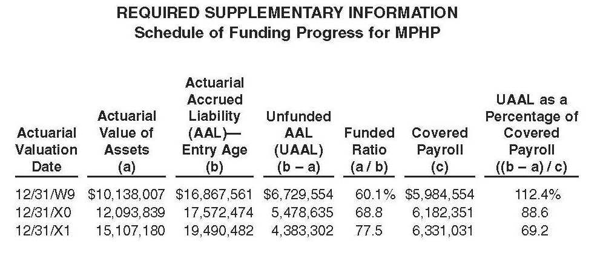
Current GASB 45: Sample RSI

Slide 46
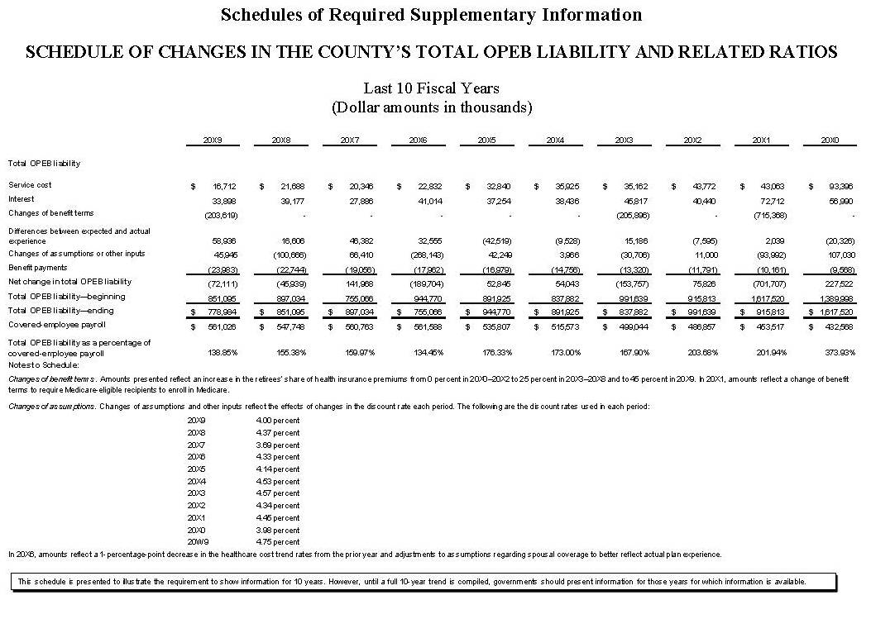
New OPEB Standard: RSI
Notes:
This schedule will also have trust activity included if one exists

Slide 47
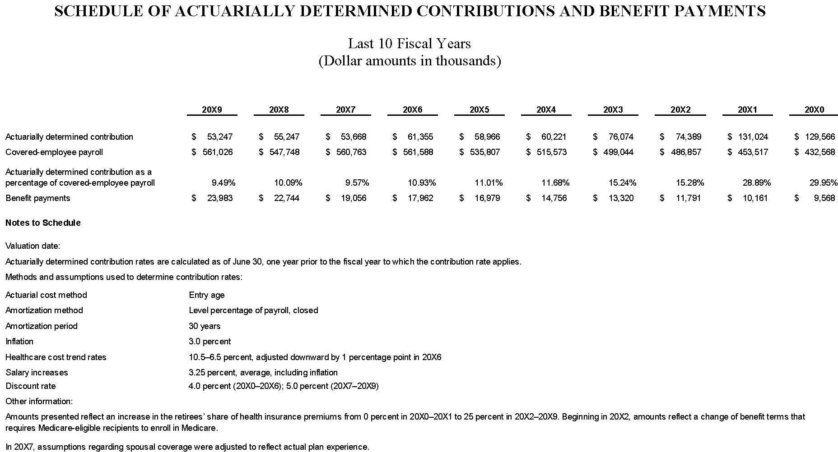
New OPEB Standard: RSI

Slide 48
New GASB Disclosures and RSI
New OPEB Standards require display of far more info
Actuarial valuations will need to provide far more info
  8 additional alternative liability figures for +1% and -1% exhibit
  Breakdown of components of cost
  Support for deferred inflows and outflows
Separate from the valuation, support will be needed for adjustment of valuation to measurement date
Separate tracking and amortization for deferred inflows and outflows
Info will need to be retained to show 10 year history

Slide 49
Effective Date and Transition
Fiscal years beginning after December 15, 2016 (one year earlier if funding through qualifying trust)
  For June 30 year end agencies, effective date is the 2017-18 fiscal year for employer (one year earlier for trust)
Beginning deferred outflows of resources for contributions, if any, subsequent to the measurement date should be recognized
All other deferred outflows/inflows of resources balances are “all or nothing” at implementation
RSI schedules will be prospective if information not initially available

Slide 50

What’s a Finance Officer To Do?
CalPERS activity: Be aware of issues and be prepared to address with Board/Council in relation to changes
ASOP 6 Exception 3.7.7.c.4: Discuss how actuary expects to determine costs. Where appropriate and where desired, request 3.7.7.c.4
New GASB standards: This needs at least another slide or two

Slide 51
What’s a Finance Officer To Do? GASB
Think about how to communicate changes to Boards/Councils. Should be consistent with what is said about GASB 67 and 68
If pre-funding, think about how funding process affected. Separate valuation? Using what assumptions?
Prepare for implementation. Weigh earlier implementation to eliminate extra valuation against dealing with above issues earlier than necessary and considering availability of actuarial resources
New standards will require a lot of additional actuarial work AND involvement of actuaries between valuations. Expect additional fees
New standards require additional accounting resources. Where outside resources used to draft disclosures, expect additional fees

Slide 52
What’s a Finance Officer To Do? GASB
New GASB OPEB standard preserves Alternative Measurement Method (AMM)
There will be many additional calculations and disclosures needed
Users of AMM should make sure they will have adequate support for the additional requirements
  Multiple liability calcs
  Expanded Note Disclosures and RSI

Slide 53
Big Changes in Measuring
OPEB Costs and Liabilities
Questions?
Shari Strain, Big Bear City CSD
(909)584-4010; sstrain@bbccsd.org
Geoff Kischuk, TCS, Inc
(805)496-1700; gkischuk@totcomp.com
Tina Henton, Vicenti, Lloyd & Stutzman, LLP
(626)857-7300 ext. 250; thenton@vlsllp.com

