Slide 1

THE CALIFORNIA DROUGHT – What’s in Your Rates?
Greg Clumpner,
Director of Utility Rate Practice, NBS
Robert DeLoach
President, DeLoach & Assoc., Inc.
Martin Krieger
Finance Director, Desert Water Agency
February 18, 2015

Slide 2

THOUGHT FOR THE DAY
“We know the value of water when the well runs dry.”
Benjamin Franklin
The California Drought – What’s in Your Rates?

Slide 3
OVERVIEW OF “WHAT’S IN YOUR RATES?”
Robert DeLoach – Stories from the Trenches
  Trends in Local Government Elections
  The Politics of Rate Setting
  Train, Educate & Inform
Greg Clumpner – Setting Rates in California
  Drought Rates
  Recycled Water – The New Supply Source
  Making Your Rates Defensible
  Social Justice: The New Trend in Water Rates?
Martin Krieger – DWA’s Tribal Litigation
  Summary, Possible Impacts, Current Status
Questions
The California Drought – What’s in Your Rates?

Slide 4
Robert DeLoach
“Stories from the Trenches”
The California Drought – What’s in Your Rates?

Slide 5

STORIES FROM THE TRENCHES
Trends in Local Government Elections
  Changing demographic of elected officials
  Issue orientation
  Steeper learning curve
The Politics of Rate Setting
  All politics are local
  Only justified in certain cases: emergency needs
The California Drought – What’s in Your Rates?

Slide 6
STORIES FROM THE TRENCHES
3. Train, Educate & Inform
  Know your board or council
    Understanding, ‘good will’ and mutual respect
  Sustainable management practices
    Operations and fiscal integrity
    Asset management strategy
      Conduct an asset inventory and condition index
      Programed and funded CIP
  Your “first line of defense” when rate increases needed
    Leverage their political position
  ASCE Report Card for America’s infrastructure – (D)
The California Drought – What’s in Your Rates?

Slide 7
Greg Clumpner
Drought Rates
Recycled Water
Defensible Water Rates
Social Justice – The New Trend?
The California Drought – What’s in Your Rates?

Slide 8
Drought Rates
The California Drought – What’s in Your Rates?

Slide 9
OVERVIEW OF DROUGHT RATES
Possible Purposes & Uses of Drought Rates:
Recover revenue lost due to lower water sales.
Incentivize customers to reduce consumption in order to meet cutbacks/restriction.
Drought rates should be “revenue neutral”:
  Some expenses may go down (purchased water, power costs, etc.) and the annual revenue requirements may be lower
  Or…costs could go up (access to cheaper water is restricted, and purchased water costs go up)
  The agency should only be trying to recover actual revenue requirements
The California Drought – What’s in Your Rates?

Slide 10
OVERVIEW OF DROUGHT RATES
Forms of Drought Rates:
Fixed Surcharge
  Easy to Implement and Understand.
  Provides no incentive to change usage & appears to penalize everyone regards of consumption levels.
Uniform or Tiered Rate Surcharges
  Focus is on wasteful use and high consumption.
  Lacks the revenue stability of a fixed surcharge.
Drought Penalties
  Focuses on changing behavior patterns.
  Legally it’s not covered under Prop 218.
  Disadvantage: it requires enforcement & “water cops” may not be a popular concept.
The California Drought – What’s in Your Rates?

Slide 11
OVERVIEW OF DROUGHT RATES
Other Factors to Consider:
How much conservation will occur “voluntarily”?
How much conservation will you need to achieve through drought rates (i.e., in response to incentives)
How much “messaging” and public outreach is planned?
Equity Concepts:
  Customers who reduce usage should not pay more.
  Try to avoid unintended messages (e.g., “Why are you telling us to use less water and then charging us more?”)
The California Drought – What’s in Your Rates?

Slide 12
Recycled Water –
The New Supply Source
The California Drought – What’s in Your Rates?

Slide 13
BRIEF OVERVIEW OF RECYCLED WATER
Possible Purposes & Uses of Drought Rates:
Benefits of Recycled Water:
  Reduces need for additional Potable supplies
  Replaces Potable uses that can be Supplied by RW
  Highest financial benefit might be Recharge (?)
What’s the Cost?
  Higher level of Treatment (likely required)
  Distribution System to limited no. of customers
  Avoided Highest New Potable Supply (a credit)
  Avoided Cost of Wastewater disposal (a credit)
Colorado Perspective: Use Water “To Extinction”.
The California Drought – What’s in Your Rates?

Slide 14
Making Your Rates “Defensible”
The California Drought – What’s in Your Rates?

Slide 15
DEFENSIBLE RATES – INDUSTRY STANDARDS
General Industry Standards:
Well-designed financial plan & revenue requirements
Prepare a “cost-of-service” analysis
Carefully consider “rate-design” issues (i.e., legal)
Prepare a Comprehensive Rate Study & Build a Solid Administrative Record
The California Drought – What’s in Your Rates?

Slide 16
DEFENSIBLE RATES – COST ALLOCATIONS
General Thoughts on Cost-Allocations:
Three Basic Categories of Cost Allocations:
  Allocations Between Customer Classes
    Needs to reflect differences in peaking requirements, total water use, etc.
  Allocations Within Customer Classes
    Rate design can significantly affect monthly bills of individual customers
  Allocations Between Fixed and Variable Charges
    These have impacts on both revenue stability and water conservation objectives
The California Drought – What’s in Your Rates?

Slide 17
DEFENSIBLE RATES – COST ALLOCATIONS
  Fixed and Variable Costs:
Fixed Costs
Variable Costs
Total
Revenue
Requirements
Capital Improvements, Debt Service, Salaries & Benefits
Energy, Purchased Water, Treatment Chemicals
The California Drought – What’s in Your Rates?

Slide 18
DEFENSIBLE RATES – COST ALLOCATIONS
How Fixed & Variable Costs Should be Collected:
Fixed Costs
Variable Costs
Total Revenue Requirements
Fixed Charges
Volumetric Charges
Revenue Stability
The California Drought – What’s in Your Rates?

Slide 19
DEFENSIBLE RATES – TAKEAWAYS
Pay attention to industry standards and recent court rulings when preparing new rates.
Establish your rate objectives and policies and clearly present & communicate them to the public.
Establishing a Complete Administrative Record is critical.
Conservation is an increasingly important objective:
    You may need to meet drought restrictions.
    General regulatory pressures mandate that your rate structure encourage efficient use.
The California Drought – What’s in Your Rates?

Slide 20
“Social Justice” – A New Trend in Water Rates?
The California Drought – What’s in Your Rates?

Slide 21
SOCIAL JUSTICE…
What is “Social Justice”?
Wikipedia: “Social justice is "justice in terms of the distribution of wealth, opportunities, and privileges within a society". Classically, "justice" (especially corrective justice or distributive justice) referred to ensuring that individuals both fulfilled their societal roles, and received what was due from society.”
It assumes it’s a superior approach to setting rates.
It implies there are other “undefined criteria” that should be used in setting water rates.
It views “societal institutions” (like water agencies) as distributors of wealth, opportunities, etc.
The California Drought – What’s in Your Rates?

Slide 22
SOCIAL JUSTICE…
Attitudes about Social Justice:
Audience question at an AWWA Conference:
“Why should someone with money be able to
buy as much water as they want just because
they can afford it?”
Borderline Socialism?
An example: Water Budget-Based Rates
    Those with larger lawns get more water at a lower prices (i.e., Tiers 1 & 2) than those with smaller lawns.
    There is no penalty for high consumption levels (per se).
    Customers are treated differently depending on their “needs” – Do you have large or small lawn?
    Emphasis is on “Efficiency” not “Conservation”
The California Drought – What’s in Your Rates?

Slide 23
SOCIAL JUSTICE…
A Social Justice Example
from Water Rates:
Water Budget-Based Rates (WBBRs):
  Are now the “Politically-Correct” Rate Design
  The amount you get, and price, depends on your “Needs”
  WBBRs Tailor 4-5 Water Tiers to Each Customer
    Amount of Water in Each Tier depends on Your Landscaping, Household Size, etc.
    Weather (ET) also Changes Tier sizes - So Customers Never Really know their tier size until they get their monthly bill.
  Everyone Acknowledges that WBBR’s emphasize “Efficiency” rather than “Conservation”
The California Drought – What’s in Your Rates?

Slide 24
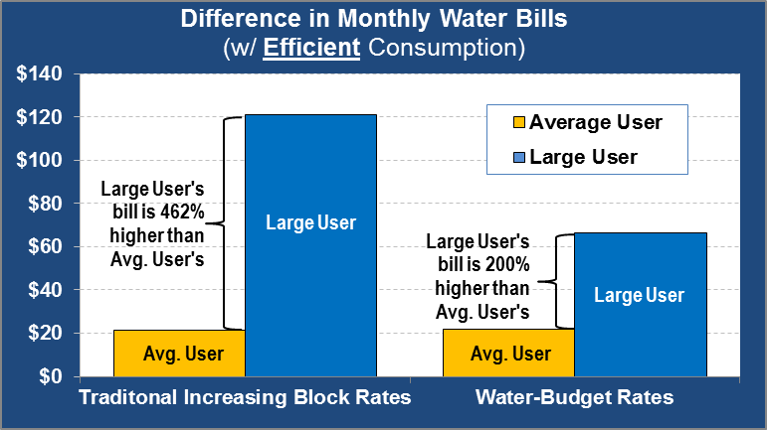
SOCIAL JUSTICE…
Water Rate Comparison/
Illustration:
Allocation-Based Rate (WBBRs) vs. Traditional 3-Tier Rates – Assuming Efficient Use:
Large User
(Traditional)
Large User
(WBBRs)
The California Drought – What’s in Your Rates?

Slide 25
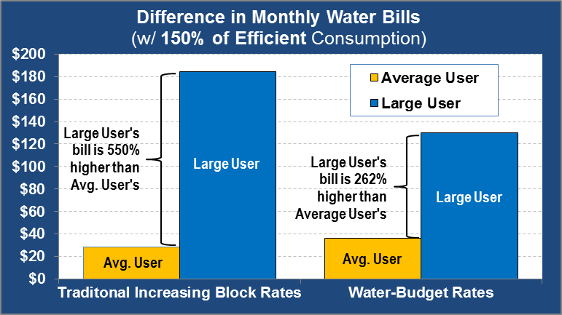

SOCIAL JUSTICE…
Water Rate
Comparison/Illustration:
Same Comparison but with Inefficient Water Use:
Large User
(Traditional)
Large User
(WBBRs)
The California Drought – What’s in Your Rates?

Slide 26
SOCIAL JUSTICE…
Takeaways from WBBRs vs. Tier Rates:
Customers with larger than average consumption will have smaller bills under water budget rate structures than under traditional tiered rates.
Larger consumers pay a lower average price for their water than under traditional tiers (since more of their water is in lower tiers).
Traditional tiers encourage more conservation than WBRs, regardless of whether you are using water efficiently or not.
There are some basic inconsistencies between WBBRs and basic (common-sense) rate-making principles
The California Drought – What’s in Your Rates?

Slide 27
Martin Krieger
Desert Water Agency (DWA) – Update on DWA Lawsuit Regarding a New Federal Rule
The California Drought – What’s in Your Rates?

Slide 28
SUMMARY OF LITIGATION: WHAT’S THE ISSUE?
Summary of the New Federal Rule:
  Federal Rule affects Special Districts, Counties, Cities, School Districts, Healthcare Districts, Flood Control Districts, other local Governmental entities & the State.
  Affects ability for entities to assess taxes for services, including possessory interest tax, business tax & sales tax on Tribal lands.
  If you do not have any Tribal lands in your jurisdiction, you will not be affected. If you do, you may be affected.
The California Drought – What’s in Your Rates?

Slide 29
SUMMARY OF LITIGATION: WHAT’S THE ISSUE?
Here’s the New Federal Rule Affecting Leases of Indian Lands:
  A new federal rule has been promulgated and published as final in the Federal Register on December 5, 2012 and go into effect on January 4, 2013.
  These rules amend provisions of Chapter 25 of the Code of Federal Regulations Part 162, promulgated by the Bureau of Indian Affairs through the Department of the Interior.
  These rules deal with residential, business, and wind solar resource leases on Indian Land. It is mostly innocuous from state or local government perspective with one very significant exception.
The California Drought – What’s in Your Rates?

Slide 30
SUMMARY OF LITIGATION: WHAT’S THE ISSUE?
Here’s the New Federal Rule Affecting Leases of Indian Lands (cont.):
  Section 162.017, a new provision, expressly prohibits state and local taxation on permanent improvements on leased Indian land, taxation of activities conducted under a lease on leased Indian lands, and taxation of possessory interests of leased Indian lands. This section appears to prohibit the levy of a possessory interest tax on leased Indian Land and the levy of business license taxes, utility user taxes, and even sales taxes on residences or businesses operating from leased premises on Indian land.
  These new rules and regulations can be found at Federal Register, Vol. 77, No. 234, Pages 72440-72509. The Rule goes into effect on January 4, 2013.
The California Drought – What’s in Your Rates?

Slide 31
SUMMARY & TIMELINE
OF LITIGATION
Genesis of the Lawsuit:
  July 2012 – the Bureau of Indian Affairs (BIA) and U.S. Dept. of Interior hold public meetings throughout the U.S. discussion the implementation of new Federal Rule Affecting Indian lands.
  These meetings were held without notice to State, County or Local agencies, thus not allowing them to comment on the proposed changes.
The California Drought – What’s in Your Rates?

Slide 32
SUMMARY & TIMELINE
OF LITIGATION (CONT.)
Genesis of the Lawsuit (cont.):
  Dec. 27, 2012 – City of Palm Springs received announcement from BIA regarding new Federal Rule affecting leases of Indian lands.
  Dec. 28, 2012 – DWA obtained from the Federal Registry a copy of the new rule to analyze potential effects to DWA as well as other governmental entities.
  Jan. 4, 2013 – New Federal Rule is adopted by U.S. Dept. of Interior (without any public notice or comment).
  April 2013 – DWA initiated litigation against the U.S. Dept. of Interior & BIA to overturn the Federal Rule on the grounds that it violates the California Constitution.
The California Drought – What’s in Your Rates?

Slide 33
SUMMARY & TIMELINE
OF LITIGATION (CONT.)
Genesis of the Lawsuit (cont.):
  BIA held nationwide webinars, workshops & meetings to create their own taxing authority.
  Jan. 2014 – Local Tribe in DWA service area initiates litigation against County of Riverside to Cease & Desist the taxation of possessory interests on their leased lands.
  April 2014, DWA joined the lawsuit.
The California Drought – What’s in Your Rates?

Slide 34
POSSIBLE IMPACT OF THE
FEDERAL RULE
Summary of Possible Impacts of the New Federal Rule:
  If this new Federal Rule prevails, Governmental agencies would be prohibited from collecting any form of tax revenues from possessory interest on Indian leased lands.
  Possessory interests would not generate tax revenues but would still be using services generated from Tax revenues (e.g., Police, Fire, Streets, Water, Sewer).
The California Drought – What’s in Your Rates?

Slide 35
CURRENT STATUS OF
THE LAWSUIT
Current Status of the Lawsuit:
  Two years have passed since the new Federal Rule was adopted and the issues with both lawsuits (DWA vs. U.S. Dept. of Interior-BIA and Tribe vs. County of Riverside & DWA) are resting in the court system.
  Stay tuned for further updates – this could be a long journey before it is resolved.
  Meanwhile… current practices are unchanged & no action will be taken until the court case is resolved.
The California Drought – What’s in Your Rates?

Slide 36

QUESTIONS?
The California Drought – What’s in Your Rates?

Slide 37
CONTACT
Robert DeLoach
robertadeloach1@gmail.com
909.758.0273
Greg Clumpner
gclumpner@nbsgov.com
530.297.5856
Martin Krieger
martin@dwa.org
760.323.4971 ext. 120
The California Drought – What’s in Your Rates?

